Slide 1
Old and New Growth:
Augmenting library instruction with gamification and game-based learning
Laura Barrett, Head of Teaching & Learning, Dartmouth
Jentry Campbell, Librarian for Research & Learning - STEM, Dartmouth
Alexis Gomez, Evening Circulation & Reserves Supervisor, Dartmouth
Yolanda Hood, First-Year Experience and Instruction Coordinator, UMass Lowell
May 31, 2024
Notes:
Welcome everyone and thank you for joining us for our presentation: Old and New Growth: Augmenting library instruction with gamification and game-based learning
My name is Alexis Gomez. I’m the Evening Circulation and Reserves Supervisor at Dartmouth Libraries.
And this is Yolanda Hood, the First-Year Experience and Instruction Coordinator at UMass Lowell, and before this, I was the Learning and Engagement Librarian for Dartmouth Libraries.
Two of our Dartmouth colleagues are unable to be here with us in person today but had equal roles in brainstorming this presentation and running the game-based learning examples we’ll be sharing soon. They are Laura Barrett, the Head of our Teaching and Learning department, and Jentry Campbell, our Librarian for Research & Learning for the STEM fields.
Today we are going to be talking about the role that play and game-based learning can have in augmenting and expanding the library’s outreach potential on top of traditional library instruction sessions.
Like many academic libraries, Dartmouth and UMass Lowell libraries have had to figure out how to continue reaching students and teaching them about basic library services and information literacy skills despite having fewer hours of in-class instruction available to us or simply not having enough librarians or staffing levels to effectively reach so many students within the confines of the one-off course-based library instruction session.
So, how do we reach students outside of the traditional classroom sessions, and perhaps more importantly, how do we convince students to give us some of their PRECIOUS free time to learn about library services? Enter - play and game-based learning.
Today we’re going to discuss the role that play, playfulness, gamification, and game-based learning all have in expanding our outreach potential; what it is, what makes it work, and then we’ll briefly discuss three examples of game-based learning that we’ve implemented at our own libraries before ending with a Q&A session.
(2 min)

Slide 2
Play and Playfulness in Library Instruction
Notes:
We’ll start off with an overview of play and playfulness as it relates to library instruction.

Slide 3
Gamification vs. Game-Based Learning
“Gamification applies game elements or a game framework to existing learning activities; game-based learning designs learning activities that are intrinsically game-like.”
For example:
online discussion forum for a Physics course might be gamified via a badge system
vs.
economics course, students might compete in a virtual stock-trading competition
“Gamification and game-based learning both promote engagement and sustained motivation in learning, but they do not necessarily result in improved learning outcomes.”
(Center for Teaching Excellence, University of Waterloo)
Notes:
So, we first want to point out that our presentation has a focus on game-based learning and gamification. We have provided a brief explanation and example here (slide) of what is meant by the two similar concepts. They are both important because they can/do bring added benefits to the classroom and can improve engagement. Sometimes there is a toss-up about how much might be learned. But, there is literature on that as well at the Center for Teaching at the University of Waterloo and many other universities.
We want to emphasize that we embraced these methods because of my interest in playful pedagogy. Playful pedagogy simply places play at the center of learning.
Studies tell us that, adults (18 and older) who play in class or meetings (no matter the seriousness of the class or meeting or the subject matter of the class or meeting) are more likely to be open to listening/learning about the topic at hand, are more likely to feel a sense of vulnerability with those in their class, are willing to speak up, make suggestions, answer questions with less fear of failure.

Slide 4
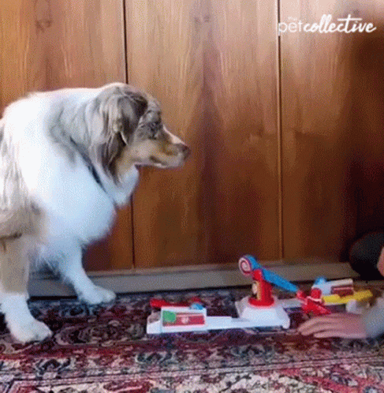
What IS Play?
“An activity that is carried out for the purpose of amusement and fun, that is approached with an enthusiastic and in-the-moment attitude, and that is highly-interactive.”
(Van Vleet, M. & Feeney, B., 2015).
Notes:
So, What is play? There are so many definitions of play. I like to use the definition that Van Vleet and Feeney , (2015), propose:
An activity that is carried out for the purpose of amusement and fun, that is approached with an enthusiastic and in-the-moment attitude, and that is highly-interactive.
Now, I know what you may be thinking. If that is the definition of play, then how can we even begin to use it in our classrooms, library instruction sessions, and meetings?
I am suggesting that playful learning begins with the definition of play itself. And some keywords stand out in this definition---fun, enthusiastic, in-the-moment, highly-interactive. Those keywords are at the foundation creating the type of space that we want in our classrooms and our meetings. We want openness and creativity.

Slide 5
Why Play and Playfulness?
In play we can imagine and experience situations we have never encountered before and learn from them...We can learn lessons and skills without being directly at risk. Stuart Brown, MD
...It is the deeper playful underpinning and provision of opportunities to learn from failure that are at the heart of playful learning in higher education. Rikke Norgard, Claus Toft-Nielsen, Nicola Whitton
​
Play is "a way of being in the world."​ Play as pleasurable, not always fun​
"play can be pleasurable when it hurts, offends, challenges us and teases us"
​Miguel Sicart
Notes:
Forbes (2021) published a wonderful study of playful pedagogy with her graduate students in two of her counseling courses. Her students reported feeling a sense of safety in her classroom, felt that it removed barriers to learning, and felt that playful pedagogy was highly underutilized in their experience of adult education and wanted to experience more of it.
This ultimately makes us think of some of the gaming approaches that librarians and teachers take in their classrooms.
In our libraries, we want young adults to feel at ease and open to the idea of play. If young adults embrace that idea we know that they have a better opportunity of learning concepts that we may teach OR being more open to trying the concepts that we are teaching and being less fearful of failure.
As a librarian, I do traditional instruction sessions. BUT, I find that I am most successful with students when I use playful methods like gamification and game based learning. I do Zombie apocalypses, Crime Scene Investigations, and Scavenger Hunts. We’ve even had orientations to the library where students are locked in overnight.
Now, I’m not suggesting that people must engage in gamification or game-based learning to make the classroom or meeting space a more open and safe place. Because gaming is only one aspect of playfulness. You can tell jokes, you can play music, you can toss a balloon around the room, you can provide mini cups of slime for students to play with. Play is a way to open that liminal space for learning—”I’m trying something new and that is scary but in this context I feel safe, and everyone is on the journey with me.”
Playful pedagogy is a good way to help students be more open about learning new things, but it also helps to teach students how to negotiate life as well.
(Alexis test ran this script - Slides 2-5 are currently 4 minutes)

Slide 6
Play as a Vehicle for Building Community
Notes:
Beyond its ability to open that “liminal space for learning” as Yolanda put it so well, play is also an excellent vehicle for building community.

Slide 7
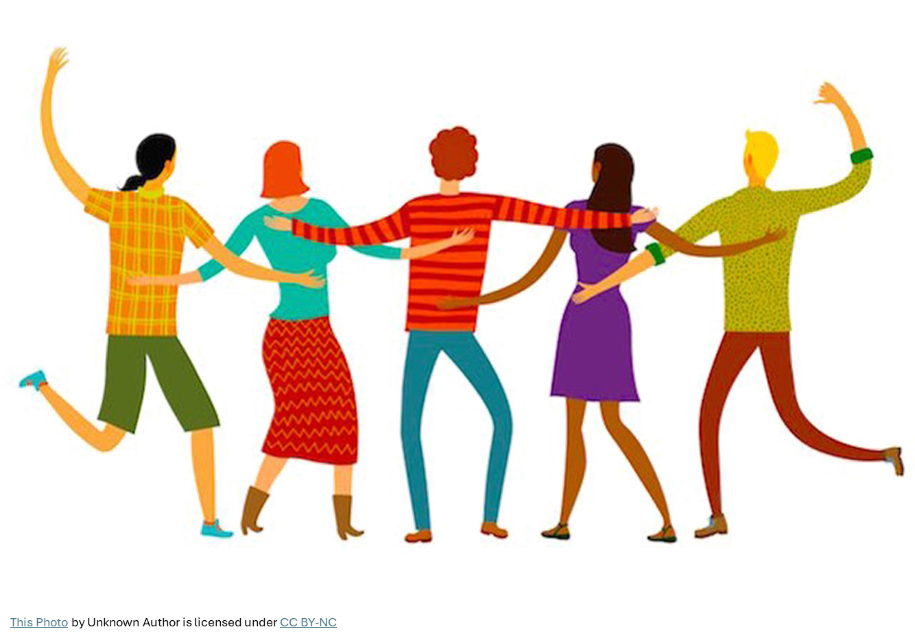
Play as Community-Building
Play builds interpersonal relationships
Playing together opens a vulnerable, safe, community space
Place-based play can tie players to the space/campus and thereby to the community
Place-based play can engender feelings of belonging.
(Forbes L.K., 2021; Davis, J., 2010)
Notes:
Play is great at building relationships. When students play together to complete a game, or even if it’s a competitive game, the play allows them to form relationships, between each other and between themselves and the educators running the games, in this case, with librarians.
In the Forbes study Yolanda mentioned earlier where Forbes incorporated play throughout her courses, student participants reported that play seemed to facilitate relationship-building between each other and between themselves and the professor. Once participant noted that “Fun and play allows for genuine human connection that you don’t get if you’re serious all the time.” Several of the participants talked about play in this class building a sense of safety and community that enabled them to be vulnerable, learn more deeply, and make more connections - both to the content they were learning about and between each other. (Forbes)
One of the examples we’ll discuss in detail later is an in-person escape room that Yolanda ran at UMass Lowell. In the feedback she received from her participants, students reported getting to make new friends and meet new people as one of the things they appreciated about the event. In addition to simply meeting other people, play that is tied into a place or location - like a town or an aspect of a college campus - can further facilitate that community-building.
In each of the examples we are sharing from our own institutions today, we used a place- or location-based anchor, be it in the plot or how the game was structured, to grab students’ attention and tie them to the campus in some form or fashion, building a sense of belongingness and community. For example, we created a virtual escape room called Agents of Time where students had to play as a “time agent” to go back in time and save a stolen clock hand from the iconic bell tower at Baker-Berry Library on campus. The bell tower is iconic - it’s at the center of campus and has often been used in broader Dartmouth marketing materials. By tying the game to a place-based, campus-based, location or story, we hope to better connect students to their campus community through the course of the game.
Access to and familiarity with spaces on campus is one way to help engender a sense of belonging in students, particularly for student groups from underrepresented populations, like First Generation and lower-income students. (Davis). By tying playful library games to specific places - be they a building, an iconic landmark, a historical figure unique to the town, etc. we can help familiarize students with their surroundings, with their campus, and give them that added sense of belonging and community.
In our examples today, the virtual escape room uses the bell tower. An in-person escape room, uses the story of a local, infamous legend to hook students’ curiosity and expand upon their ties to the town of Lowell, where the campus sits. And in a scavenger hunt inside the library, we leaned into the confusing, maze-like layout of the library stacks and by gamifying the labyrinthian library space, hopefully made it a little less intimidating and gave students some ownership of the space. The place-based hook in library instruction game design we hope can share the message with students that this is YOUR bell tower, at YOUR library, YOUR town’s history - these are YOUR spaces, you belong here. If you wind up trying out your own library games, we’d encourage you to use something unique to your campus or your institution’s history as a hook or plot point for your game.
Play in library instruction helps to build that community and sense of belongingness in our students - both through relationship building and through rooting them in the physical spaces they are going to inhabit for the next 4 years.
(4min)

Slide 8
Play as Means of Engagement
Notes:
And finally, before we dive into the details of the examples themselves, we wanted to touch on play as a means of improving engagement with our students. We’ve talked a little already about how play helps to engage students with the content and open them up to connecting more deeply with the material. But play also can serve as a lure of sorts to get students to voluntarily participate and give up some of their previous free time to learn about library research skills.

Slide 9
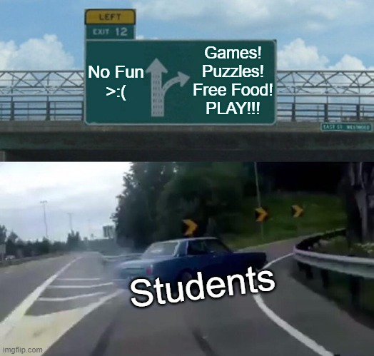
Play to Increase Engagement
“Gamification is a powerful tool due to its ability to capture people’s attention, to engage them in a target activity, and even to influence their behavior.”
(Kim, B., 2015).
Notes:
One of the benefits of the traditional library instruction session is a captive audience. You go to a class, students are there, and they have to listen to you - or at least we hope they’re listening. But if you can’t make it to every class session, whether it’s because the professor has decided their course time is better used another way or because your department simply doesn’t have enough boots on the ground to make it to hundreds of class sessions, we need to find a way to reach students in their free time, something your average undergraduate student has precious little of.
Play becomes a way to get students in the door. Food lures undergraduates to programs like nothing else. Fun can too.
Gamification and game-based learning can increase the number of people voluntarily participating in your programming. According to research shared in an issue of Library Technology Reports on Understanding Gaming, Pierce County Library in Washington gamified their summer reading program and saw an increase from 200 participants to 650 participants with no additional marketing efforts. An online training program at a large consulting company saw increased course completion and a 37% increase in users returning to the training site each week after they gamified the training program. Kim includes a number of other examples in this chapter from gamified library instruction sessions, orientation programs, etc. As Kim puts it, “Gamification is a powerful tool due to its ability to capture people’s attention, to engage them in a target activity, and even to influence their behavior.” This power of play and games to increase participation is hugely important when we’re talking about enticing students to sacrifice their limited free time to come learn something practical about the libraries in between their classes, clubs, midterms, student jobs, and every other campus task vying for their time. Play can get them in the door.
(3min)

Slide 10
Examples!
Notes:
With all the boring theory now out of the way, let’s dive into the details of our our three example games.

Slide 11
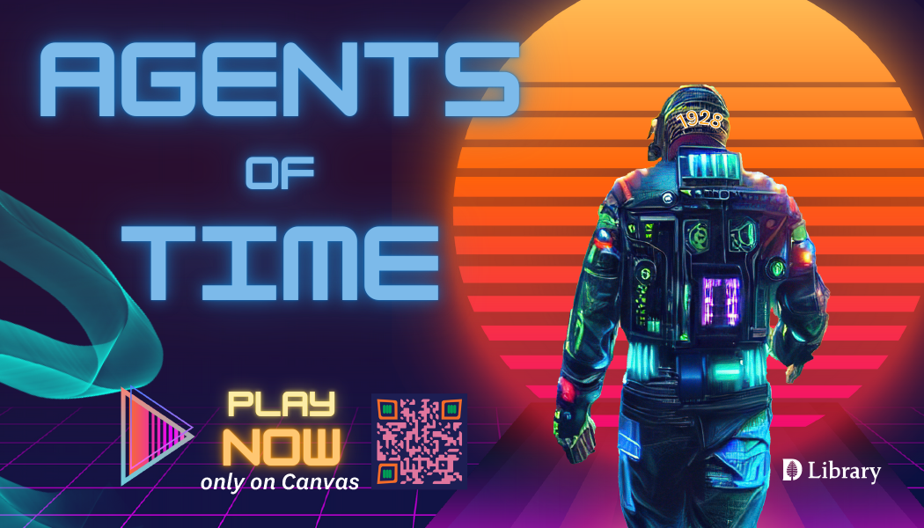
Example 1: Agents of Time
What Was It:
Hybrid escape-room style experience
Learning Outcomes:
Familiarity with key spaces
Knowing how to get help
Accessing basic search skills/tools
Staff Timing and Maintenance:
3 Librarians
Significant brainstorming time and task development
Asynchronous so minimal maintenance cost
Place-Based Anchor:
Iconic Baker-Berry Library clock tower
Notes:
Our first example is Agents of Time, a Canvas-based, escape-room style experience, in which players learn about library services and skills. (Canvas is the Course Management System that Dartmouth uses.)
This game was a necessity. Faculty had reported that students were not prepared for research when they began their 3rd and 4th years at Dartmouth. Unfortunately, there had been a significant drop in library instruction in the first year writing program due to Covid. Once we returned to campus, we could not create an uptick in instruction at the numbers prior to covid. We realized that hundreds of students were missing the opportunity to be introduced the library and that important information literacy skills were not being passed along by graduation.
So, we decided to create a set of learning outcomes for students who graduated from Dartmouth. We began this process by first focusing on first and second year students. What should they know as they progress through those first two years. Once we determined what they should know, we created this game to teach the skills. With the game, we would not have to wait for faculty to invite us into the classroom. Faculty wouldn’t feel pressure on their time/availability bc students could do this game asynchronously. The ultimate goal was to integrate this game into the two year curriculum and assess learning outcomes at the end of the first and second years. Outcomes were relatively simple: familiarity with key spaces, knowing how to ask for help, and accessing basic search skills and tools. The most important is asking for help as we have a significant consultation practice between students and librarians at Dartmouth.
In terms of staff timing and maintenance required to develop, launch, and run the game, it took about six months to create. That includes voiceovers, video clips (we have a librarian hologram that speaks to the students before they begin the game), puzzles, graphics, etc.
Another virtue of it being asynchronous is that students can access this whenever they want. In between classes, in between terms, while bored in class. Students can stop the game and come back to it at their leisure.
So, Laura, Jentry, and I began the process of creating Agents of Time. Although this version is hosted online, it does incorporate physical components (such as going into the stacks to find a book). Most of the time was spent determining where to host the game - Canvas was finally settled on because it was something students are already familiar with and we can see their login info to know who is registered and how many people complete the course. Because campus lore and ritual is so important on Dartmouth’s campus. I decided to base Agents of Time around something familiar to students but that also had an interesting story. Because the clock tower is a known entity in the area and much beloved I chose the tower. I was happy to find out that one of the clock hands went missing fairly recently. Some say it blew away in a snow storm. But, it was never found after the snow melted which led some to believe that a fraternity or sorority took it as a prank. We decided to tie in the missing hand. We emphasized that we wanted that particular hand to be returned because it has a special message engraved on it that is passed down to each class. So, I created the narrative. Then we gathered together and plotted skills that we wanted them to practice and tied that in to the narrative. We would even practice some of the steps and clues that we were writing to ensure that they were clear. Jentry met with instructional design and learned how to make all the puzzles, questions, quests, etc. work inside of Canvas and became our canvas expert.
A really nice piece to this was the fact that we were able to test-run the game with engineering who were in an engineering design course. We used their feedback to finalize and launch the escape room campus-wide and to plan for agents of time 2.0.
We also had our library student assistants test the game throughout various steps so that they could catch parts/pieces that weren’t working or didn’t make sense.

Slide 12
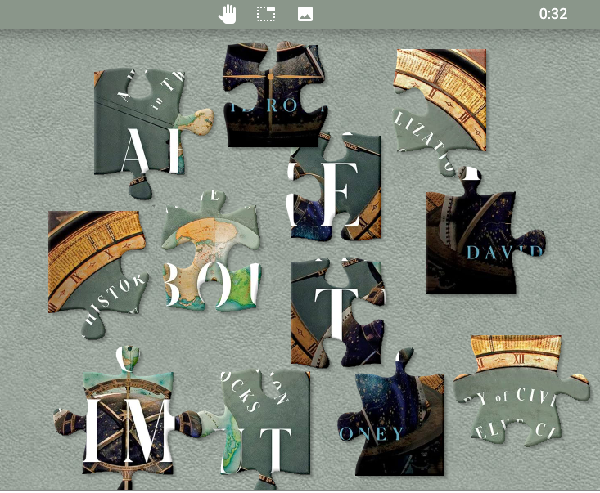
Example 1: Agents of Time
Outcomes and Takeaways:
110 registrants over 1.75 terms (partial fall and full winter terms)
Able to assign it (to students in courses or to student employees working at the library)
Potential for future collaboration with professors/campus units
Currently in the process of collecting feedback via survey
Notes:
In terms of outcomes and takeaways from the game, as of this past Winter Term, which for us ended March 12th, we had 110 registrants in the course. Given that this is the first time we’ve done anything like this, and that we weren’t able to launch it until mid-fall last year and it hasn’t seen a full academic year online yet, we’re quite happy with this number.
Some professors have linked to it or assigned it in their courses and one of our student supervisors in the library has encouraged all of her student employees to play this (and get paid to do so) as part of their optional training. We’re currently actively looking into other partnerships we can leverage to get the game spread more widely - for example, we could approach our First Year Writing Program to try to get it advertised there, we could run it as part of our campus’ first generation “First Year Experience Program” - a pre-orientation session for first gen students.
An important part of game-based library learning is to embrace the iterative process. This was a first-time experiment. It worked! Now we’re working on gathering feedback from participants and professors alike to improve it, spread it, adapt, and iterate going into the future.
Speaking of iterating, our second example is of a scavenger hunt that was actually the second iteration of this scavenger hunt style of game at Dartmouth Libraries.
(5 min)

Slide 13
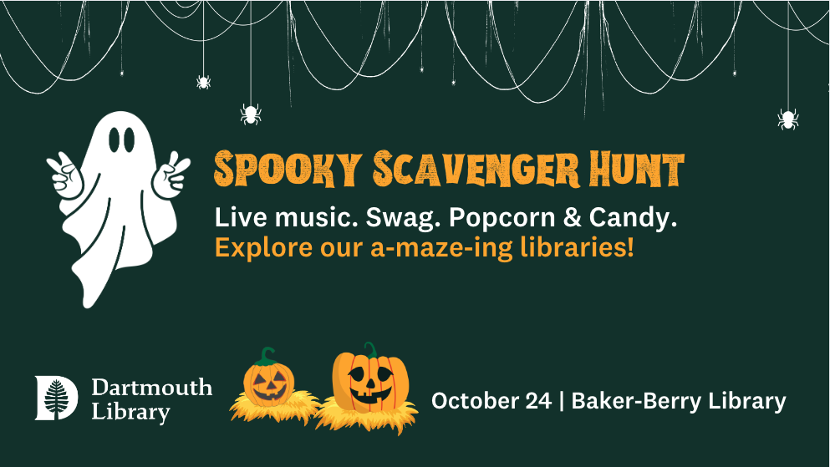
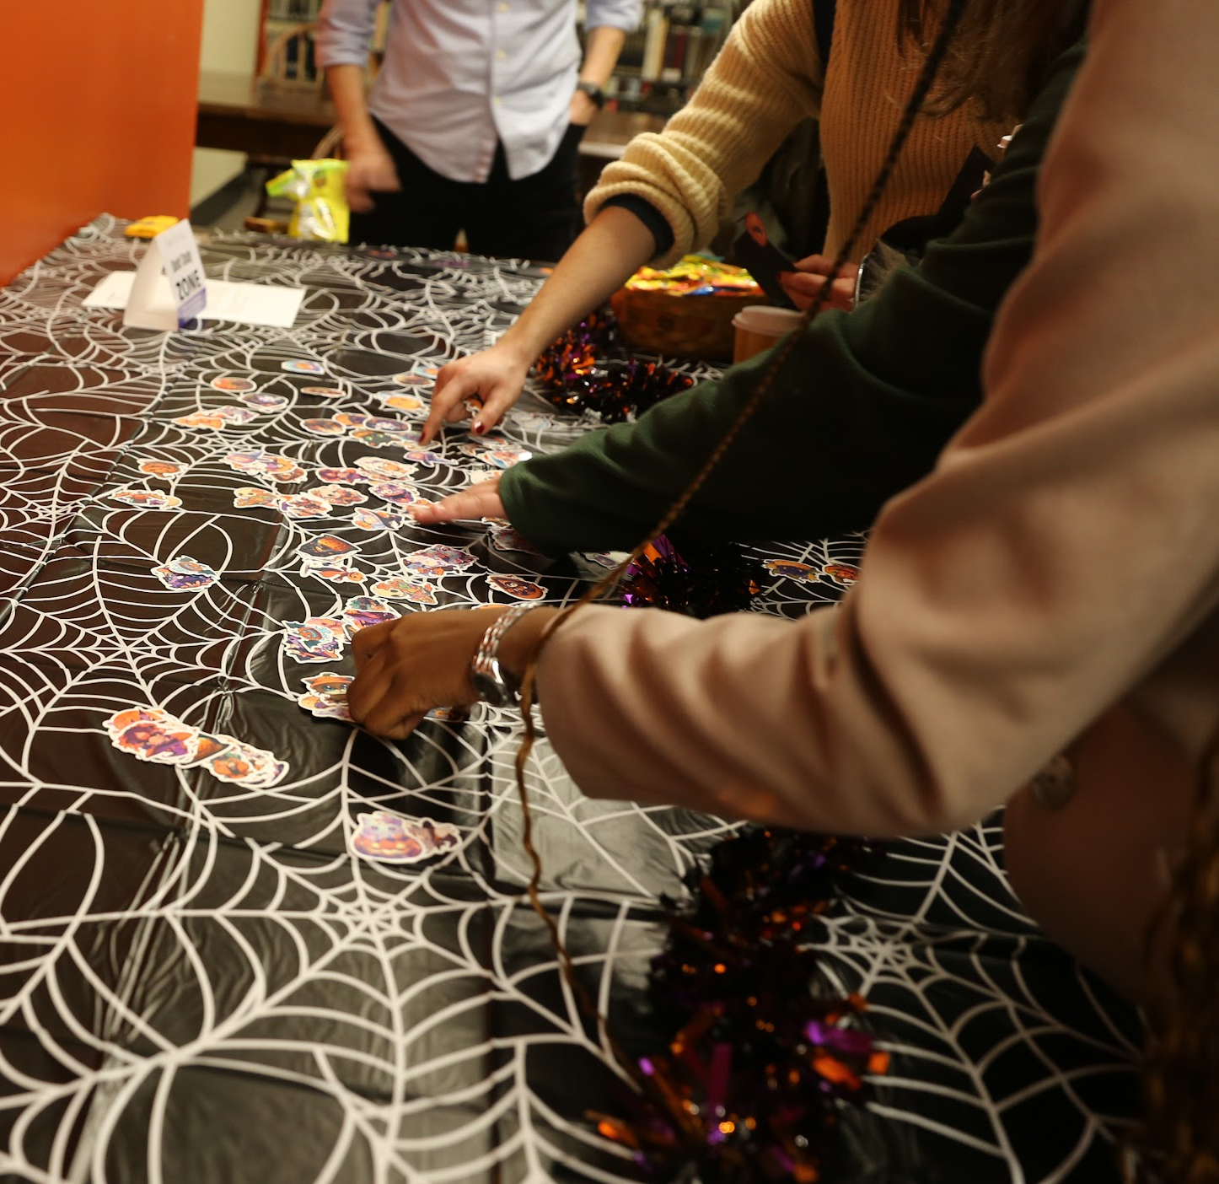
Example 2: Library Maze & Riddles
What Was It:
Scavenger hunt style game
Learning Outcome:
To familiarize students with library physical spaces, library staff, and library services
Staff Timing and Maintenance:
Planning committee of 12, met weekly
1-day, 2-hour event, 2 hours of set up and take down time
Swag, decorations, candy, clue prep
Place-Based Anchor:
Labyrinthian library spaces and stacks
Notes:
Last fall, we ran a Halloween-themed scavenger hunt in the library a few days before Halloween. It was an iteration on a scavenger hunt that Yolanda was the brains behind that we ran in 2022 during Dartmouth’s First Year Orientation week. This past fall, we were given less time during the formal orientation week schedule, and at a time slot that we knew would lead to dismal turnout rates, so we decided to roll the dice and take the same scavenger hunt concept and structure, but to do it around Halloween, which for us is between midterms and finals. The hope was to catch students when they were free and not overwhelmed by the start of the school year, but also still within their first term as Dartmouth freshmen, when they could use an orientation to the library.
So, what was it? A physical scavenger hunt through the library where students visited spaces within the library (the circulation desk, unique collections, study spaces, etc.) following rhyming clues.
The Learning outcomes were to familiarize students with library spaces of interest, services that would be helpful to new students (like course reserves or meeting with research librarians), and getting to meet library staff (hearkening back to that relationship-building point).
In terms of staff timing - We had a first year orientation committee of 11 to 12 people all from different departments and libraries across campus. We met most weeks for about an hour over the course of three or so months to create the clues, brainstorm, plan and purchase decorations, etc. Given that we’d already run a scavenger hunt the previous year, that had also been test-run with our first year experience program participants, we largely knew the ropes and didn’t have to reinvent the wheel. The biggest lifts were just giving the theme a facelift, buying everything, using Canva to whip up some snazzy marketing materials, and then the 2 hours of the actual scavenger hunt and an hour before and after for set up and take down.
Our “place-based anchor” here is admittedly a bit of a stretch, but students and staff alike talk about how labyrinthine and maze-like the library spaces, halls, and stacks are. So we leaned into it! Instead of having an intimidating maze of cold, silent spaces, our scavenger hunt participants got to experience the maze of the library as a fun game.

Slide 14
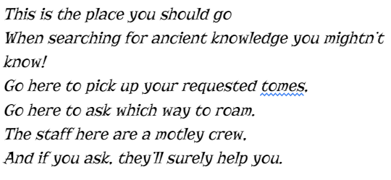
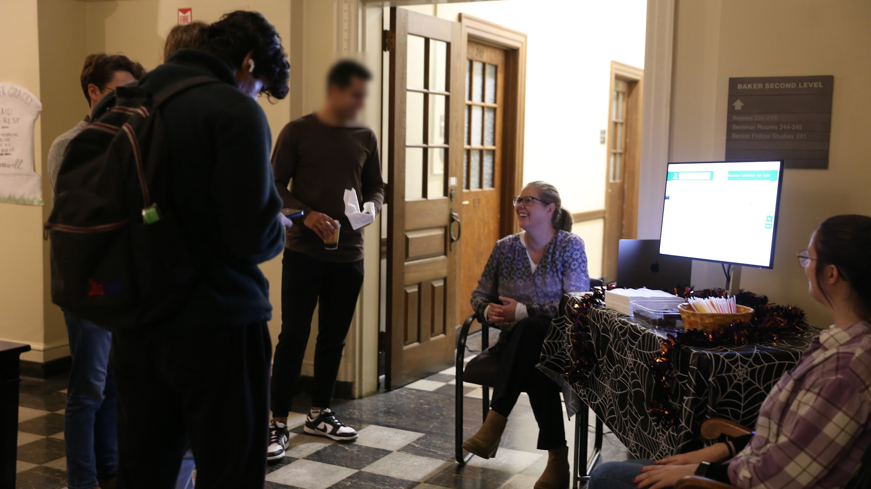
Example 2: Library Maze & Riddles
Outcomes and Takeaways:
30 participants completed the scavenger hunt, but…
Dozens of additional conversations about library services by interested passersby (lured in by the fun!)
Learned that our marketing efforts were sub-par
Figure out how to directly deliver a feedback survey to participants in future
Notes:
To start this slide off, I wanted to share an example of one of the clues we used. [Read the clue]. This was the clue for our Circulation Desk where students learned about course reserves, placing holds, interlibrary loan, and that it’s generally the spot to go if you have a question and we can direct you where to go next.
We had 30 students complete the full scavenger hunt, which was fewer than we were hoping for. However, we had dozens of students who swung by the various stations to talk to library staff. They were attracted by the decorations, swag, and food and our staff at each station reported having tons of substantive conversations with students about research librarian services, the archives collections, online resources, you name it. Students would come by to ask for a cookie and then stuck around to learn about whatever that station was teaching! We didn’t know that would happen, so we only have anecdotal evidence, but based on all the table staffers I spoke to, I know we at least connected with a few dozen students on top of the official participants but wouldn’t be surprised if that number was over a hundred.
Assessment is always important to these kinds of events - again, iterative process. We had a QR code for feedback at the final station…that no one noticed. So make sure your assessment tool is obvious or you have a way of emailing it to people directly! We also heard from students that our marketing didn’t reach them as well as we’d hoped. A lot of students wanted to participate when they saw the event, but didn’t have time because they didn’t know it was happening. We learned that bathroom stall posters are super important for getting the word out and next time we do this we’ll try to coordinate with the housing office to blast dorm email listservs.
(6 minutes for all of the Maze content. I’ll shave it down and hit the highlights only for this part).

Slide 15
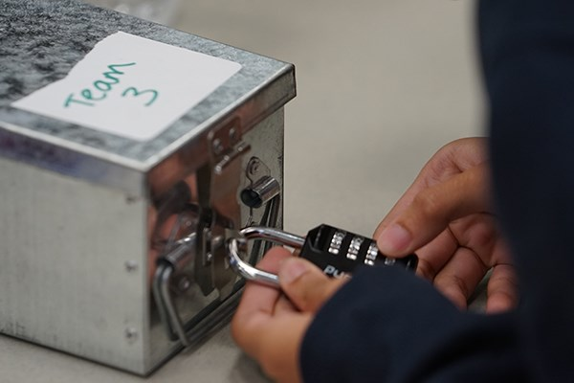
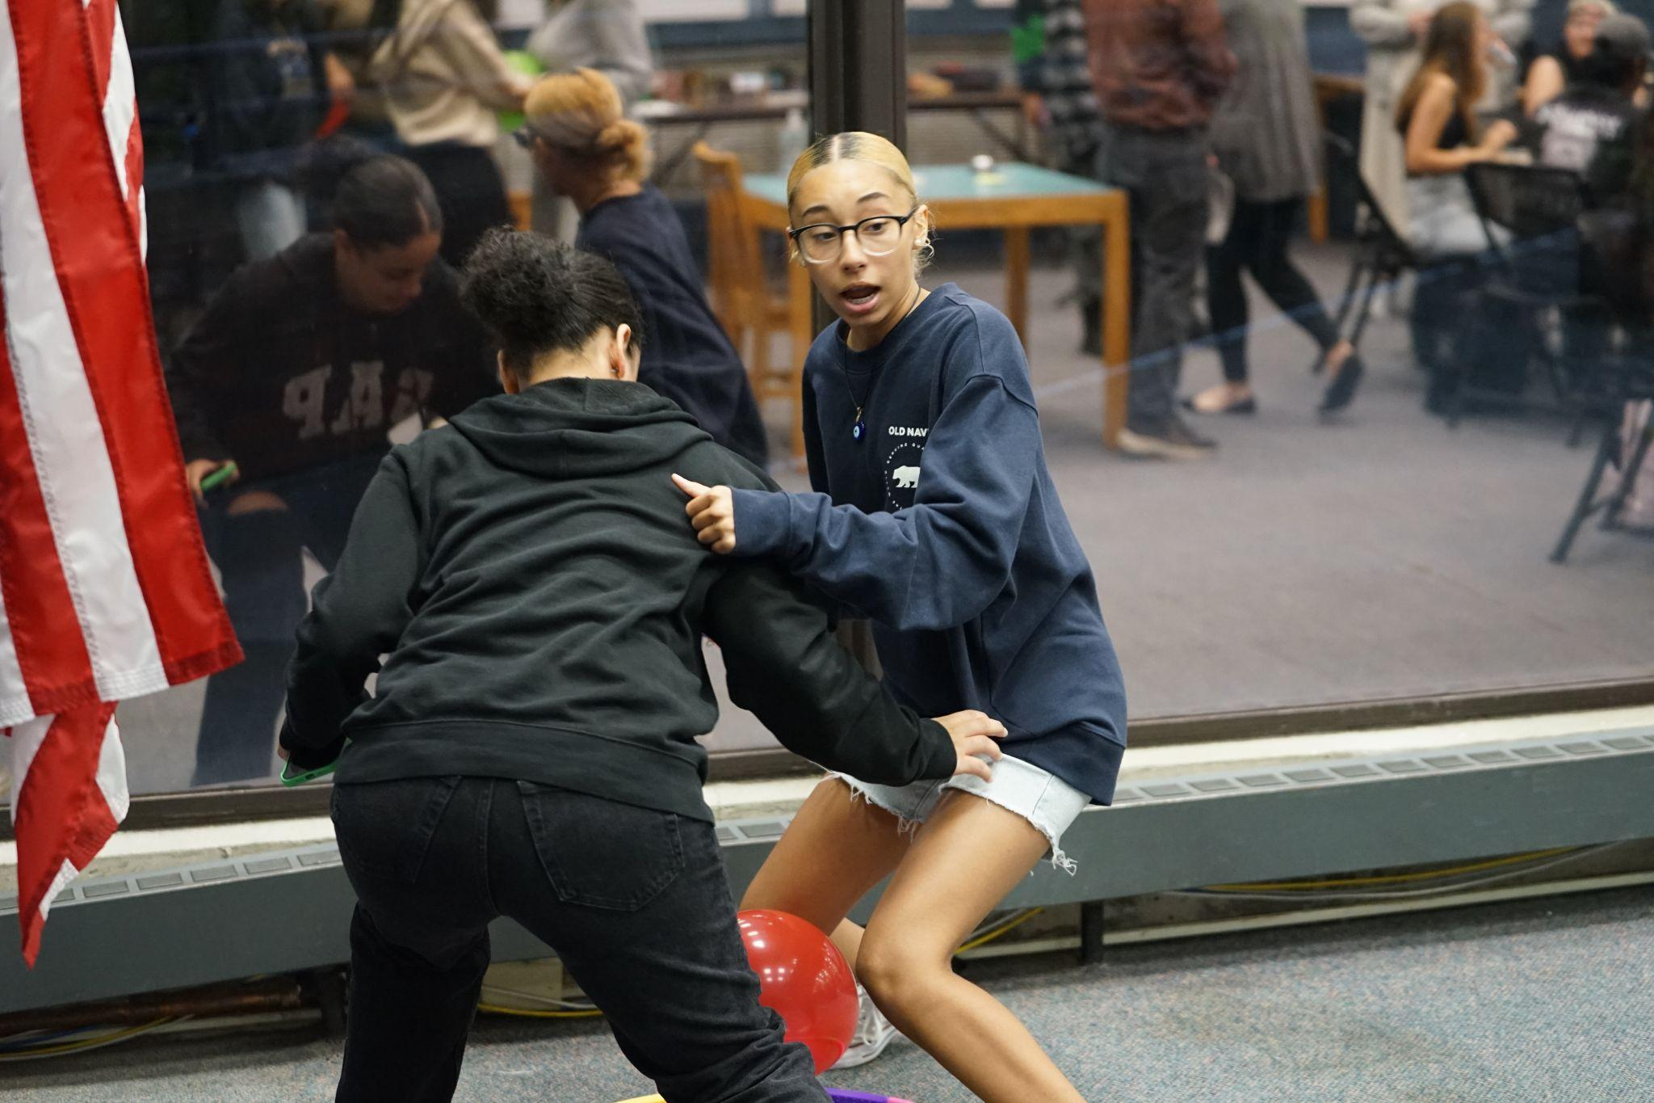
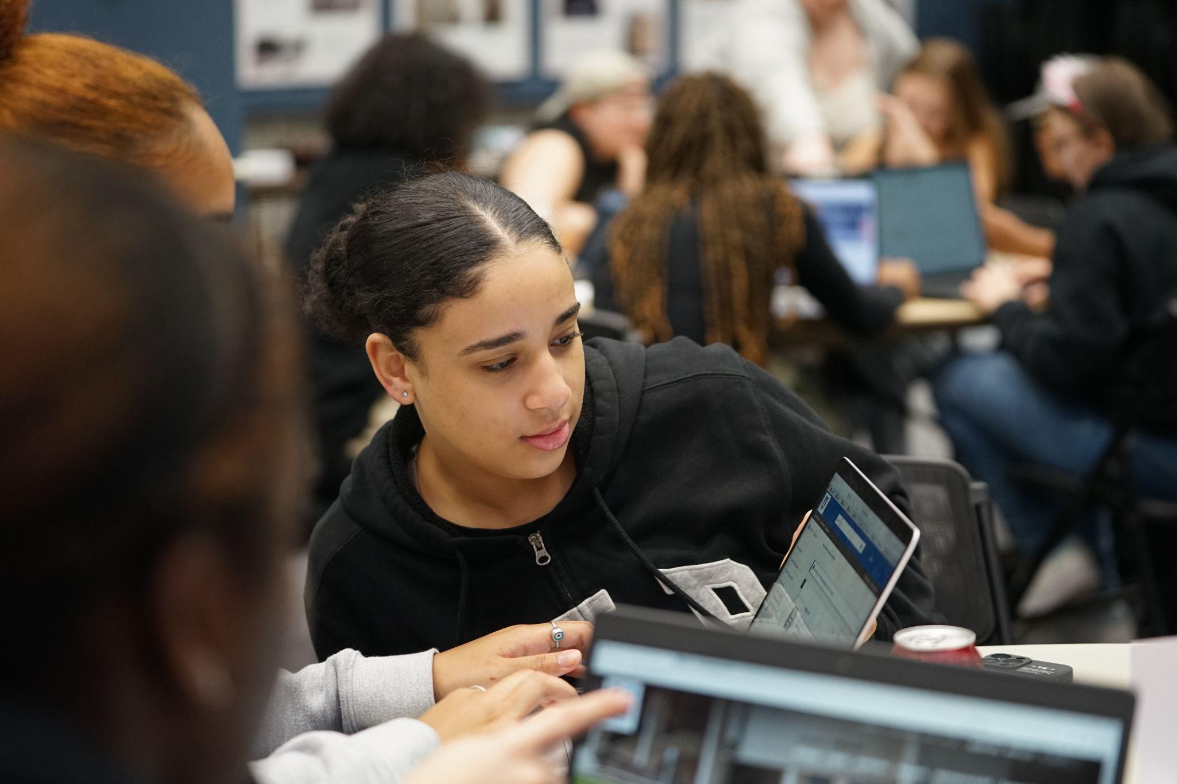
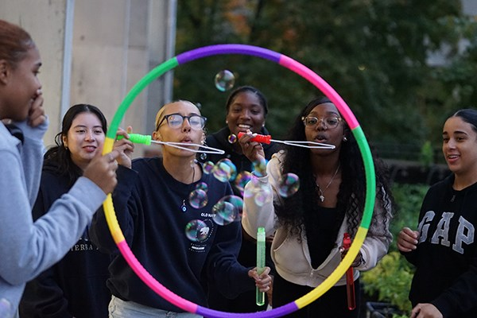
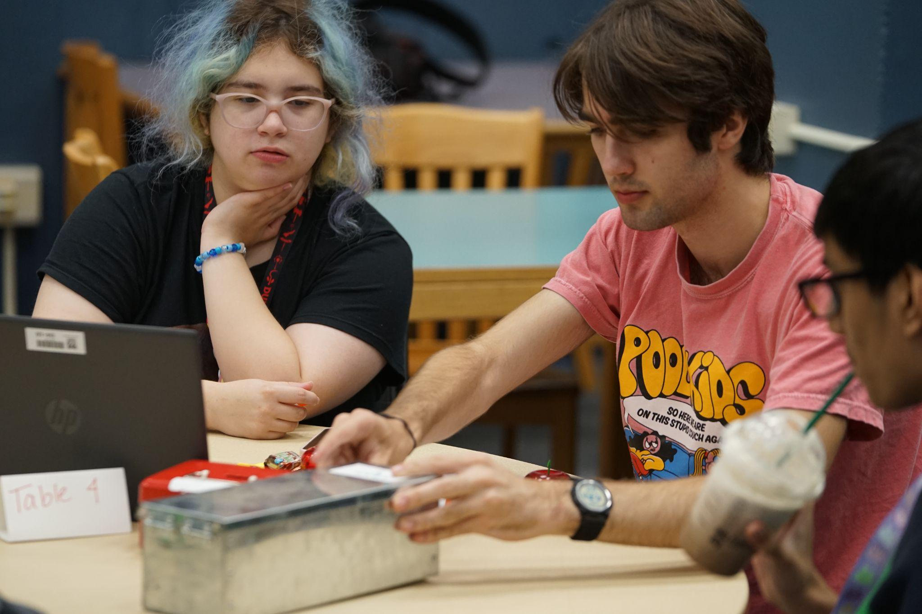
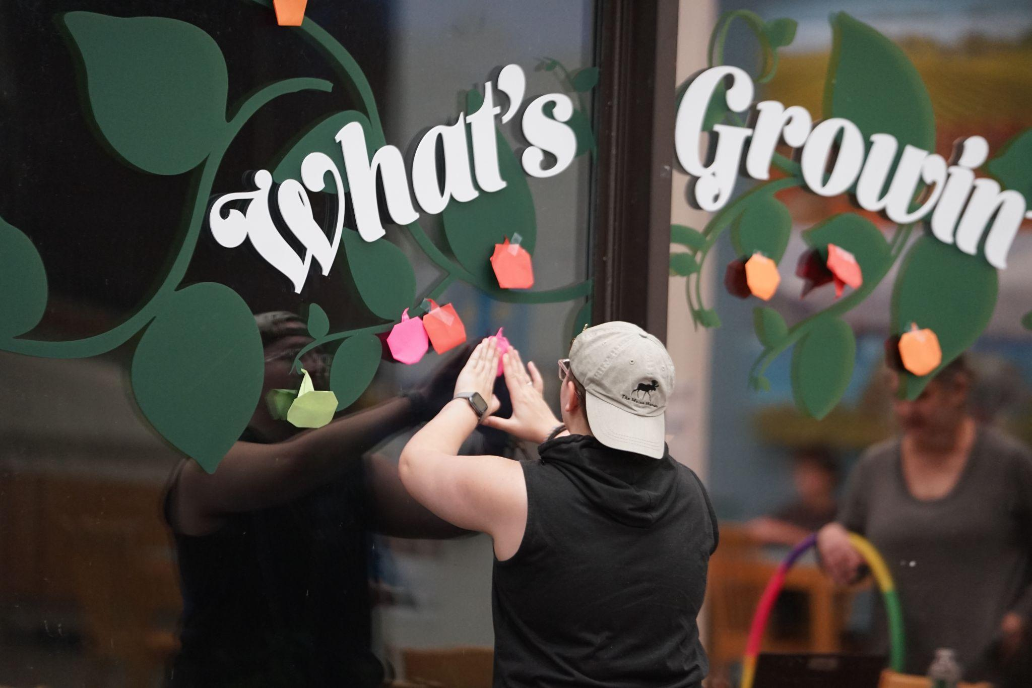
Example 3: Jolly Jane Escape Room
What Was It:
Physical escape room
Learning Outcome:
Students will have hands-on experiences with
library resources
Students will meet library staff
Staff Timing and Maintenance:
Planned and coordinated over 6 weeks with
student assistant and 2 librarians
Place-Based Anchor:
Jolly Jane infamous historical local figure
Notes:
Our final example is…This escape room was created as an activity for the first gen program on our campus. It was an opportunity to re-connect with this program that had not had any library attention for some time (due to Covid and staff retirements). We wanted something fun, that students would want to do. But, we also wanted to introduce students to our resources and staff. This was the easiest way to do it. No pressure, but students have an opportunity to try some of the resources hands on. They won’t necessarily remember anything, but there is that vague idea that they tried the quick search and found articles. They’ve played this game with staff and have a sense of how approachable we are and that we really do want to help them.

Slide 16
Example 3: Jolly Jane Escape Room
Outcomes and Takeaways:
Library re-connected with a vital population and university program (28 students)
Students had an opportunity to see and interact with library space
Students had an opportunity to see and interact with library staff
Students want opportunities to play without judgment
Students want opportunities to meet others without awkwardness
Need more library staffing to meet students intellectual and social development needs
Notes:
We received feedback from the first gen program because students had to respond to the event. We had 28 students participate (which was our capacity–this was new for us at UML, and we didn’t have a lot of staffing, so we didn’t want too many students to arrive and overwhelm us. In the student responses, they all had fun. I went in thinking this cohort of freshmen would know each other. A surprising number of students did not. And, mentioned that they were meeting new people and potential friends. A few students even mentioned library resources they used and one student said i realize we can filter now. Adults need play just as much as children. And, these students embraced play. At UML, we need more staff. First year program wanted to do this more than once and at both of our campus libraries for the academic year.

Slide 17
Questions?
Notes:
And now we’d like to turn the conversation over to you! What questions do you have for us? About play and playfulness, games and gamification, or any of the examples we shared? We have a few potential questions listed here to get the gears turning. Feel free to ask one of these or anything else on your mind.

Slide 18
References
Brown, S. (2010). Play How It Shapes the Brain Opens the Imagination and Invigorates the Soul. Avery Publishing.
Centre for Teaching Excellence. (n.d.). Gamification and game-based learning. University of Waterloo. https://uwaterloo.ca/centre-for-teaching-excellence/catalogs/tip-sheets/gamification-and-game-based-learning#:~:text=In%20short%2C%20gamification%20applies%20game,that%20are%20intrinsically%20game%2Dlike.
Davis, J. (2010). Recommendations. In The first generation experience: Implications for campus practice and strategies for improving persistence and success (pp. 176-202). Routledge.
Forbes, L.K. (2021). The process of play in learning in higher education: A phenomenological study. Journal of Teaching and Learning, 15(1), 57-73. https://.doi.org/10.22329/jtl.v15i1.6515
Kim, B. (2015). Gamification in education and libraries. Library Technology Reports, 51(2), 20-28.
Norgard, R.T., Toft-Nielsen, C., Whitton, N. (2017) Playful learning in higher education: developing a signature pedagogy, International Journal of Play, 6(3), 272-282.
Sicart, M. (2017). Play Matters. MIT Press.
Van Vleet, M. & Feeney, B. (2015). Young at heart: A perspective for advancing research on play in adulthood. Association for Psychological Science, 10(5), 639-645.

Slide 19
Additional Resources
Forbes, L. (Ed.) & Thomas, D. (Ed.). (2022). Professors at play playbook. Carnegie Mellon University: ETC Press.
Gillen-O’Neel, C. (2021). Sense of belonging and student engagement: A daily study of first- and continuing-generation college students. Research in Higher Education, 62, 45-71. https://doi.org/10.1007/s11162-019-09570-y
Hicks, A. & Sinkinson, C. (2021). Participation and presence: Interrogating active learning. portal: Libraries and the Academy, 21(4), 749-771. https://doi.org/10.1353/pla.2021.0040

