Slide 1
Cultivating Information Literacy Pedagogy with Student-Instructor Partnership
Rachel Fundator
Clarence Maybee
Samantha LeGrand
Notes:
1-4: C
5-12: R
13-18: C
19: R
Close: C and R

Slide 2
Goals
Describe elements of students as partners (SaP) and how it may be applied to library contexts
Explain how SaP supports inclusive teaching and learning
Identify opportunities for integrating SaP practices into initiatives in your context
Photo by Marcelo Dias, pexels.com

Slide 3
Overview
Our context
Overview to Students as Partners
Program spotlights
Concluding thoughts

Slide 4
Our Context: Initiatives & Needs
Variety of teaching and learning initiatives
Teaching with AI
Institute for Information Literacy
Cultivating a research community focused on exploring the role of information literacy in addressing information challenges

Slide 5
Need for Student Voices and Involvement
Hearing from student voices supports building inclusive programs
Foster meaningful learning experiences by collaborating with students
SPIRaL - Undergraduate research program focused on information topics that are personally meaningful and relevant
PAL - Teaching and learning community on AI in the classroom

Slide 6
Students as Partners (SaP) Approach
Pedagogical approach applied to classroom teaching, curricular design, program development, etc.
Flexible and contextual:
Nature of the task
Partners’ interests, goals, expertise
Degrees of participation
Benefits (Cook-Sather et al., 2019)
New perspectives foster more inclusive teaching environments
Deeper appreciation for learning efforts
Mutual responsibility and agency

Slide 7
Partnering and Engagement
SaP extends beyond engagement
Engagement: student input; instructor-initiated
SaP: reciprocity and ongoing involvement
“Ideation, creation, and decision making” (Salisbury et al., 2020, pg 305)
Example: redesigning library spaces
Engagement:
students complete a survey to provide feedback about using library spaces to librarian committee charged with developing a renovation plan
Partnering:
workshops to co-design library spaces
renovation plan committee establishes priorities and makes recommendations
students are partners in the work

Slide 8
How do you currently engage students in your context?
ⓘ
Click Present with Slido or install our Chrome extension to activate this poll while presenting.
Notes:
📣 This is Slido interaction slide, please don't delete it. ✅ Click on 'Present with Slido' and the poll will launch automatically when you get to this slide.

Slide 9
Creating SPIRaL: Student Partners for Information Research and Literacy Undergraduate Research Program
Context:
Welcome undergraduates into the researcher community
Development project goals:
Partner with students with varied disciplinary perspectives to conceptualize and develop a personally meaningful undergraduate research experience

Slide 10
SPIRaL Development Team
Librarian-faculty: faculty development, student-centered pedagogy
Graduate assistant: history and disability studies
Undergraduate assistant: mechanical engineering
From left to right: Samantha LeGrand, Rachel Fundator, Ben Weiss, Secret Permenter

Slide 11
SaP Practices Used to Develop SPIRaL
(Fundator et al. (in-press))
Celebrate and leverage expertise of all partners
Students have experiences with libraries and research that can better inform a program for other students
Layer reflection
Engaged in structured individual and group reflections to document our work, deepen learning, and help us discover insights and paths forward
Pursue transparency
Modeled the messiness of design and research

Slide 12
Ongoing Benefits
Students are intrigued by the co-created program and the research topic
Ben and Secret continue to shape SPIRaL
SaP philosophy has seeped into the program
Current SPIRaL researchers assumed a sense of responsibility for improving the program for future researchers

Slide 13
Where do you think a SaP approach may be most meaningful or impactful in your context?
ⓘ
Click Present with Slido or install our Chrome extension to activate this poll while presenting.
Notes:
📣 This is Slido interaction slide, please don't delete it. ✅ Click on 'Present with Slido' and the poll will launch automatically when you get to this slide.

Slide 14
Expanding SaP
at Purdue

Slide 15
Creating Partners for Algorithmic Literacy (PAL)
A Student-Faculty Learning Community
Context:
Navigating AI in education
Program Goals (ground in SAP):
Bridge barriers between teachers and learners
Transform response to AI in education
Shared decision-making (faculty and students) about AI in the classroom
Notes:
from reactive to proactive, participatory
Context:
there is uncertainty for everyone, and SaP gives another way of engaging that is less top-down / one-directional

Slide 16
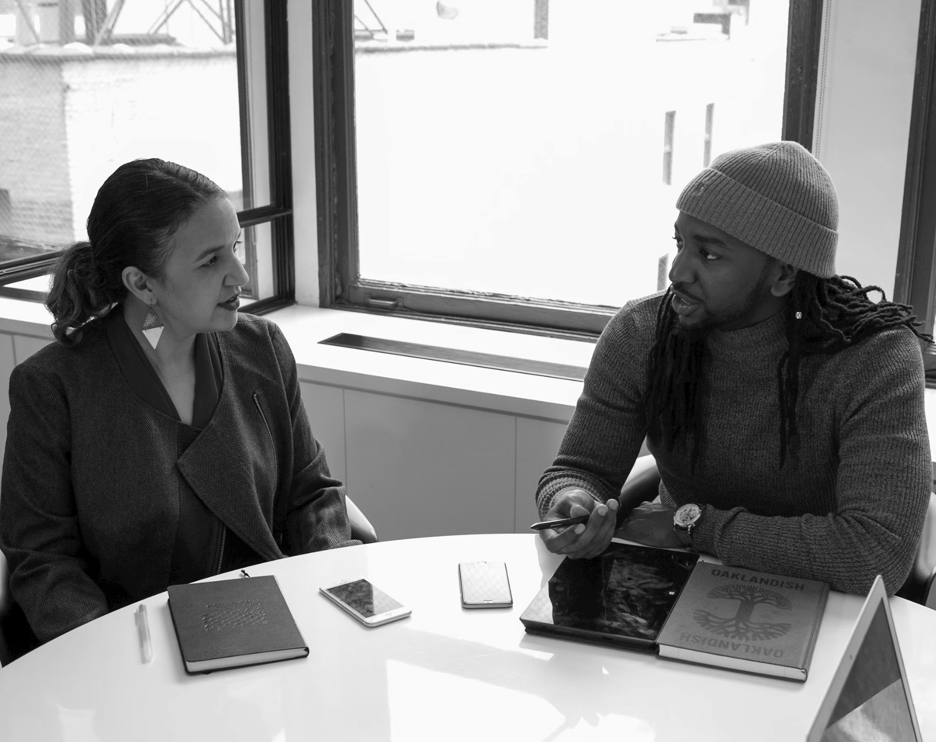
PAL Pilot Cohort
Co-Facilitators:
Purdue Libraries
Center for Instructional Excellence
Co-Design Student and Faculty Partners:
Faculty and students from 11 departments across campus
2nd, 3rd, and 4th year students
Lecturers, clinical faculty, and tenure-track faculty
Photo by Jopwell Collection, unsplash.com

Slide 17
SaP Practices Applied to PAL
Inclusivity - Paired partners from different departments to share areas of expertise
Empowerment - Multiple modes for engagement: in-person discussion, online discussion posts, private pre- and post-surveys, small group feedback sessions
Shared responsibility - Explored Algorithmic Literacy Pedagogy Framework together in series of discussion-based sessions
Healey et al., 2014
Notes:
Authenticity: identify roles, strengths, and shared goals
Student prep session to share goals and ideas on engaging in pedagogical discussion
Inclusivity: leverage knowledge of all partners
Paired partners from different departments to share areas of expertise
Empowerment: constructive critique and challenge
Multiple modes for dialogic engagement: in-person discussion, online discussion posts, private pre- and post-surveys, small group feedback sessions
Shared responsibility: all partners learn and teach
Explored Algorithmic Literacy Pedagogy Framework in series of discussion-based sessions
Partners co-developed curricular plan using worksheet that guided them through implementing facets of the FrameworkOverwhelmingly, response to AI in education has been instructor-centered
Recognized a need to create practical guidance for students to be integrated meaningfully in discussion and decision-making
Response:
Algorithmic Literacy Pedagogy Framework to guide implementation of AI-integrated teaching/learning practices
SaP program model (PAL) to encourage pedagogical co-design

Slide 18
Ongoing Benefits
6 co-developed curricular plans
Valuable participant reflections and feedback will inform future programs
Faculty and student partners featured as exemplars on university-wide faculty development website
1 student participant collaborating on future publication
Notes:
6 co-developed curricular plans - starting point to encourage dialogue and shared exploration of AI across campus
Valuable participant reflections and feedback will inform future programs
2 partner pairs featured as exemplars of SaP and algorithmic literacy on university-wide instructor professional development material
1 student participant collaborating on future publication4-week pilot program
12 participants - 6 students, 6 faculty
Discussion and engagement around a partnership-oriented Algorithmic Literacy Pedagogy Framework
Well received - participants communicated that
they wished they had more time to work together,
to get to know one another,
and that there were more partnership programs on campus

Slide 19
Things to Consider with SaP
Challenges
Fostering trust
Addressing instructor misconceptions about partnership
Gaining institutional support
Opportunities
Collaboration with colleagues and students across campus
Scholarship of teaching and learning projects

Slide 20
Benefits of SaP Across Contexts
Flexibility of SaP
Refine existing library structures or practices
Build something new with student partners (SPIRaL)
Explore innovative teaching approaches with student partners (PAL)
Student growth
Sense of creativity, choicefulness, and agency
SaP as an opportunity to participate in change and progress

Slide 21
What is one thing you could do to incorporate SaP into your current practice or context?
ⓘ
Click Present with Slido or install our Chrome extension to activate this poll while presenting.
Notes:
📣 This is Slido interaction slide, please don't delete it. ✅ Click on 'Present with Slido' and the poll will launch automatically when you get to this slide.

Slide 22
Thank you!
Questions?

Slide 23
References
Cook-Sather, A., Bahti, M., & Ntem, A. (2019). Pedagogical partnerships: A how-to guide for faculty, students, and academic developers in higher education. Elon University Center for Engaged Learning.
Fundator, R., LeGrand, S., Permenter, S., & Weiss, B. (in-press). Students as partners in the library: Perspectives of partnering to develop a new information literacy undergraduate research program. International Journal for Students as Partners.
Healey, M., Flint, A., & Harrington, K. (2014). Engagement through partnership: Students as partners in learning and teaching in higher education. The Higher Education Academy Report, (July), 1-76. http://dx.doi.org/10.1080/1360144X.2016.1124966
Salisbury, F., Dollinger, M., & Vanderlelie, J. (2020). Students as partners in the academic library: co-designing for transformation. New Review of Academic Librarianship, 26(2–4), 304–321. https://doi.org/10.1080/13614533.2020.1780275

