Slide 1
Changing Librarian Roles in the Emerging Digital and Open Education Landscape: An Environmental Scan Research Study
Donna Harp Ziegenfuss, EdD
University of Utah
LOEX 2024

Slide 2
While we are getting settled …. Will you answer a few poll questions?
Scan the QR code
OR
https://forms.gle/UTbLZs76n96sUnQu6
What is your experience with OERs?
Does your library have an OER librarian?
In what department or unit is the OER librarian housed?

Slide 3
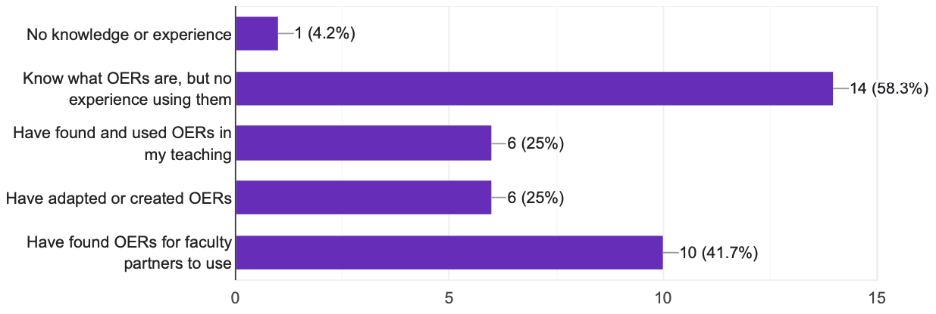
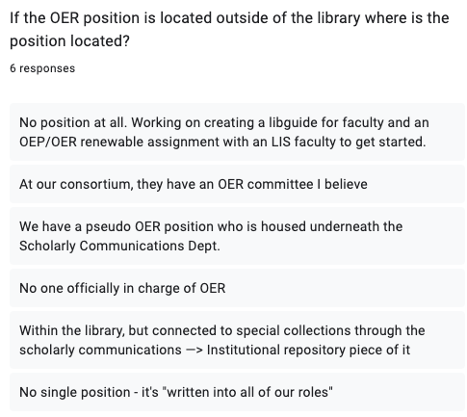
Results from the pre-presentation poll
What is your personal experience with OERs? Select all that apply.
If the OER position is located outside of the library where is the position located?
Does your library have an OER librarian position?
No
Yes

Slide 4
Session Objectives
OERs and Open Pedagogy
What are OERs and open pedagogy?
Why OERs and open pedagogy?
How to find and Use OERs
Doing an Environmental Scan
Steps of analysis
Qualitative content analysis methods
Notes:
What are OERs and Open Pedagogy?
What are OERs
How do you find OERs
What are the opportunities and challenges of OERs
Why OERs and Open Pedagogy?
Reflect on their own institutional instructional context for OERs and open pedagogy
Identify areas of open learning that they would like to explore and align to their broader campus initiatives.
How to Find and Use OERs
Find the open resources provided that they can take and use for themselves or share with other faculty on their campus
Using an Environmental Scan methodology

Slide 5
OERs and Open Pedagogy?
Image: Giulia Forsythe Flicker

Slide 6
The UNESCO Definition:
"Open Educational Resources (OERs) are any type of educational materials that are in the public domain or introduced with an open license. The nature of these open materials means that anyone can legally and freely copy, use, adapt, and re-share them” (UNESCO)
Why recreate the wheel … build on what is out there

Slide 7
Why OERs and Open Pedagogy?
You can use a variety of resources - a diversity of perspectives
Learning materials are free, affordable & accessible
AACU research – Making the Case for OERs and Leveraging Open Educational Resources to Advance DEI
More heads are better than one! Build on others’ work with attribution
An opportunity for you to give back to others
Engage students and level the power in the classroom
Enhance and promote your OWN work with CC licensing

Slide 8
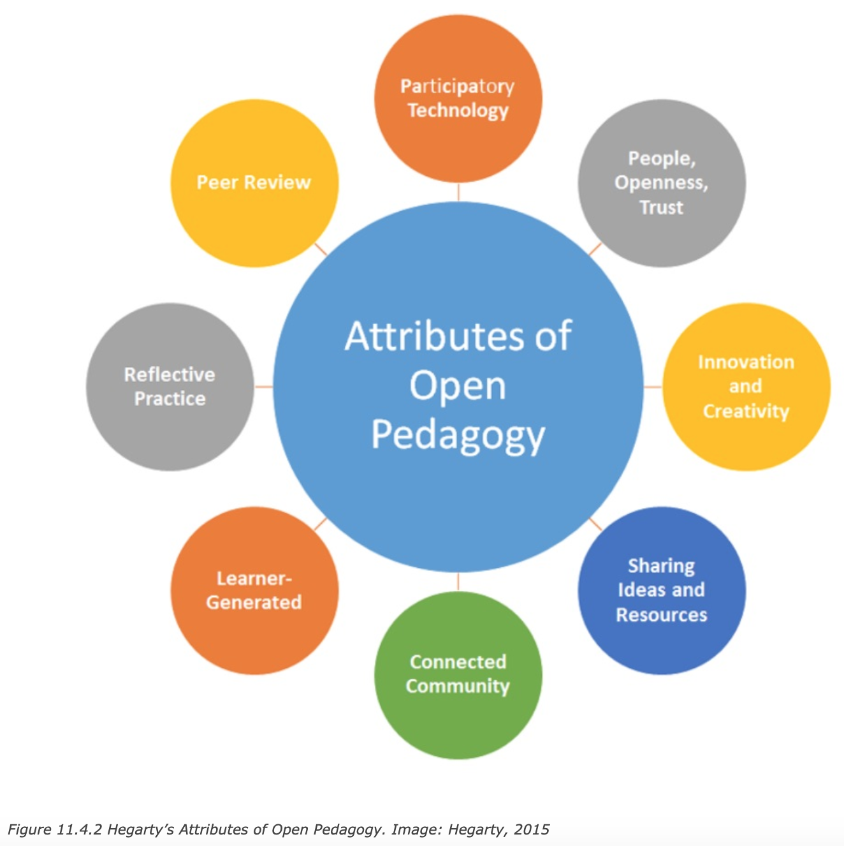
Open Pedagogy or Open Education Practice
Open education is not just about resources
Includes open pedagogy/andragogy, that impacts our teaching practice and relationships
(Hegarty, 2015)

Slide 9
Pros & Cons of OERs
Advantages
Reduces cost
Variety and flexibility
Easy to incorporate
Different media formats for diverse student population
Fast to incorporate
Disadvantages
Discoverability
Time consuming to find
Commitment is needed to create or update materials
Can be inconsistent evaluation of materials

Slide 10
The Five R Framework (Wiley, D. et. el., 2007, 2014 )
Reuse
Revise/Rework
Remix
Redistribute
Retain (2014)
the right to reuse content as verbatim or unaltered
the right to adapt, adjust, modify, or alter the content itself
the right to combine the original or revised content with other content to create something new
the right to make and share copies of the original content, your revisions, or your remixes with others
the right to make, own, and control your own copies
Wiley Video

Slide 11
OER Creative Commons License
Options for adding a creative commons license to use on your own materials and apply a CC license to your work
Use or adapt the CC licensed materials of others for your own needs and use the attribution tool from U of Washington to include your work attribution
Instructional designers or librarians can help in adopting or adapting OER

Slide 12
Finding OERs
Image: Flicker Sell Hhu

Slide 13
Repositories
Merlot
OER Commons (books, websites, lessons, handouts)
OASIS (Openly Available Sources Integrated Search)
Mason OER Metafinder (federated search)
Open Education Network Books (OEN)
Creative Commons Search
The National Science Digital Library (NSDL)
Teaching Commons
MIT OpenCourseWare – modules, and powerpoints, notes, activities
Community of Online Research Assignments (CORA)

Slide 14
Textbooks & Other Directories
Pressbooks Directory
Open Textbook Library
Libretext (books and learning objects)
OpenStax Textbooks
Bccampus
UCL Press (UK)
EdTech Books (BYU) – some graduate level books
An OERbook that provides links to many resources by discipline
OpenOregon– links by course/discipline

Slide 15
Evaluating Open Books
Evaluating OERs criteria
Other evaluation tools
Faculty checklist from the University of Manitoba OER book Adaptation Guide (p. 15)
British Columbia Open Education Librarians (BCOEL) rubric
Merlot Peer Review Rubric that is used for peer review of Merlot LOs
Evaluation Areas:
Access & Technical Usability
Audience Identification
Author / Authority
Licensing & Permissions
Quality of Content
Relevance of Media Type
Subject Coverage
Search Functionality & Browsing
User-friendliness
Usability for Learning/Teaching

Slide 16
Additional Resources about OERs & Open Pedagogy
Open Pedagogy Approaches (Pressbooks)
The Open Pedagogy Student Toolkit (OEN)
DOERS - OERS and Promotion & Tenure
OER book: Valuing OER in the Tenure, Promotion, and Reappointment Process
The Equity Through OER Rubric
Open Education Organizations
CCCOER (Community College OER org)
Regional OER compacts https://www.ncoer.org/
Rebus OER Community

Slide 17
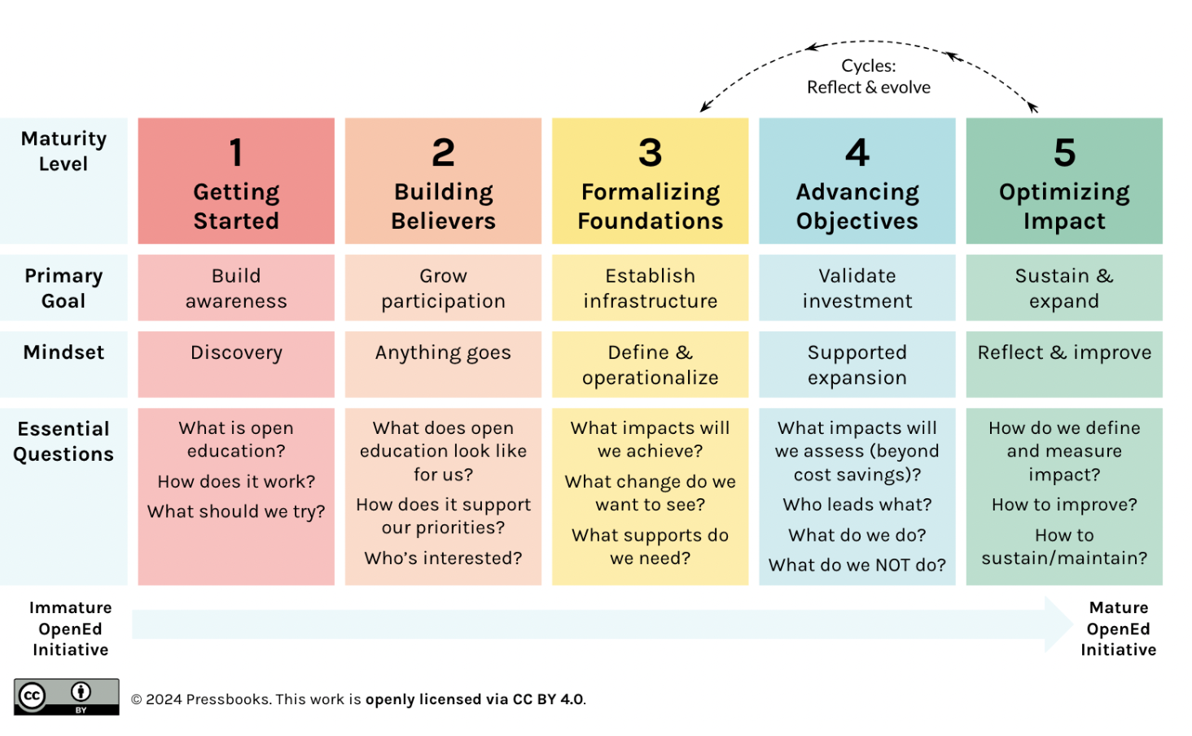
OER Journey and Open Education Maturity Model (Pressbooks)
More information about the maturity model (PDF)

Slide 18
OER & Open Pedagogy Professional Development
Conferences & Webinar Series
Open Education Conference (OpenEd)
OEGlobal conference
State Symposiums/Summits (Georgia State U, Florida, Michigan, Northeast, Ohio, Utah)
CCCOER webinar series
SUNY OER Summit
Courses & Certificates
Creative Commons Certificate Course
Universal Design for Learning (UDL) post-secondary certificate (CAST)
SPARC Open Education Leadership Program
OEN Certificates in Open Educational Practices and Open Education Librarianship
AACU Institute on Open Education Resources
Some Publications & Blogs
International Journal of Open Educational Resources (IJOER)
The Journal of Open Educational Resources in Higher Education (JOERHE)
Open Praxis Journal
Open Pedagogy Notebook
Open Pedagogy Project Roadmap

Slide 19
Role of Librarian related to OERs
Help to find the OER and information on open pedagogy
Help educate on the topics of OER and open pedagogy
Help evaluate the quality of the resources
Help faculty use CC licensing so their work receives attribution
Assist in the adaptation of OERs
Help faculty find publication venues for this work

Slide 20
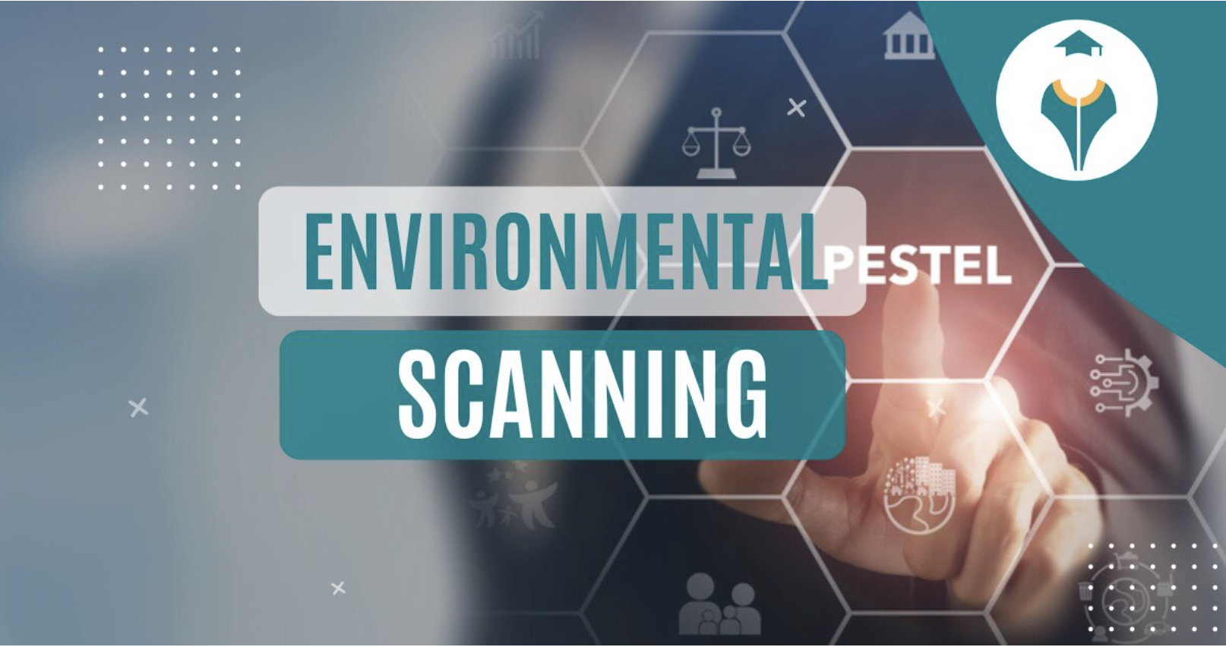
Environmental Scan Methods
Image: Shiksha Online

Slide 21
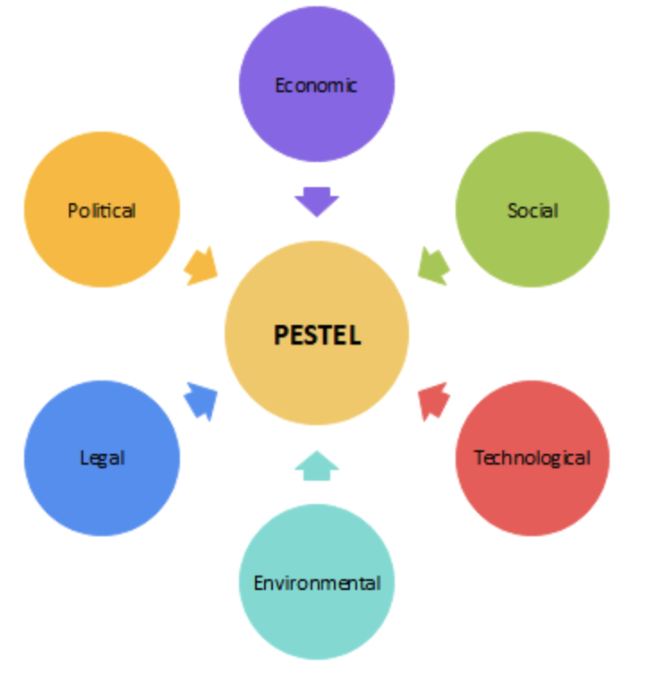
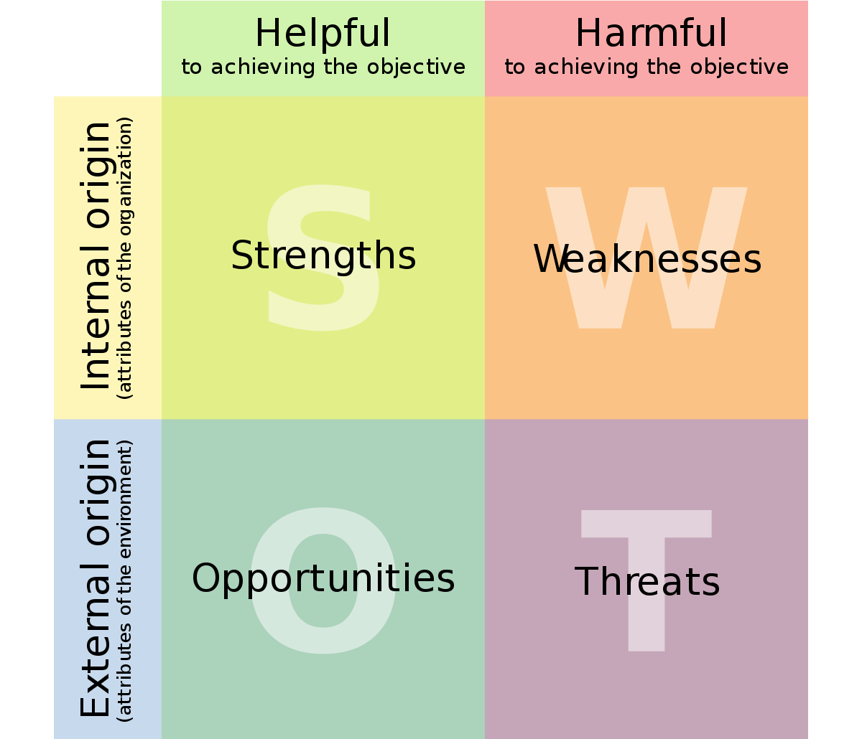
The Environmental Scan Process
“Decision makers use environmental scans to collect, organize, and analyze data on their assets and shortcomings in external and internal environments, to guide strategic planning and decision making.” (Wilburn, Vanderpool & Knight Prev Chronic Dis. 2016 PubMed PMID: 27536901; PubMed Central PMCID: PMC4993117. 2016, p. 1)
SWOT Analysis
PESTEL Analysis
Image: EdrawMax Online
Image: Wikimedia

Slide 22
Why do an Environmental Scan?
Explores multiple facets of an issue or a problem
Both qualitative and quantitative data
Not just a scholarly undertaking - involves a variety of data sources
Perspectives of different stakeholders
Uses external and internal sources
Purpose is intentional
Usually an internal purpose and intent to use findings
Aligning work to mission, goals and strategic plan
Wilburn, Vanderpool & Knight Prev Chronic Dis. 2016 PubMed PMID: 27536901; PubMed Central PMCID: PMC4993117

Slide 23
Future Work & Research Questions
What are the opportunities and barriers associated with open pedagogical practice?
What are the current attitudes of librarians, faculty, and students about using OERs and open practice in teaching and learning?
What might be the best way to help faculty integrate OERs into course work and increase student-centered learning through open education practice initiatives?
How is the library leadership role in open education impacting student success?

Slide 24
Methodology
Collected secondary data: (1) transcripts of webinars, events, and interviews; (2) open education scholarly article abstracts; (3) reports and newsletters; (4) open education list-serves, notes, blogs
Used a qualitative Content Analysis (CA) methodology to identify themes
Experimented with Atlas.ti software AI for analysis.
Two methods (traditional researcher driven coding method and Atlas.ti AI-assistant coding method were used to analyze and summarize data.
(Drisko & Maschi, 2016; White & Marsh, 2006)

Slide 25
Findings – 5 Themes
Integrating OERs and OP on a college campus is a team sport
Building campus-wide awareness, OE capacity, and digital competencies should be customized to the university culture and context
Designing a community of OP is needed to bridge support for different stakeholders
Impacting student success happens by empowering students through equitable and inclusive OP
Sustainability requires extending beyond the OERs to align OE work to the library and university strategic planning priorities.

Slide 26
Continued Planning
Create a Playbook – a framework for implementing an OER Open Pedagogy initiative
Conduct a needs assessment
Identify OER advocates to form an advisory group across the institution
Focus on customizing planning for the different stakeholders

Slide 27
Additional Resources Based on the LOEX Post-Presentation Discussion
Where do you get started with OERs?
The OER Starter Kit Pressbook
Open online modules (U of Utah work in progress)
Texas state resource
Humanities books recommendations
OER Commons Arts & Humanities Textbooks
Columbia University Library List of OER resources
Humanities: Open Textbook Library Pressbooks BC Campus
Scholars ARE Collectors: A Proposal for Re-thinking Research Support Article

Slide 28
Questions?
Donna Harp Ziegenfuss
Librarian, Faculty Services
donna.ziegenfuss@utah.edu

Slide 29
References
Bell, S., Dempsey, L., Fister, B., Allen, N., & Wilson, B. (2015). New roles for the road ahead: Essays commissioned for ACRL’s 75th anniversary. [Report] Association of College and Research Libraries. https://alair.ala.org/bitstream/handle/11213/17196/new_roles_75th.pdf?sequence=1
Drisko, J.W., & Maschi, T. (2016). Content analysis. Oxford University Press.
Hegarty, B. (2015, July-August). Attributes of open pedagogy: A model for using open educational resources. Educational Technology, 3-13. https://www.jstor.org/stable/44430383
Jhangiani, R. S. (2018). 7 things you should know about open education: Practices. Educause Learning Initiative. https://kpu.arcabc.ca/islandora/object/kora%3A521/datastream/PDF/view
Pressbooks (2024). Mapping your OER journey: Charting progress, navigating challenges, and building impact. [Youtube video]. https://www.youtube.com/watch?v=SWRG8IcVQa0
Watson, C.E. & Rush-Marlowe, R. (2023). Making the case for open educational resources. An AACU Report. AACU. https://www.aacu.org/publication/making-the-case-for-open-educational-resources
White, M. D., & Marsh, E. E. (2006). Content analysis: A flexible methodology. Library Trends, 55(1), 22-45 https://doi.org/10.1353/lib.2006.0053
Wilburn, A., Vanderpool, R.C., & Knight, J.R. (2016). Environmental scanning as a public health tool: Kentucky’s human papillomavirus vaccination project. Preventing Chronic Disease, 13. https://doi.org/10.5888/pcd13.160165

