Slide 1

UNMASKING THE
HIDDEN CURRICULUM
How it negatively impacts the one-shot model and
first-generation lower-income students
Katie Albright and Don Simmons Jr.

Slide 2

AGENDA
  Introduction to the hidden curriculum
  How does the hidden curriculum affect FGLI students?
  The one-shot instruction model
  How one-shots perpetuate the hidden curriculum
  Proposed solutions

Slide 3
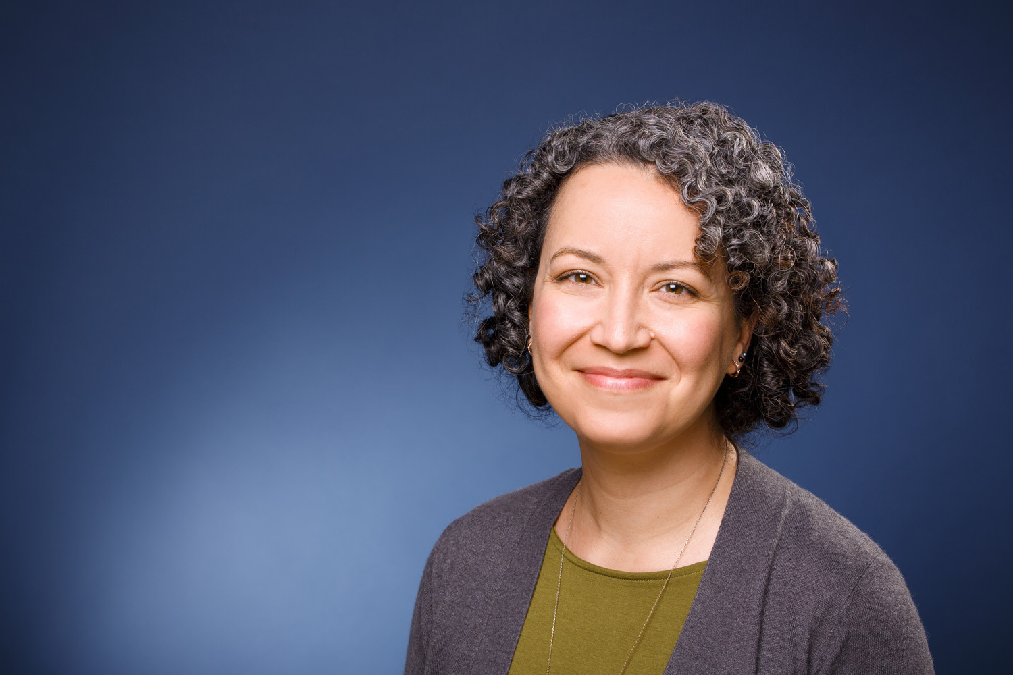
KATIE ALBRIGHT
I’m the Student Success Librarian at Otterbein University in Columbus, OH. I’m responsible for collaborating with different academic and administrative departments on campus to support students in a variety of ways, primarily through outreach and assessment. A lot of my advocacy, research, and work involves historically excluded and marginalized student populations, with a particular focus on inclusion and belonging. I’m currently working on a website to assist FGLI students through the college application and admissions process.

Slide 4
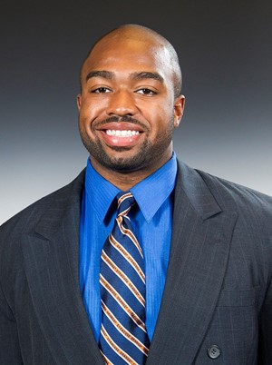
DON SIMMONS JR.
I serve as the Information Literacy Coordinator and Student Engagement Librarian at Westchester Community College in White Plains, NY. My primary responsibility is to elevate the information literacy program and ensure our library instruction is inclusive and engaging for our predominantly student of color population. My work and research also involves the Critical Information Literacy (CIL) framework and its three pillars: Mis-disinformation, Algorithmic Bias, and Information Privilege. I continue to work on evolving CIL lesson planning for one-shot instruction.

Slide 5
“The hidden curriculum consists of values, norms, and beliefs, amongst others, that are not documented or part of the official teaching, but that students are exposed to in the classroom.”
Source: Roussow, N., & Frick, L. (2023, March 27). A conceptual framework for uncovering the hidden curriculum in private higher education. Cogent Education, 10(1)

Slide 6
“The hidden curriculum is the rules of the game that some people get the rulebook for and some other people don’t.”
Source: Replogle, J. (2022, April 26). You Can Succeed At College Once You Figure Out All The Little Things No One Tells You About.

Slide 7
THE HIDDEN CURRICULUM | INTRODUCTION
  First introduced as a concept in 1968 by Philip Jackson and connected with higher education in 1971 by Benson Snyder
  The hidden curriculum exists everywhere. Your institution has it too!
  “University systems actively, though subtly, dictate which interactions and transactions are critical for success ... at issue is that the hidden curriculum perpetuates inequality by only being hidden from some.” *
  Many instructors are unaware of the hidden curriculum and therefore end up perpetuating it with their students
  Students from first generation and lower income (FGLI) backgrounds may struggle when the hidden curriculum requires that they behave in ways that are antithetical to their cultural backgrounds and identity
Source: Laiduc, G., & Covarrubias, R. (2022). Making Meaning of the Hidden Curriculum: Translating Wise Interventions to Usher University Change. Translational Issues in Psychological Science, 8(2), 221-233.

Slide 8
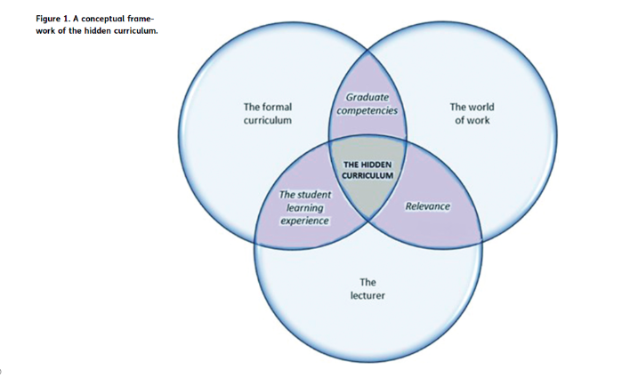
Source: Roussow, N., & Frick, L. (2023, March 27). A conceptual framework for uncovering the hidden curriculum in private higher education. Cogent Education, 10(1)

Slide 9
THE HIDDEN CURRICULUM | PORTELLI
In 1993, John P. Portelli identified four major meanings of the hidden curriculum:
  The hidden curriculum as the unofficial expectations, or implicit but expected messages
  The hidden curriculum as unintended learning outcomes or messages
  The hidden curriculum as implicit messages arising from the structure of schooling
  The hidden curriculum as created by students
Source: Portelli, J. P. (1993). Exposing the hidden curriculum. Journal of Curriculum Studies, 25(4), 343-358.

Slide 10
THE HIDDEN CURRICULUM | GAIR AND MULLINS
Gair and Mullins conducted an empirical study of the hidden curriculum experience in higher education and identified specific themes:
  The hidden curriculum is not hidden at all but is enacted effortlessly in the manner that the university functions on a daily basis
  The physical environment of the university conveys a hidden curriculum
  The hidden curriculum is mediated through human beings
  Certain practices, missions, cultures, perspectives, attitudes and ideologies are regarded as accceptable in a specific institutional environment
Source: Roussow, N., & Frick, L. (2023, March 27). A conceptual framework for uncovering the hidden curriculum in private higher education. Cogent Education, 10(1)

Slide 11

HOW DOES THE HIDDEN CURRICULUM MANIFEST IN HIGHER EDUCATION?
  Independent vs. interdependent models of self
  Understanding faculty office hours
  Eye contact with authority figures
  Debating grades or asking for extensions
  Navigating a syllabus
    Assignment due dates
  Knowing what instructors expect of you
    “The cultural capital that traditional students possess can give them a head start in the “pattern recognition” that allows them to identify professors’ expectations and to respond to them appropriately.”
  Asking for help/burdening others
  “The obscure language of academia”
Source: Collier, P. J., & Morgan, D. L. (2008). Is that paper really due today?’’: differences in first-generation and traditional college students’ understandings of faculty expectations. Higher Education, 55, 425-446

Slide 12
THE HIDDEN CURRICULUM | WHY SHOULD WE CARE?
  Contributes to class stratification and perpetuates systems of inequality
  Leaves FGLI students feeling like they don’t belong/contributes to feelings of imposter syndrome
  Retention and graduation rates
    Approximately 33% of students at 4 year schools are considered first-generation college students
    First generation students are about 8.5 times more likely than continuing generation students to drop out
    Student from middle and upper-class backgrounds graduate at a rate of 57% higher than students from low-income families
  “If higher education is embedded with cultural biases related to race and social class, then ‘at-risk’ students do not have a fair chance to earn college degrees and move up the socioeconomic ladder.” *
Source: Smith, B. (2013). Learning at the Margins. In B. Smith, Mentoring At-Risk Students Through the Hidden Curriculum of Higher Education (pp. 17-53).

Slide 13

SOME SUGGESTIONS
  Create assignments that encourage help-seeking behaviors or require different types of campus engagement
  Be transparent about expectations
  Consider the language you use--is it unnecessarily formal/archaic?
  De-stigmatize the use of office hours and related resources
    Asking for help is NOT a sign of weakness!
  “The end goal is not assimilation”

Slide 14
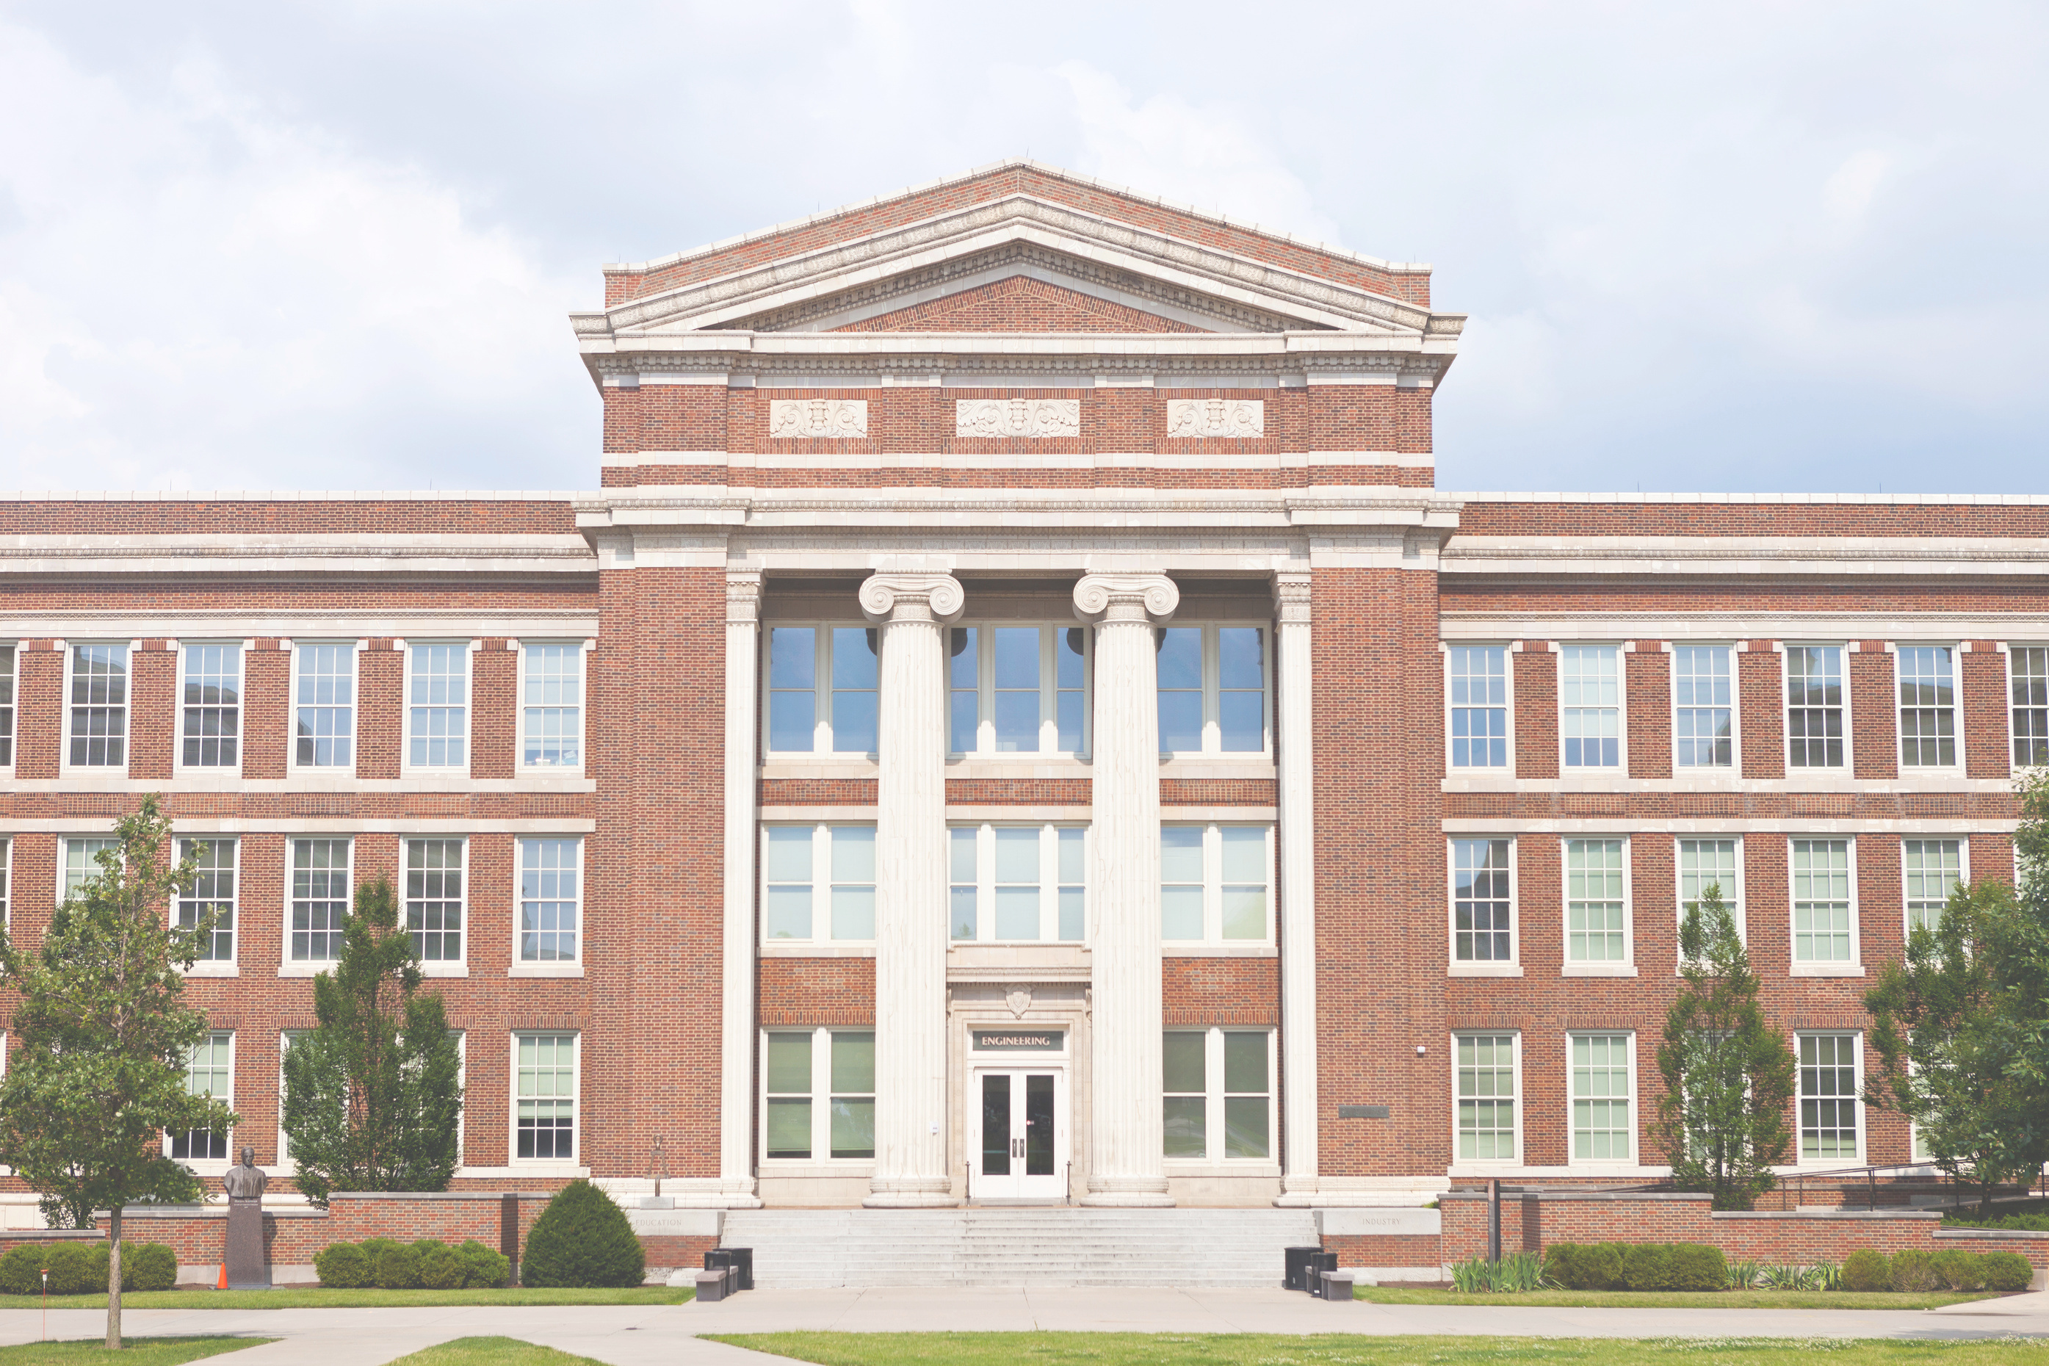
UP NEXT:
How does the hidden curriculum affect
one-shot information literacy instruction?

Slide 15
THE ONE-SHOT INSTRUCTION MODEL
  Originally called "bibliographic instruction" in the 1980s
  Academic librarians began taking on instructional roles in the 1990s, leading to the development of the one-shot model (Martin & Jacobson, 1995)
  One-shot model is now a primary instructional method in academic librarianship – offers focused information literacy (IL) skills within a limited timeframe
  Facilitates collaboration between librarians and faculty – provides students direct access to subject matter expert librarians who can align resources with course requirements
  However, one-shots often lack depth in fostering critical thinking and inclusive teaching methods

Slide 16
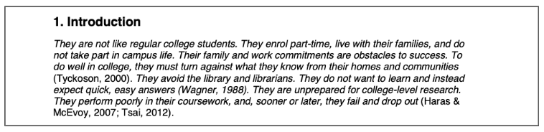
LIS LITERATURE | THE DEFICIT MINDSET
Source: Ilett, D. (2019). First-generation students’ information literacy in everyday contexts. Journal of Information Literacy, 13(2), 73–91. http://dx.doi.org/10.11645/13.2.2675

Slide 17
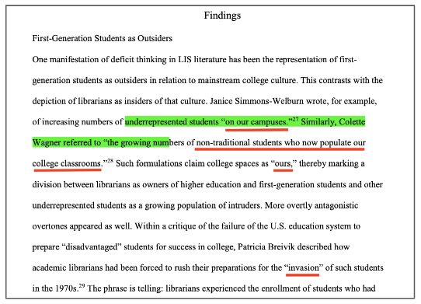
Source: Ilett, Darren, "A Critical Review of LIS Literature on First-Generation Students" (2019). University Libraries Faculty Publications. 65. https://digscholarship.unco.edu/libfacpub/65

Slide 18
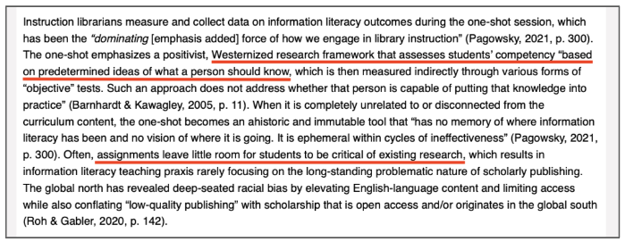
THE ONE-SHOT | HIDDEN CURRICULUM
  Westernized research framework: Assumed standards for student knowledge
  One-shot coupled with deficit model – hinders FGLI students with critical thinking and information retrieval
  “Because education is about affect, emotion, and beliefs as well as knowledge, because it is about sociocultural practices and not just cognitive skills, transactional one-shots can never truly be transformational” (Nicholson & Seale (2022)
Source: Nataraj, L., & Siqueiros, A. (2022). “Slow Your Roll”: Making Time for Reflection and Diverse Epistemic Practices in Library Instruction. College & Research Libraries, 83(5). https://doi.org/10.5860/crl.83.5.819

Slide 19

PROPOSED SOLUTIONS
  Self-education – cultivating critical awareness through the “Cultural Competence Framework”
  Culturally Responsive Teaching

Slide 20
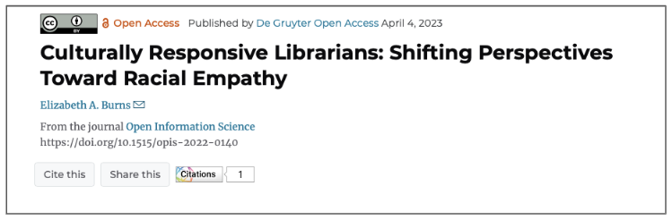
SELF EDUCATION “CULTURAL COMPETENCE FRAMEWORK” (BURNS, 2022)
  Cultivate Sociocultural Awareness: Reflect on biases, both explicit and implicit
  Foster Interpersonal Awareness: Develop empathy and understanding
  Embrace Responsibility for Change: Create a personal improvement plan with actionable steps and measures for progress
  Advocate Through Voice and Action: Be an agent of change
Source: Burns, E. A. (2023). Culturally responsive librarians: Shifting perspectives toward racial empathy. Open Information Science 7(1), 1-16. https://doi.org/10.1515/opis-2022-0140

Slide 21
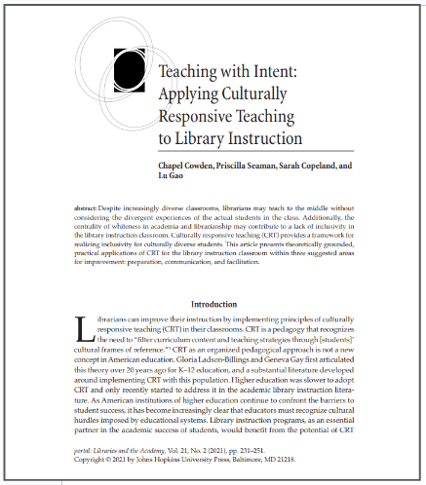
CULTURALLY RESPONSIVE TEACHING (CRT)
  CRT acknowledges the necessity to tailor instructional content and pedagogical strategies to students’ cultural perspectives (Cowden et al., 2021).
  Draws from critical pedagogy, multiculturalism, feminist pedagogy, and other theories
  Cowden et al. (2021) offers strategies for integrating CRT into library instruction, emphasizing librarian preparation, communication, and facilitation during one-shot sessions – also proposes simple adjustments like pre-class reflection and culturally sensitive preparation to improve self-awareness skills and overcome traditional one-shot limitations
Source: Cowden, C., Seaman, P., Copeland, S., & Gao, L. (2021). Teaching with Intent: Applying Culturally Responsive Teaching to Library Instruction. portal: Libraries and the Academy 21(2), 231-251. doi:10.1353/pla.2021.0014

Slide 22
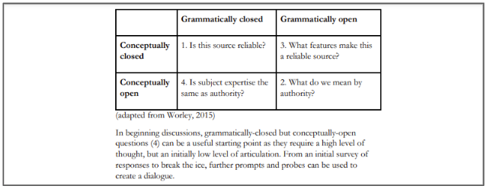
Source: Flynn, D. (2021). Integrating Critical Teaching Practices into the One-Shot Library Classroom. Critical Library Pedagogy in Practice (pp. 30-66). Innovative Libraries Press. https://eprints.leedsbeckett.ac.uk/id/eprint/8110/

Slide 23
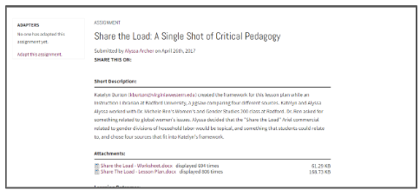
Source: Archer, A. (2017). Share the Load: A Single Shot of Critical Pedagogy. Project Cora; Community of Online Research Assignments. https://projectcora.org/assignment/share-load-single-shot-critical-pedagogy

Slide 24
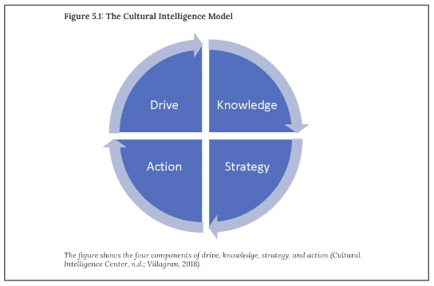
Source: Saunders, L., & Wong, M. (2020). Instruction in Libraries and Information Centers. In iopn.library.illinois.edu. Windsor & Downs Press. https://iopn.library.illinois.edu/books/windsor-downs/catalog/book/12

Slide 25
Any questions?

Slide 26


Interested in reading more
about the hidden curriculum
and one-shot instruction?
Scan the QR code for a
complete list of resources!

