Slide 1
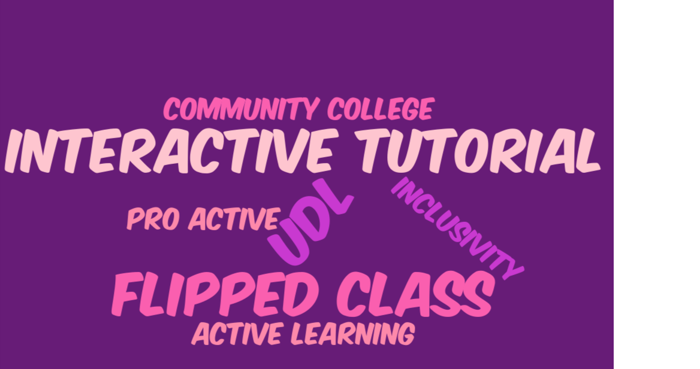
Madeline Ruggiero
Librarian/Assistant Professor
Queensborough Community College
mruggiero@qcc.cuny.edu

Slide 2
Grant study on video vs. interactive tutorial
Grant helped fund UDL design consultation with author
Tom Tobin

Slide 3
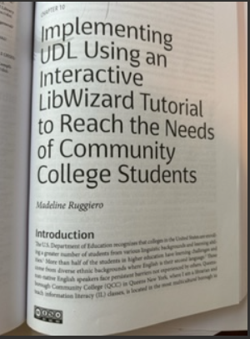
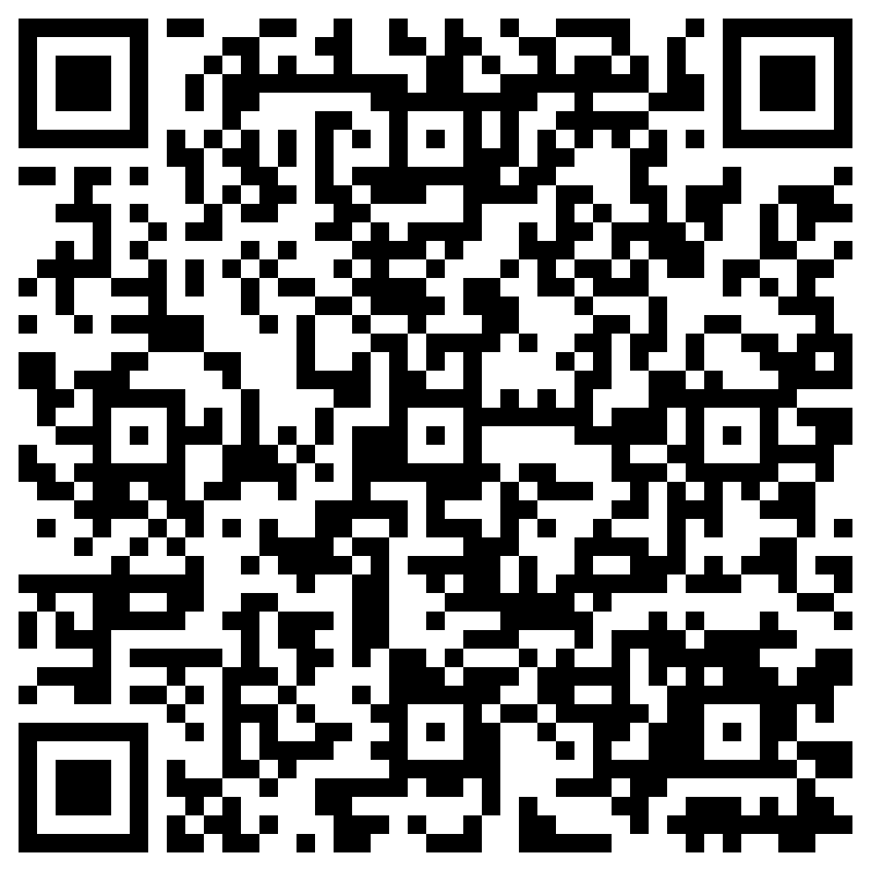
ACRL 2024 Book Chapter
CH10. Implementing UDL Using an Interactive LibWizard Tutorial to Reach the Needs of Community Colle.pdf

Slide 4
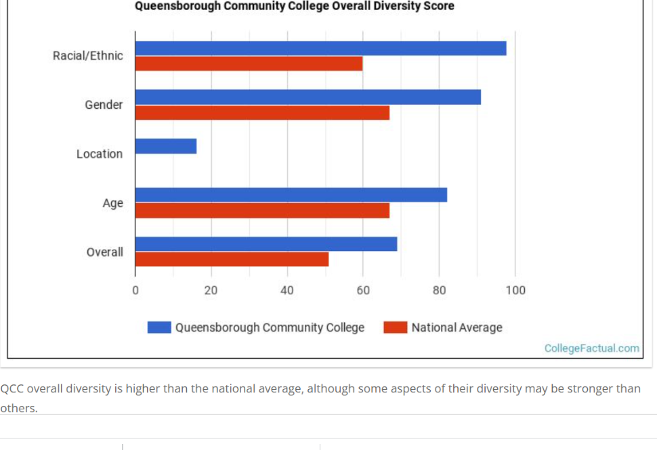

Slide 5
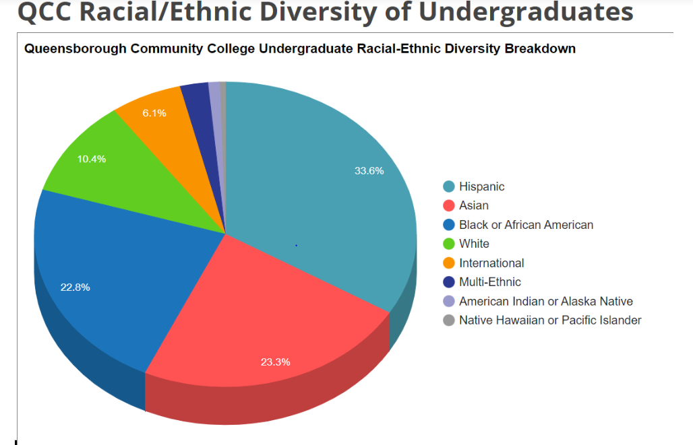

Slide 6
Enhancing Information Literacy (IL) Classes with Tutorials
Research studies provide evidence that online library tutorials can be as effective as in-person library instruction.
Hartog, P.. A. (2018). Online tutorials: a literature review. The Christian Librarian, 61(2), p. 226.

Slide 7
Interactive tutorials are a trend in IL
Student control
Student engagement
Self-pacing

Slide 8
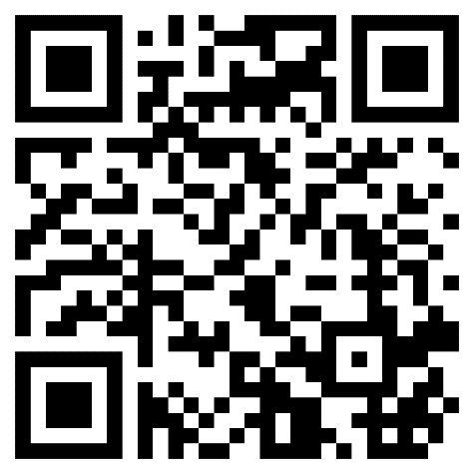
Interactive tutorials proven to be more effective than video
“Students performed much better in recreating tasks when they used a static web page with screenshots than they did after viewing a screen casting tutorial.”
McGuiness, C & Fulton, C. (2019). Digital literacy in higher education: a case study of student engagement with e-tutorials using blended learning. Journal Of Information Technology Education: Innovations in Practice, p.5.
https://www.youtube.com/watch?v=HoCOFVikd-I&t=4s

Slide 9
Best practices for creating successful online interactive tutorials
Universal Design for Learning Principles (UDL)
Bite sized modules
Interactivity
Multimedia
Harding, J & Shepherd, R. (2020). The lifecycle of a research tutorial: from concept to implementation and beyond. Journal of Electronic Resources Librarianship, 32(1), p.30. https://doi.org/10.1080/1941126X.2019.1709734

Slide 10
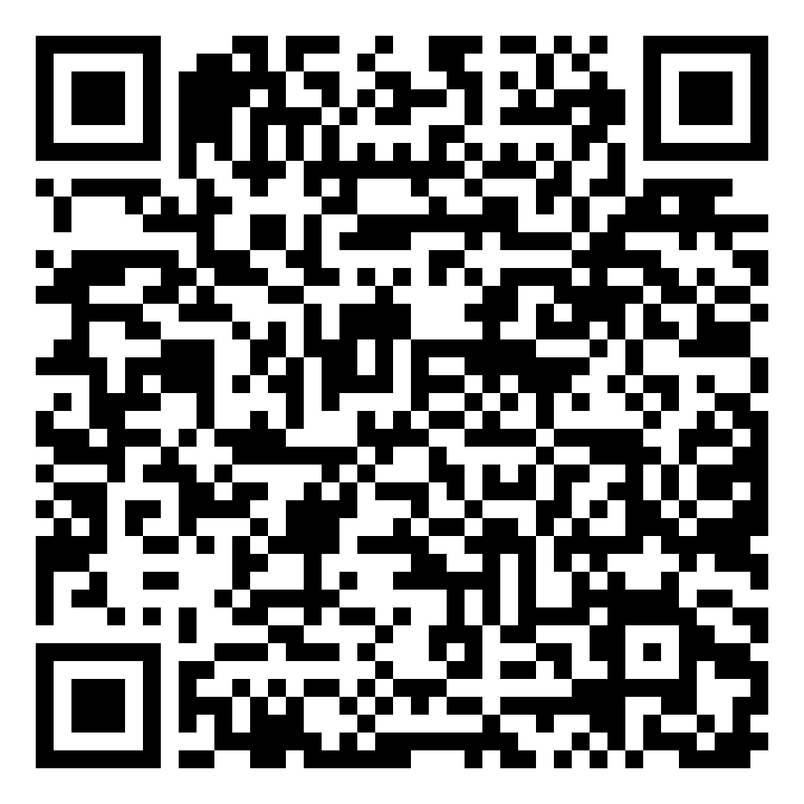
LibWizard Interactive Tutorial & UDL
Universal Design for Learning (UDL) outcomes through
Multiple means of engagement and representation
https://udlguidelines.cast.org/

Slide 11
Interactive tutorial design achieves UDL outcomes
Engage students and provide active learning
Information is given in small segments and allows viewers to choose a section for quick review
Such chunking can reduce cognitive overload, enabling users to process information more effectively (McGuinness & Fulton, 2019, p. 7).

Slide 12
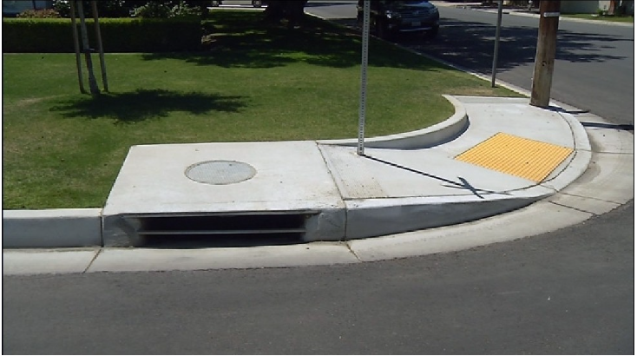
Curb Cuts How Universal Design Makes things better for everyone

Slide 13
Center for Applied Special Technology
https://udlguidelines.cast.org/

Slide 14
Equity and accessibility to mainstream education are tacit outcomes
Clear goals for engagement
Offering alternative ways to represent content
Using multiple media for communication
Allowing for formative assessment
Feedback

Slide 15
Core goal of CAST
Develop self-efficacy
Confidence
Motivation

Slide 16
UDL Offers a Flexible Approach to Learning

Slide 17
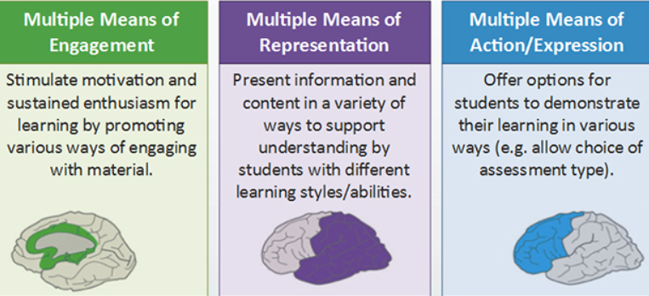
UDL Uses Brain Research to Understand How Learners Learn
Developed by CAST

Slide 18
Parts of the UDL framework
UDL Language
Representation, Engagement, Action/Expression are "principles."
The three high level points underneath each principle are "guidelines."
Underneath the guidelines are "checkpoints.”

Slide 19
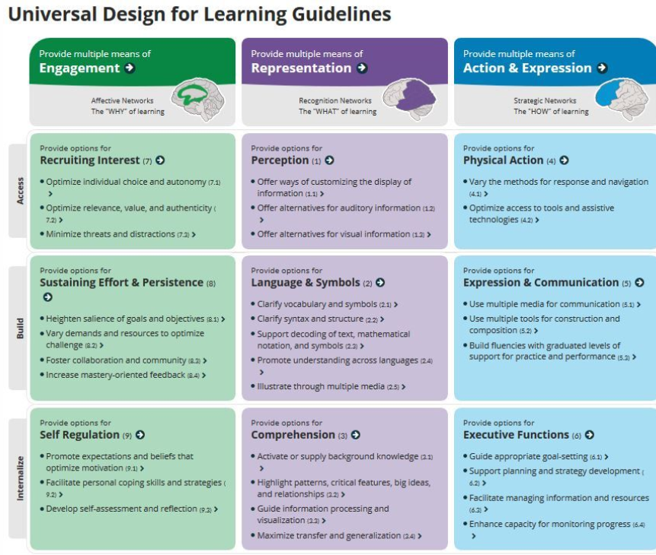
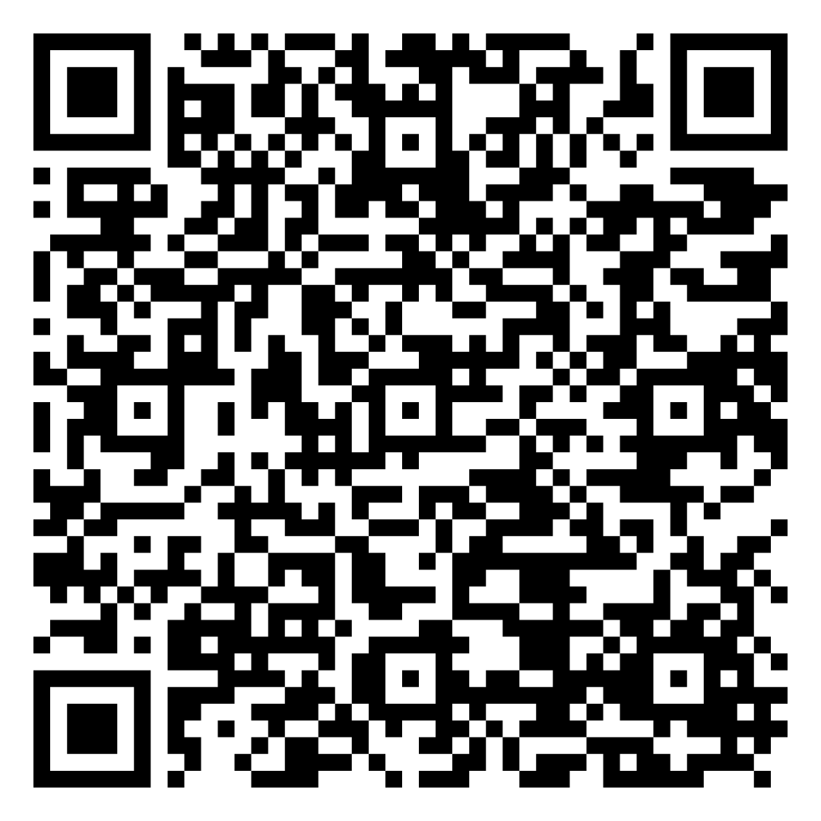
https://udlguidelines.cast.org/engagement/recruiting-interest/threats-distractions/threats-distractions-research

Slide 20
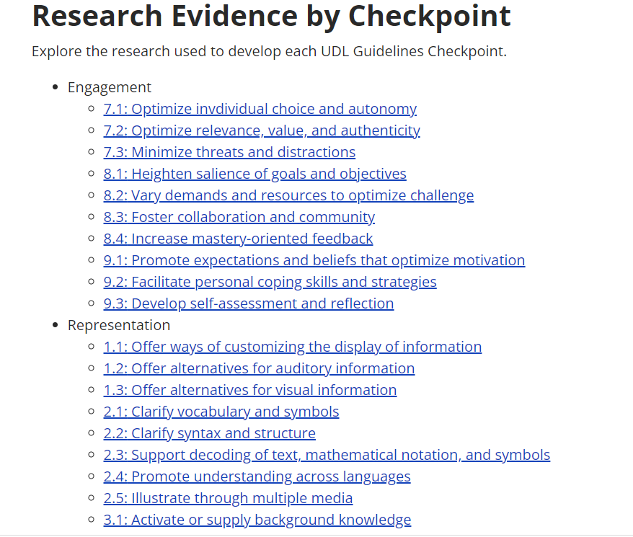

Slide 21
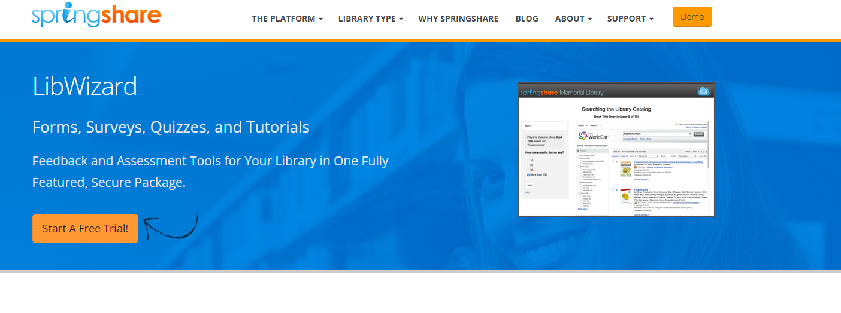
Springshare’s LibWizard: a subscription based tutorial

Slide 22
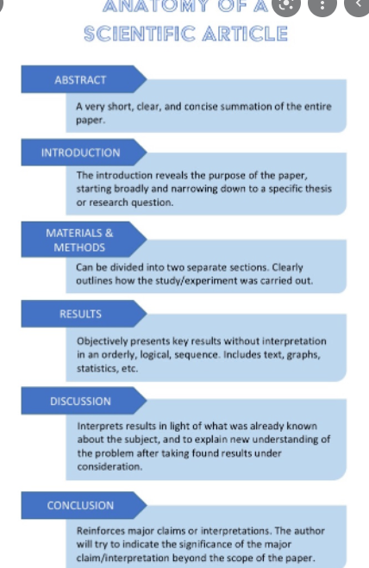
Learn the Six Components of a Scientific Article

Slide 23
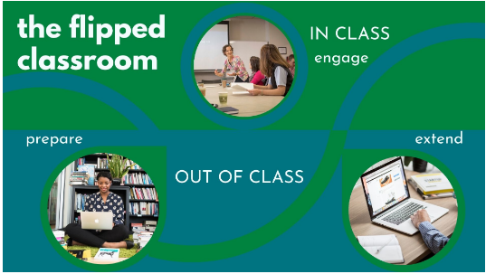
Students Practice what they Learned Outside of the Class During a Flipped Class

Slide 24
Flipped Class Benefits Students Who Need Help with Assignments

Slide 25
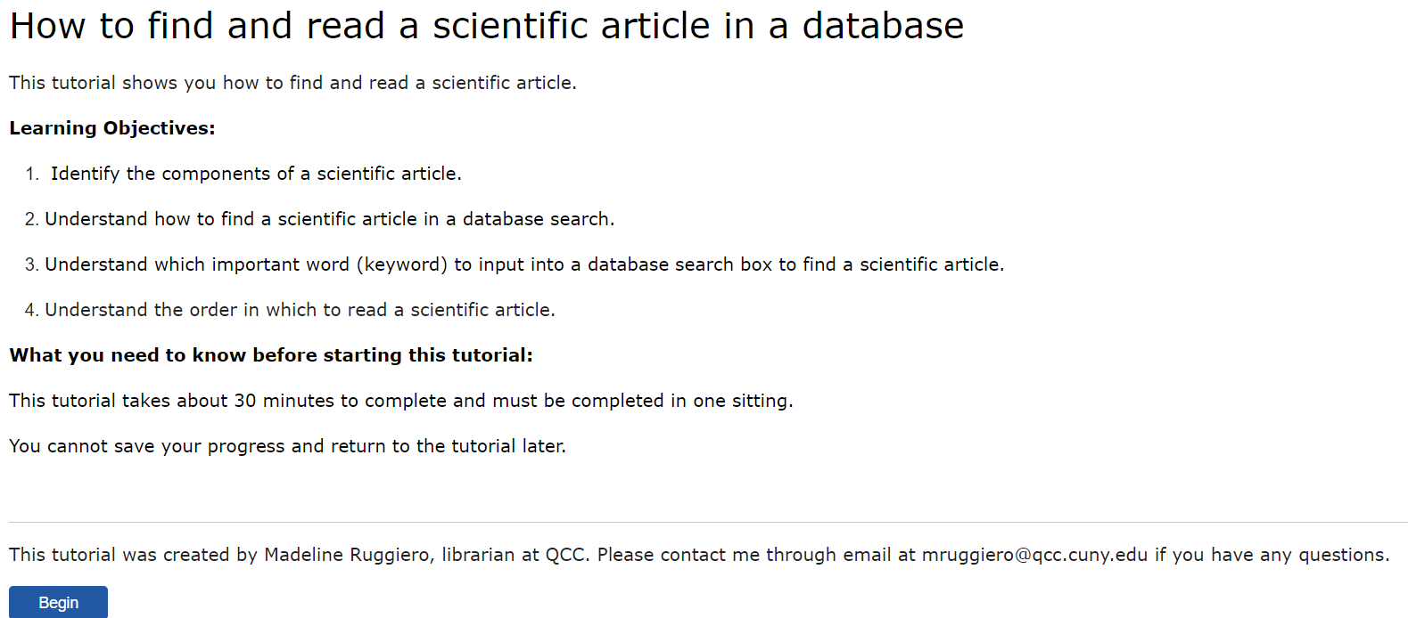
Landing page of the tutorial

Slide 26
Offer at least two ways to access the information in the tutorial
Videos uploaded to Youtube with closed captioning (CC) and transcripts can be embedded
CC option if language is not clear or speaker is fast paced
This reflects Checkpoint 1.2(offer alternatives for auditory information)
https://udlguidelines.cast.org/engagement/recruiting-interest/threats-distractions/threats-distractions-research

Slide 27
Modules

Slide 28
Modules provide info in small blocks
Details are segmented into parts
Step by step acquisition of skills
Avoid cognitive overload

Slide 29
Explicit instructions and content presented in small modules

Slide 30
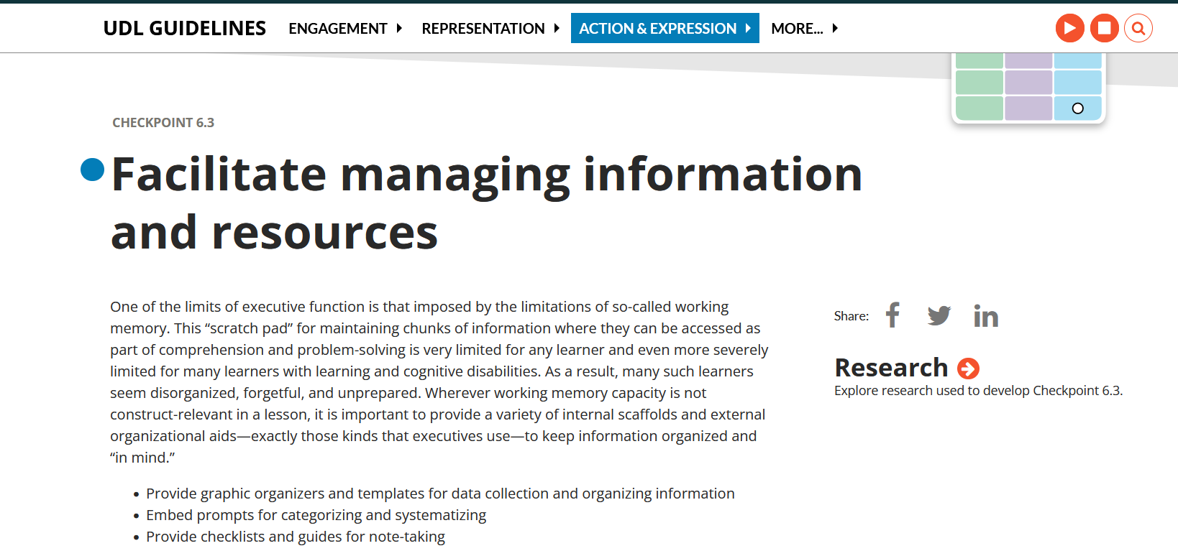

Slide 31
Tutorial begins with a Welcome Video that sets a positive tone, presents expectations, and clarifies the importance of the tutorial

Slide 32
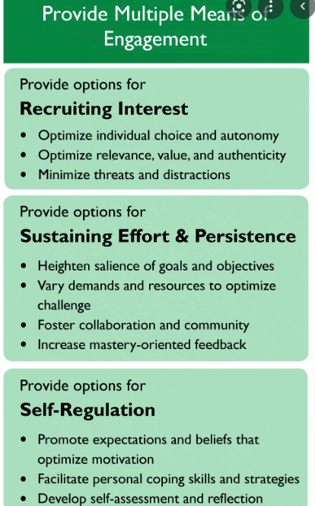
Purposeful Engagement: Optimize Relevance, Promote expectations and beliefs that optimize motivation
Minimize threats and distractions:
Create a Sense of Belonging
Heighten Salience of Goals & Objectives: Purpose or Value
Promote beliefs that optimize motivation: growth mindset

Slide 33
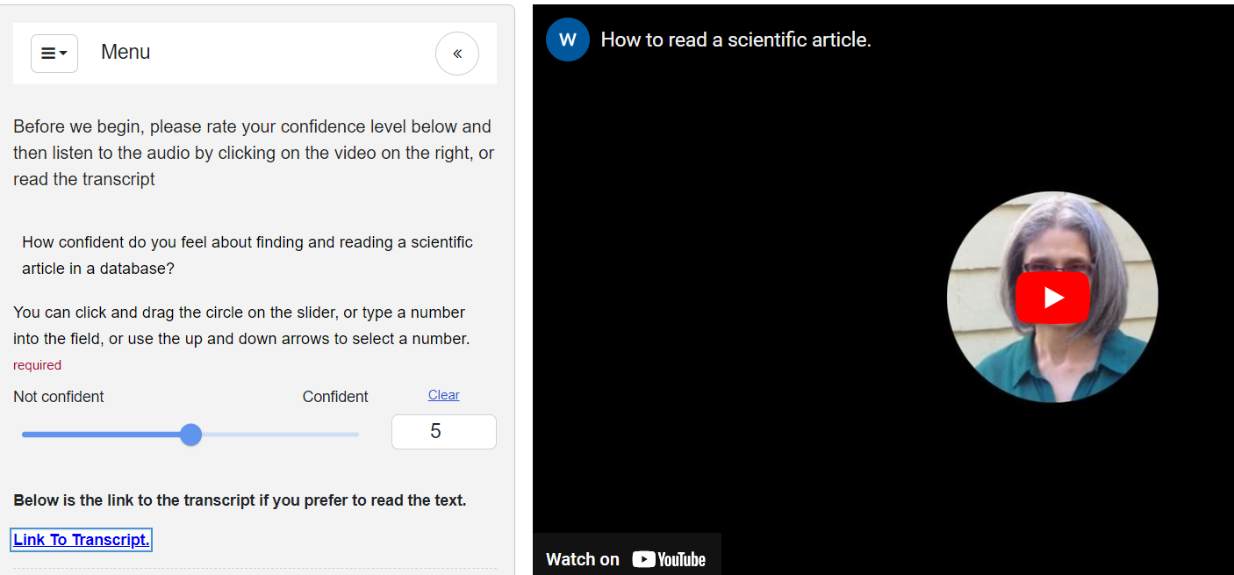
Welcome Video Embedded

Slide 34
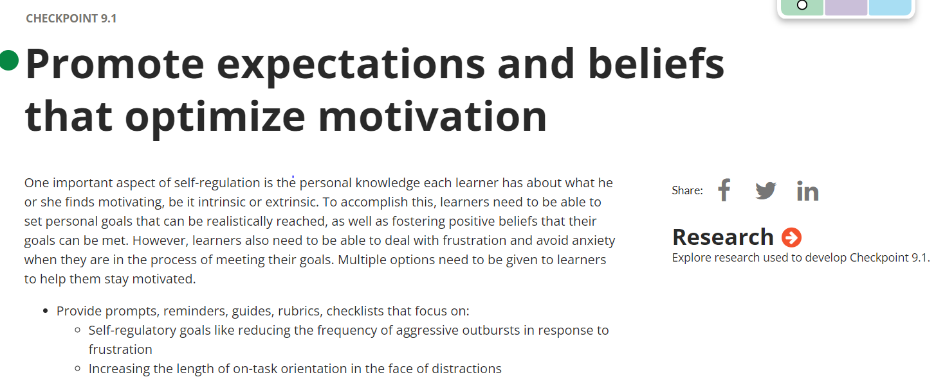
https://udlguidelines.cast.org/e/threats-distractions-research

Slide 35
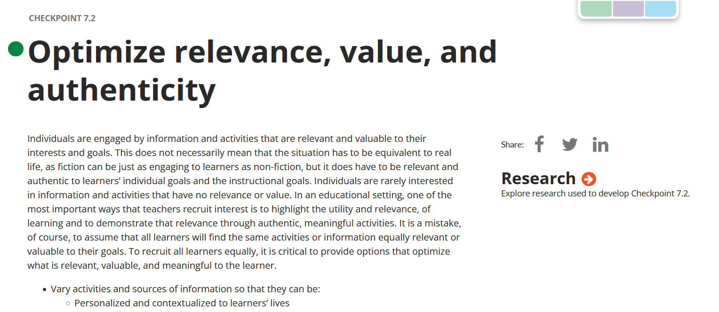

Slide 36
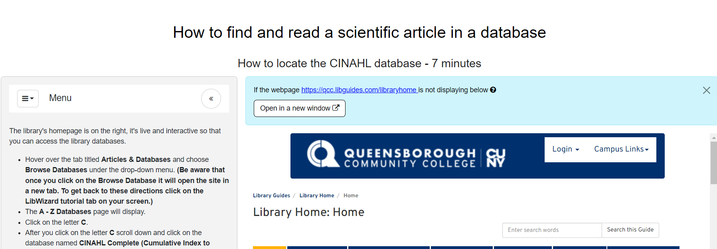
How to find a scientific article in a nursing database

Slide 37
Example of a scientific article

Slide 38
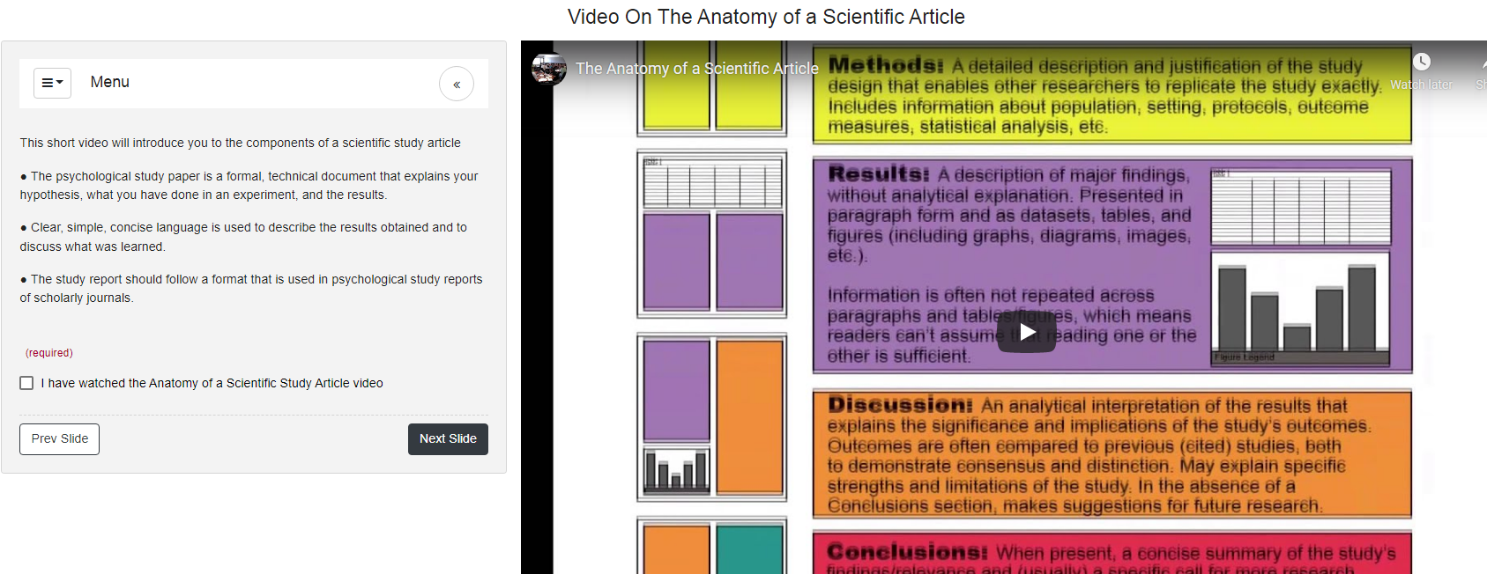
Embedded video on the anatomy of a scientific article

Slide 39
Quiz on contents discussed in the video

Slide 40
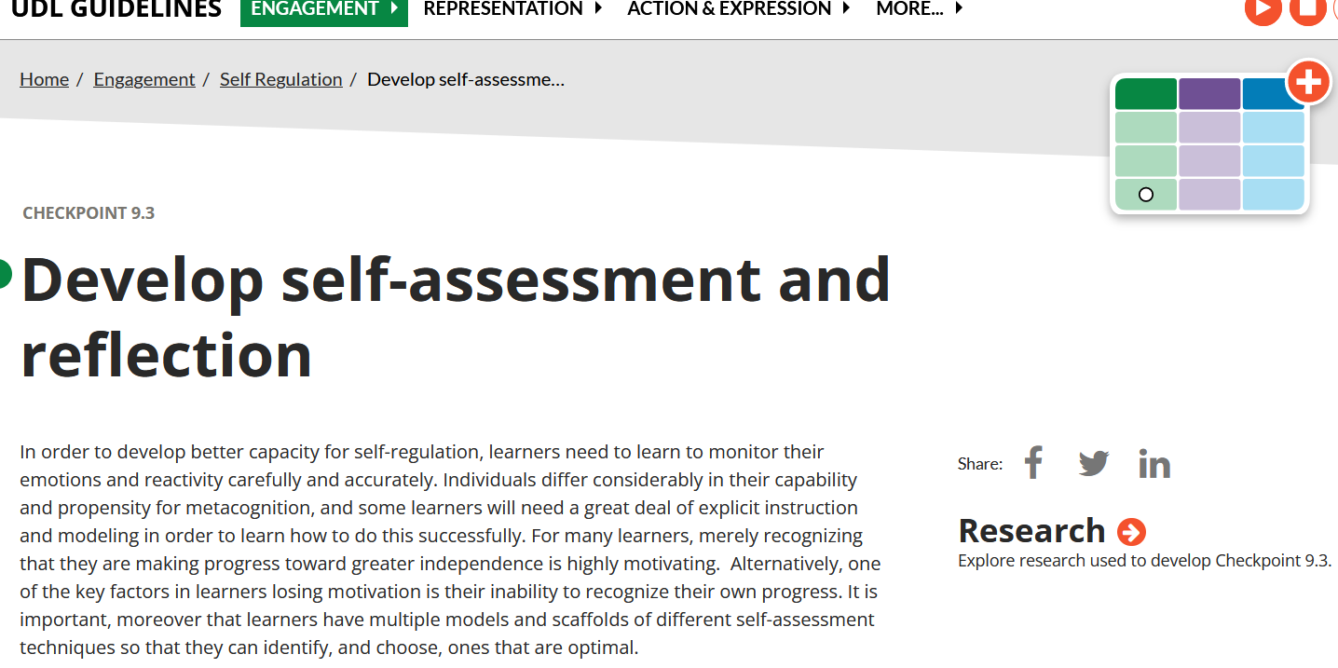
Ability for students to gain instant feedback

Slide 41
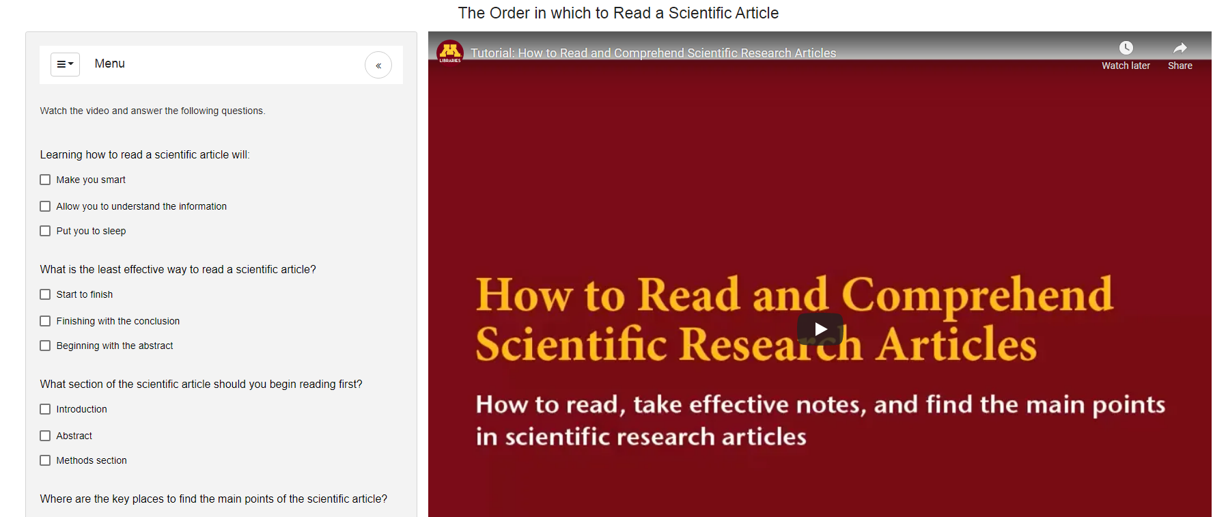
Video and quiz on the order in which to read a scientific article

Slide 42
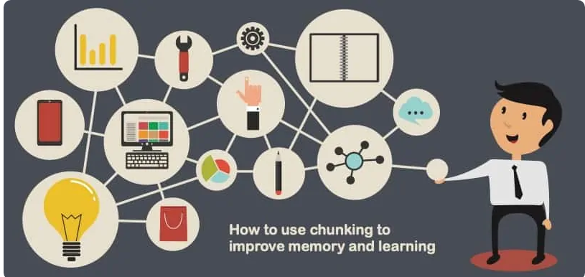
Use Chunking to Improve Memory and Learning

Slide 43
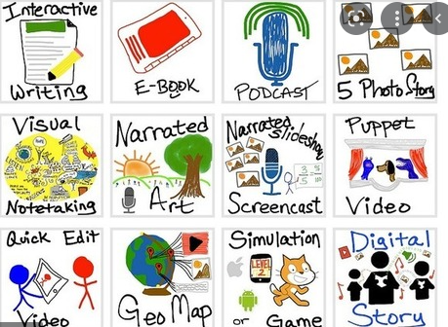
Content Presented in Multiple Formats

Slide 44
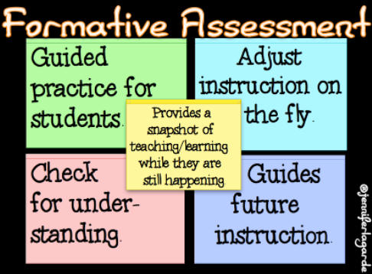
Non Graded Quizzes

Slide 45
LibWizard Limitations
HTML iframes cannot be displayed within the LibWizard tutorial. This varies within each institution. The live webpage will pop up in another window and students must go back and forth to follow directions. Students will need to tab back and forth to view the remaining directions on how to interact with the tutorial. Librarians need to work with their Information Technology department to update the site to allow for iframe display.
Tutorials are optimized for use on larger screens and not the ubiquitous smartphones. Since this required feature for engaging with the tutorial on the ever-present smartphone has gathered several votes, Springshare is working on a more responsive solution

Slide 46
LibWizard Interactive Tutorial
How to Find and Read a Scientific in a Database
https://qcc.libwizard.com/f/scientific_article_copy_copy

Slide 48
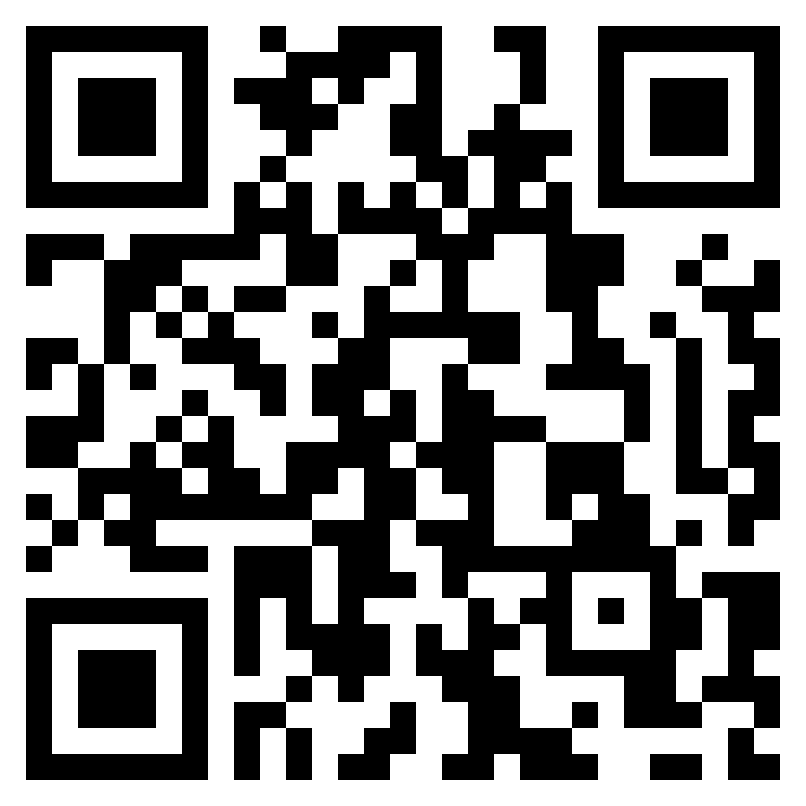
LibWizard Interactive Tutorial/Grant Study
How to Find and Read a Scientific Article in a Database
for nursing students
https://qcc.libwizard.com/f/scientific_article

Slide 49
References
Bray, Barbara and Kathleen McClaskey, Make Learning Personal, London: Sage Publications, 2015.
Burgstahler, Sheryl E. Creating Inclusive Learning Opportunities in Higher Education: A Universal Design Toolkit, Harvard Education Press, 2020.
Harding, J & Shepherd, R. (2020). The lifecycle of a research tutorial: from concept to implementation and beyond. Journal of Electronic Resources Librarianship, 32(1), 29-35. https://doi.org/10.1080/1941126X.2019.1709734
Meyer, Anne, Rose, David H. and Gordon, David. Universal Design for Learning: Theory and Practice, CAST, 2014.
National Center for Education Statistics Blog Editor. “New Report Shows Increased Diversity in U.S. Schools, Disparities in Outcomes.” NCES BLOG, June, 20, 2019
https://nces.ed.gov/blogs/nces/post/new-report-shows-increased-diversity-in-u-s-schools-disparities-in-outcomes
Queensborough Community College. “QCC Demographics and Diversity Report.” College Factual, 2022. https://www.collegefactual.com/colleges/cuny-queensborough-community-college/student-life/diversity/
Rose, David H. Anne Meyer, and Chuck Hitchcock, The Universally Designed Classroom: Accessible Curriculum and Digital Technologies, (Harvard Education Press, 2005).

Slide 50
References continued
Ruggiero, Madeline. “Scientific Study Article.” LibWizard Interactive Tutorial, June, 2020.
https://qcc.libwizard.com/f/scientific_article
Ruggiero, Madeline. “Using an Interactive Tutorial to Achieve Inclusivity in a Flipped Information Literacy Class.” Inclusive & Equitable Pedagogies, ACRL, 2022.(anticipated)
https://inclusiveeducationplanning.com.au/uncategorized/learning-styles-versus-universal-design-for-learning-udl/
https://qcc.libwizard.com/f/scientific_article_copy_copy This is the interactive tutorial on how read and find a scientific article without the surveys I gave students.
https://qcc.libwizard.com/f/scientific_article This is the interactive tutorial on how read and find a scientific article with the inclusion of the the surveys I gave students.

Slide 51
Reflection Prompts:
Things I want to try.
New facts I learned.
Things I am wondering.
One thing that resonated the most with me.
I used to think…now I think…
The most important idea I can take away.
One question I still have.

Slide 52
Fist to Five Reflection Signal
How well do you understand the material?
How well do you think you could incorporate this into your setting tomorrow? Next week?

Slide 53
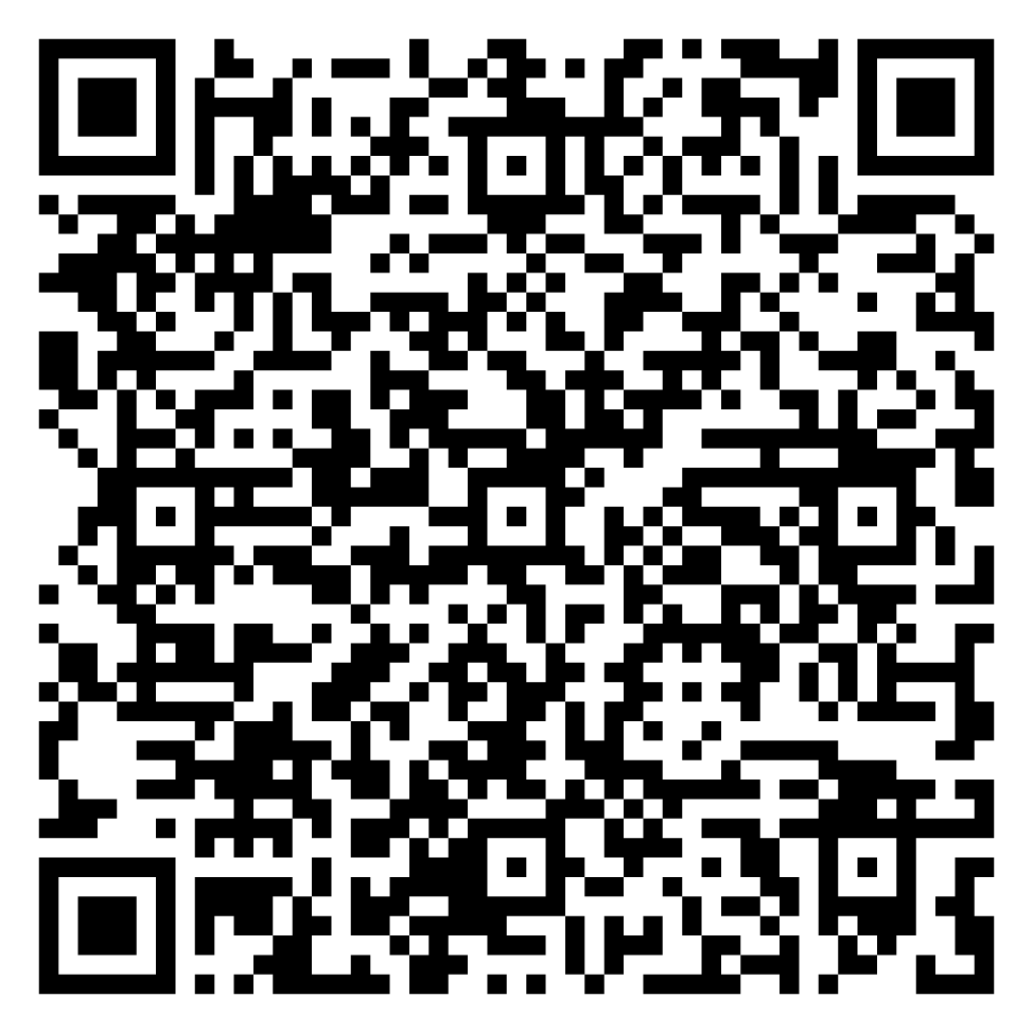
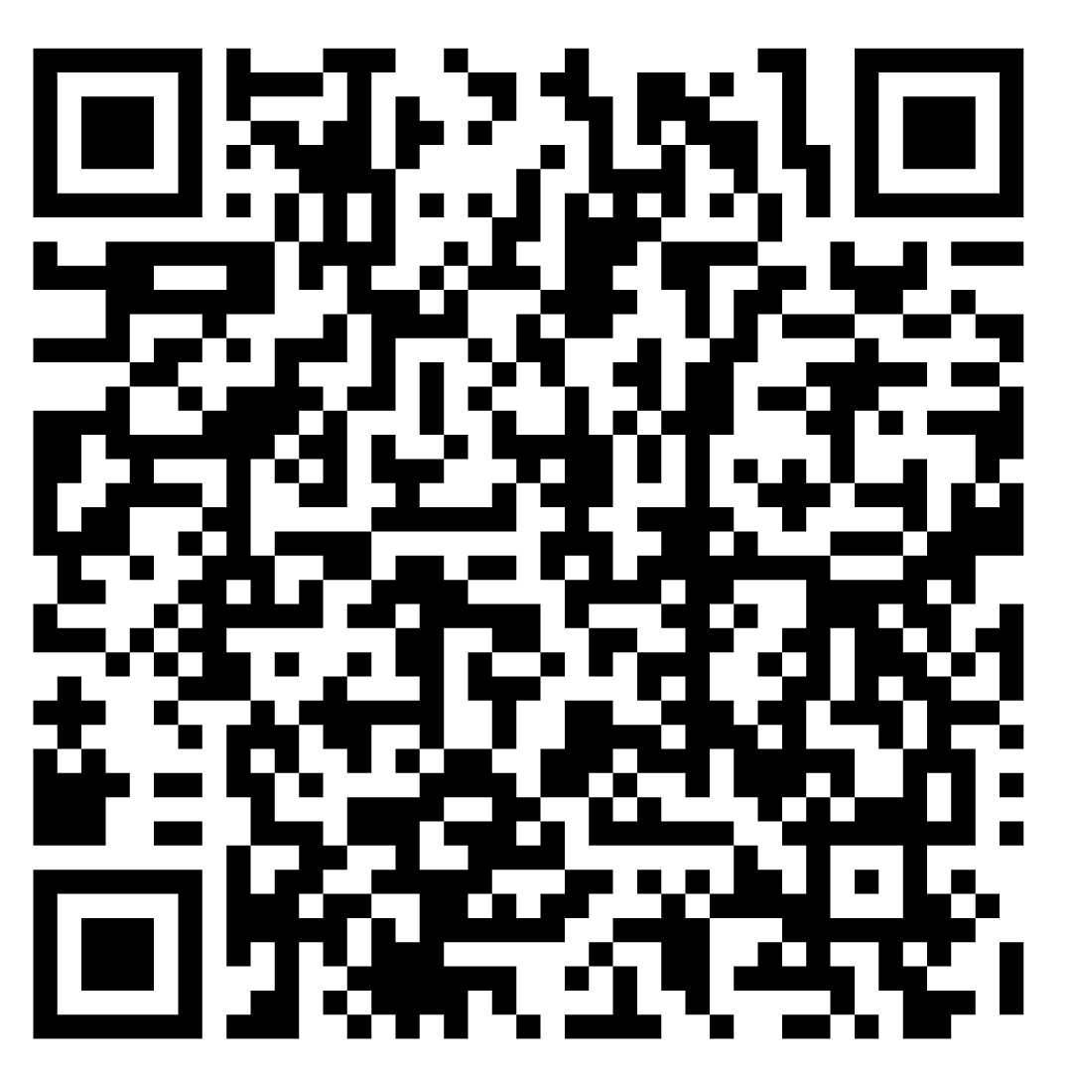
SLIDE DECK
PRESENTATION PAPER

