Slide 1
LOEX 2024 Presentation
Program Track: Planting Seeds: Pedagogy and Instructional Design
Strengthening our Roots:
Cultivating Belonging in the Library Instruction Classroom through an Inclusive Pedagogy Teacher Training Program
Christine Mueller
Instruction & Reference Librarian
Xavier University Library

Slide 2
Abstract
Grow your teaching practices to new heights! Learn how a librarian training program sprouted from an inclusive pedagogies project and bloomed into library instruction workshops for teaching librarians. Using a LibGuide on inclusive pedagogies as the focus, attendees will be shown tools to develop best practices in library instruction sessions for incorporating multiple inclusive pedagogies, as well as how these practices work in tandem with active learning strategies. Learn how to strengthen your own instructional design practices and grow a librarian training program that applies inclusive pedagogies to foster engagement and belonging in the classroom.

Slide 3
Outline
Overview of presentation
How librarian training initiative started “Workshops”
Faculty Learning Community on UDL. LibGuide created as training tool
Define inclusive pedagogies
LibGuide evolved from simply UDL into inclusive pedagogies
Description of each pedagogy
Engaged Learning works in tandem with inclusive pedagogies
Instructional Design reflection worksheet
Post-reflection after teaching a session
LibGuide evolved into training course for instruction librarians
What’s Next

Slide 4
Learning Outcomes
1. Participants will learn how to develop and conduct a teacher training program for instruction librarians.
2. Participants will learn about a variety of inclusive pedagogies and how to apply them to library instruction lesson plans.
3. Participants will learn how active learning techniques promote belonging in the library instruction classroom.

Slide 5
Description
As campuses continue to evolve teaching practices that foster a sense of belonging among students, this presentation will show how a librarian training program was developed to enhance instructional design with the incorporation of inclusive pedagogical principles.
As a member of a Faculty Learning Community on Universal Design for Learning, the presenter created a LibGuide on inclusive pedagogies and turned the information into a series of workshops designed to improve the role of teaching librarians.

Slide 6
Library Instruction for Librarians LibGuide
LibGuide created as a library instruction training tool
  LibGuide began as inclusive pedagogies (UDL, CRT, critical information literacy)
  LibGuide evolved into full training course for library instruction for librarians
  LibGuide evolved into training workshops for librarians to apply to their teaching

Slide 7
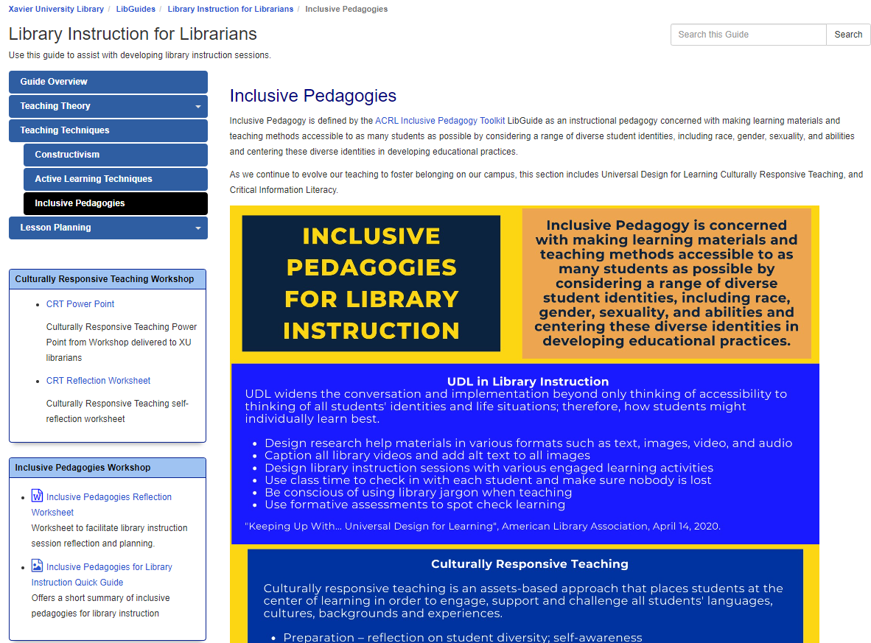
Library Instruction for Librarians LibGuide
https://libguides.xavier.edu/LibraryInstructionforLibrarians

Slide 8
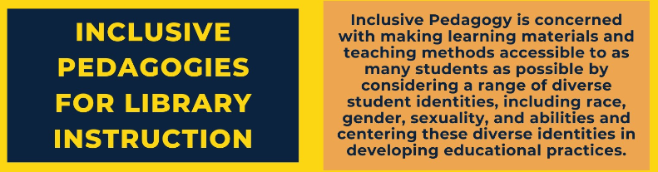
Inclusive Pedagogies Definition
Inclusive for all students
Considers divergent experiences of students
Fosters a sense of belonging
Requires self-reflection on own experiences

Slide 9
Various Inclusive Pedagogies
Universal Design for Learning
Culturally Responsive Teaching
Critical Information Literacy

Slide 10
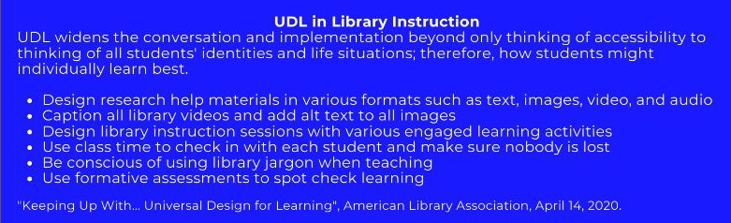
Universal Design for Learning

Slide 11
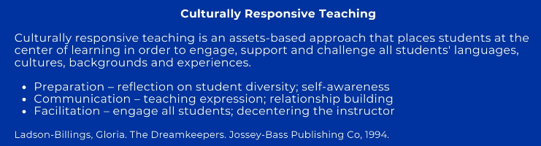
Culturally Responsive Teaching

Slide 12
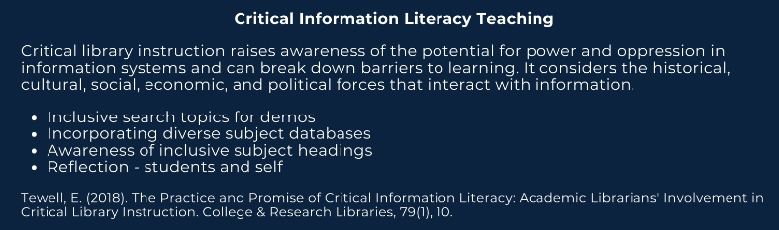
Critical Information Literacy

Slide 13
Engaged Learning Techniques
What is Active Learning?
Active learning is an instructional approach in which students actively participate in the learning process, as opposed to sitting quietly and listening. Active learning builds on constructivist learning theory, which posits that people learn by connecting new ideas and experiences to what they already know.
Why Active Learning?
Research shows that active, social, contextual, engaging and student-owned learning experiences lead to better learning outcomes.
We also know that students begin to lose their attention after about 10 minutes of lecture, so sequence your lesson to balance lectures and demonstrations with an activity. Ideally, for an hour long instruction session, 2-3 activities will help with student engagement.
Furthermore, inclusive pedagogies included in this guide work beautifully in conjunction with engaged learning techniques to foster a sense of belonging among students.
Hicks, A., & Sinkinson, C. (2021). Participation and Presence: Interrogating Active Learning. portal: Libraries and the Academy 21(4), 749-771. https://doi.org/10.1353/pla.2021.0040.

Slide 14
Inclusive Pedagogies Reflection
Incorporating inclusive pedagogy requires intentionality and reflection.
Self-Reflection
Identify own background, biases, educational and cultural experiences (see Culturally Responsive worksheet)
Write personal statement about who you are and your own inclusivity statement for use in classroom introductions
Instructor Communication
Ask about class dynamics and accommodations
Ask if using inclusive pedagogies in class
Ask about course assignments and topics students are exploring
Class Content Considerations
Identify databases in your subject area that provide diverse perspectives
Think of diverse examples to use in search strategies
Discussing critical questions of authority and exclusion in sources
Familiarize yourself with active learning techniques that you are comfortable delivering to make session student empowering
Build formative assessments into session to ensure that all students are learning content
Classroom Management
Introduce self, including own experiences and positions
Ask students what they find challenging about library research
Use inclusive language and pronouns; call students by name when possible
Reduce use of library jargon
Be prepared to pivot if inclusive topics become problematic for the students
Offer ways to obtain research help after the class session

Slide 15
Post-session Reflection
Did I reflect on my privilege, biases and assumptions?
Did I communicate with the course instructor regarding inclusion in their classroom? Were there ability or language concerns?
Did I introduce myself? Did I share an inclusion statement with the class?
Did I allow time for students’ concerns and values to be heard?
Did I establish trust so the students felt safe to share out?
Did I try to gauge students’ prior knowledge?
Did I explain jargon?
Did I use inclusive examples?
Did I use multiple modes of content representation (verbal, visual, physical or electronic handouts)?
Were critical information literacy topics introduced and/or discussed? If so, how were difficult conversations or controversies handled?
How was privilege present in the room? Were discussions, participation, group activities and topics selected equitable?
Did I use active learning? Which techniques were effective; which fell flat? Something to try differently next time:
Did I incorporate “spot checking”, formative, assessments?
Did I allow time for student questions?
Did I offer to the instructor to add library resources to the course to make research easier for the students?
Did I share my experience with fellow librarians, consult with supervisor or the instruction librarian? Would such debriefing be helpful?
Prescott, M.K. (2016). Using Personal Reflection to Incorporate Antiracist Pedagogy in Library Instruction. In N. Pagowsky & K. McElroy (Eds.) Critical library pedagogy handbook (pp. 217-221). Chicago, IL: Association of College and Research Libraries.

Slide 16
Teacher training workshops for librarians
Lesson planning using instructional design
Engaged learning techniques
Accessibility for LibGuides
Culturally Responsive Teaching
Inclusive Pedagogies

Slide 17
What’s next?
Workshop time for librarians to apply:
  inclusive pedagogies into lesson plans
  active learning techniques into teaching
  accessibility to LibGuides
Individual consultations with Instruction Librarian
Library instruction sharing workshop:
  What did you try?
  What worked, what didn’t?
  Teaching reflection worksheet

Slide 18
Thank you!
Christine Mueller, MEd, MLIS
Instruction & Reference Librarian
Xavier University Library
muellerc@xavier.edu

