Slide 1
Counting Words: Harnessing Text Mining for Information Literacy Purposes
Abigail Mann
Digital Scholarship Librarian
Illinois Wesleyan University

Slide 2
In Today’s Workshop we’ll….
Learn what Text Mining is and use Voyant to….
Analyze an article to identify key terms and topics as a means to identify further paths for research.
Effectively read a scholarly article.
Make data sets out of non-traditional sources
Thinking about how using these tools may help students become more AI-literate
There will be time for questions and discussion at the end of the session, but please do ask and muse as we go through these activities!

Slide 3
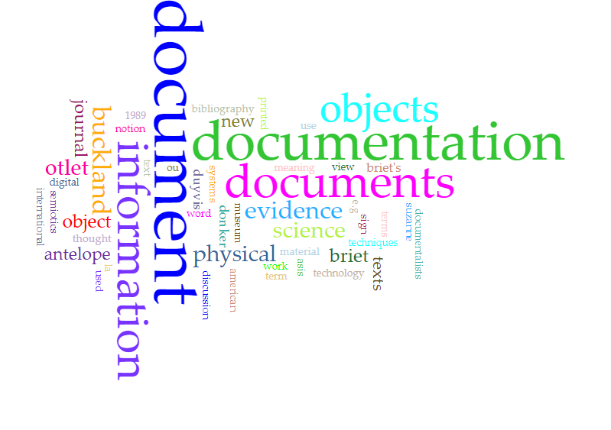
What is Textual Analysis/ Mining?
"a text mining system will allow a user to explore and interact with patterns of information from within a collection of potentially relevant documents. The goal of a text mining system is to help a user identify meaningful patterns and learn about the information space related to the information need.”
Blake, C. (2011). Text mining. Annual Review of Information Science and Technology, 45(1), 121–155. https://doi.org/10.1002/aris.2011.1440450110
Distant Reading

Slide 4
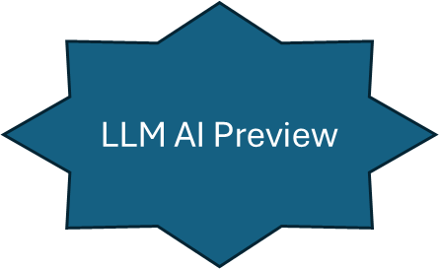
Contexts
Word Complexity
Genre Analysis
Named Entity Recognition
Topic Modeling
All Built around:
--counting words
--doing statistics
Sentiment Analysis
Part of Speech
Collocations
Word Density
Word Frequency

Slide 5
Voyant: web based tool that requires no programming/special text preparation to perform a number of textual mining activities

Slide 7
However, relatively little has been done on using Voyant as an aid in student research…
Various Pedagogical Approaches:
--reading Don Quixote
Boyle, M., & Hall, C. (2016). Teaching “Don Quixote” in the Digital Age: Page and Screen, Visual and Tactile. Hispania, 99(4), 600–614.
--Analyzing 19th century theater trends
Boyle, M., & Hall, C. (2016).
Gill, E. L. et al. (2018). Reading Macro and Micro Trends in Nineteenth-Century Theater History. In Teaching with Digital Humanities (pp. 82-). University of Illinois Press.
--Looking at linguistic patterns in early modern recipes
Froelich, Heather. “Using Voyant Tools in the Undergraduate Classroom.” https://hfroehli.ch/2019/04/22/using-voyant-tools-in-the-undergraduate-research-classroom/
(also a great libguides page of tips on using Voyant in the classroom: https://guides.libraries.psu.edu/c.php?g=1123281&p=8275191)

Slide 8
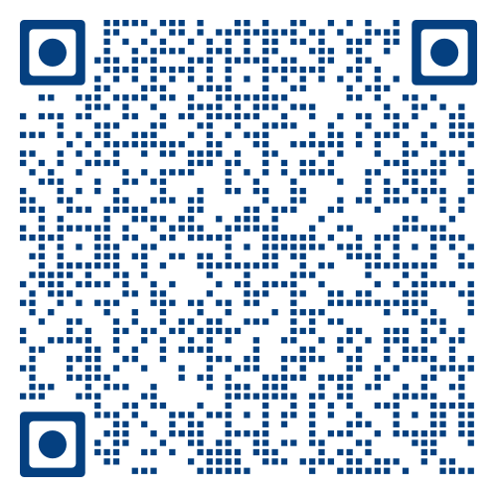
Let’s start with familiarizing ourselves a bit with Voyant
Identify Key Terms and Topics

Slide 9
Can share a corpus though using address
Offer related approaches (or same approach, different visualization)

Slide 10
Hover Over and Drag to Change Size

Slide 11
Enter specific terms of interest
(try “antelope” and “evidence.” what happens if you add “knowledge?”)
Note: sometimes changing these terms will affect what is shown in other windows
Other tools have sliders to shift parameters: in this case, how many words in the cloud

Slide 12
Hover over this to get a menu
Export(image or csv file); Change Tool; Set Parameters; Explain Tool
Try a few different tools and get explanations of what they do.

Slide 13
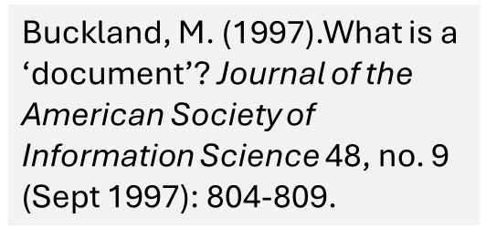
So at this point, how do you see this as a potential tool for students doing research?
“Often…students choose a topic of inquiry long before they ever meet with a librarian in an instruction session or at the reference desk. Situations where students have settled on a topic that is vague or underdeveloped or does not meet the constraints of the assignment can lead to frustration for both librarians and students as a “triage” interaction takes place—librarians do the best they can to salvage a poorly defined research topic, or students give up an idea they initially found interesting so they can complete their assignment.” (749)
Develop focused key terms
Develop key terms that are used within the field
Give students a way to backchain
Give students a process to focusing research
“It is safe to say that college and university freshmen are novices within their chosen majors in that they have not yet developed an essential grounding in their disciplines. This grounding includes a facility with the terminology and major concepts, the problems and ‘big questions’ within the discipline, as well as a sense of what questions are worth asking. Students who are required to come up with a research paper topic in a field that they know very little about may have no idea where to begin, what questions would be fruitful to ask and explore, or even where to look for guidance”
“Students struggle to get started on research assignments; they follow a familiar path through the same resources to gather sources; they rely on peers and family members for help choosing sources; and disturbingly enough, after they graduate the vast majority feel they haven’t been given a chance to practice asking questions of their own”
Eckel, E. J. (2019). Topic Development in the Freshman Engineering Paper: Finding a Focus. in Science & Technology Libraries (New York, N.Y.), PREPRINT. Western Michigan Scholarworks. https://scholarworks.wmich.edu/cgi/viewcontent.cgi?article=1043&context=library_pubs https://doi.org/10.1080/0194262X.2019.1566042
Rinto, E., Bowles-Terry, M., & Santos, A. J. (2017). Assessing the Scope and Feasibility of First-Year Students’ Research Paper Topics. College & Research Libraries, 77(6). https://doi.org/10.5860/crl.v77i6.16554
Alison J. Head, Barbara Fister, Steven Geofrey, and Margy MacMillan, The Project Information Literacy Retrospective: Insights from more than a decade of information literacy research, 2008-2022 (12 October 2022), Project Information Research Institute, https://projectinfolit.org/publications/retrospective

Slide 14
Identifying Key Terms and Topics: 3 Activities
Terms Tables
Topic Clustering
Sources and Trends
With What??
Key Text from Class
Text selected by Librarian
Keywords from Assignment
Libguides
Introductions
Text found through Student Search

Slide 15
Identifying Key Terms and Topics: Terms Table
Biggest Tip: go to the “middle” occurrences
Voyant does some very basic sentiment analysis

Slide 16
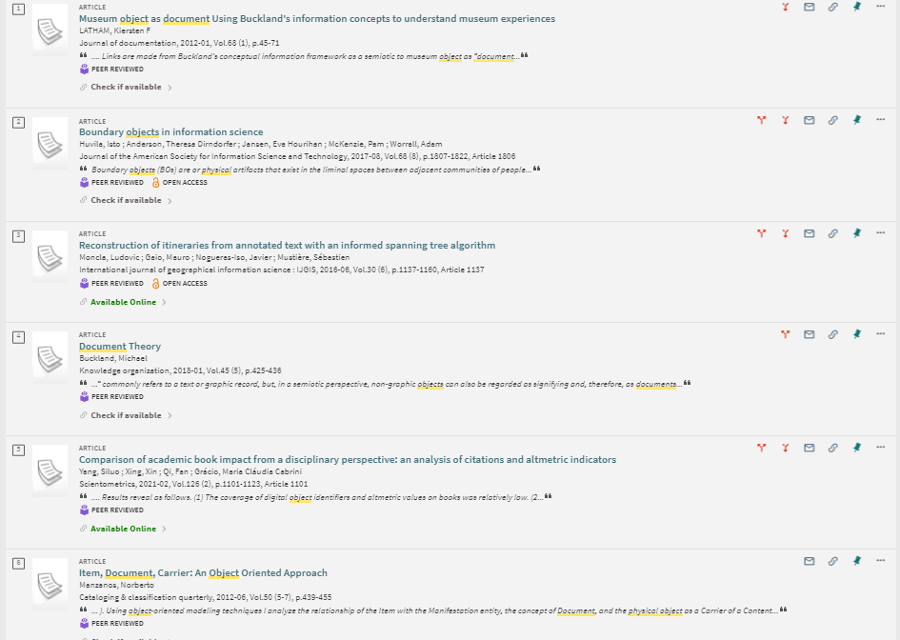
library science and information and document
“library science” and document and physical and object

Slide 17
Identifying Key Terms and Topics: Topic Clustering
More frequent
Under “Corpus Tools”
Less Frequent
Click on a color to get the percentages (of all clusters what is the frequency of these words).
This chart shows frequency of clusters in the document (more interesting when you have multiple documents)

Slide 18
Identifying Key Terms and Topics: Topic Clustering
Discuss a term vs a topic
Start to see what terms are being used w/in the discipline (vs “general” words)
Use to find related key terms/narrow a search– if you are interested in “information” search with “technical” and “museum”

Slide 19
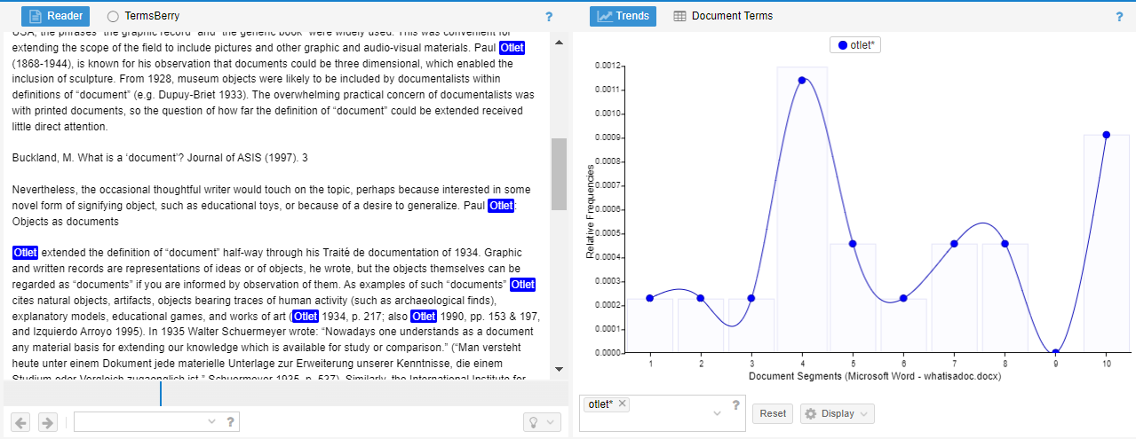
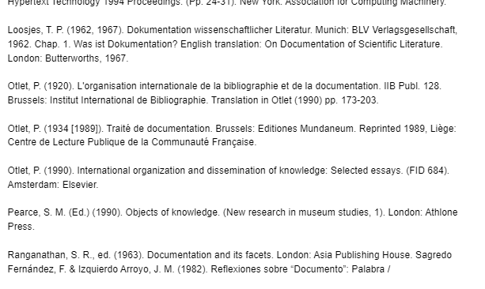
Identifying Key Terms and Topics: Sources and Trends
Clicking on a point will take you to the part of the document it tracks

Slide 20
Identifying Key Terms and Topics
Research as Inquiry
Research is iterative and depends upon asking increasingly complex or new questions whose answers in turn develop additional questions or lines of inquiry in any field.
Experts see inquiry as a process that focuses on problems or questions in a discipline or between disciplines that are open or unresolved. Experts recognize the collaborative effort within a discipline to extend the knowledge in that field. Many times, this process includes points of disagreement where debate and dialogue work to deepen the conversations around knowledge. This process of inquiry extends beyond the academic world to the community at large, and the process of inquiry may focus upon personal, professional, or societal needs. The spectrum of inquiry ranges from asking simple questions that depend upon basic recapitulation of knowledge to increasingly sophisticated abilities to refine research questions, use more advanced research methods, and explore more diverse disciplinary perspectives. Novice learners acquire strategic perspectives on inquiry and a greater repertoire of investigative methods.
Knowledge Practices
Learners who are developing their information literate abilities
formulate questions for research based on information gaps or on reexamination of existing, possibly conflicting, information;
determine an appropriate scope of investigation;
deal with complex research by breaking complex questions into simple ones, limiting the scope of investigations;
use various research methods, based on need, circumstance, and type of inquiry;
monitor gathered information and assess for gaps or weaknesses;
organize information in meaningful ways;
synthesize ideas gathered from multiple sources;
draw reasonable conclusions based on the analysis and interpretation of information.

Slide 21
Effectively Reading a Scholarly Article
Topics/Key Words
“Experts see inquiry as a process that focuses on problems or questions in a discipline or between disciplines that are open or unresolved”
Scholarship as Conversation

Slide 22
Effectively Reading a Scholarly Article
“About a third of the freshmen said they floundered with reading different formats and making sense of what they had found. Many had never seen, let alone read a journal article or an abstract before. At the same time, students wrestled with understanding what authors meant, given their lack of familiarity with scholarly language and writing style. A few students mentioned that they used an online dictionary as they read to help them understand the terminology in journal articles… Some freshmen we interviewed said they had trouble with selecting meaningful passages and tying it all together. In their words, they had problems “connecting the dots,” “figuring out the hook,” and “discerning what you’re going to use.” They purposely selected sources from the results page that had a common thesis or similar interpretation of the same set of facts, as a way of gauging the credibility. As one student explained, “I know if it’s printed several places, then it’s true and I can use it.” In other cases, students had trouble selecting which quotes to include in their papers: How do you read a 30-page article and pick out a few meaningful quotes? I mean what is the right, exact quote to select and use? I am just kind of picking from here and picking from here and there for this paper. I just don't know. I mean is the writing I do in my composition course representative of the rest of the writing I do in college?” (17)
Alison J. Head (December 5, 2012), Learning the ropes: How freshmen conduct course research once they enter college, Project Information Literacy Research Institute, https://projectinfolit.org/publications/first-year-experience-study/

Slide 23
Effectively Reading a Scholarly Article
“Many students, in the initial phases of research, are aware that their topics are broad, but they are not sure what to do about it. This is where we attempt to reemphasize the importance of reading as a way to direct research, which inevitably affects the formation of the topic.” (36)
Kazan, T. S., Behm, N. N., & Cook, P. (2021). Writing Faculty and Librarians Collaborate: Mapping Successful Writing, Reading, and Information Literacy Practices for Students in a Post-truth Era. Pedagogy : Critical Approaches to Teaching Literature, Language, Culture, and Composition, 21(2), 311–328.
“In failing to recognize the central role of reading, we represented a simplistic understanding of how students learn, develop, and apply information literacy proficiencies.” (316)
Kacy Lundstrom and Flora Shrode. "Undergraduates and Topic Selection: A Librarian’s Role" Journal of Library Innovation 4.2 (2013): 23-41.

Slide 24
Effectively Reading: 4 Activities
Terms Tables
Topic Clustering
Contexts
Trends and Terms
Identify major ideas to look for while reading
Identify points of disagreement/research questions
Help think about the structure and how to focus reading
Give students a process to approaching reading

Slide 25
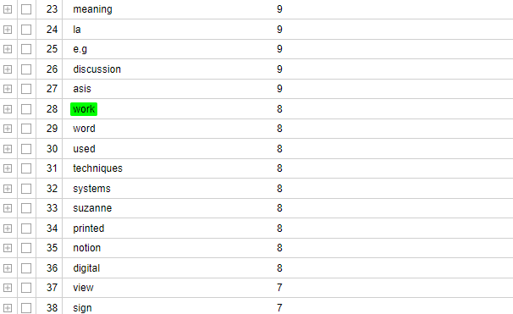
Effectively Reading a Scholarly Article: Terms Tables
Still mostly stay in the middle
Look for Unexpected
Antelope
Discussion
Look for Connected Ideas
word/printed/systems
Look for Contrasts
Digital/Printed

Slide 26
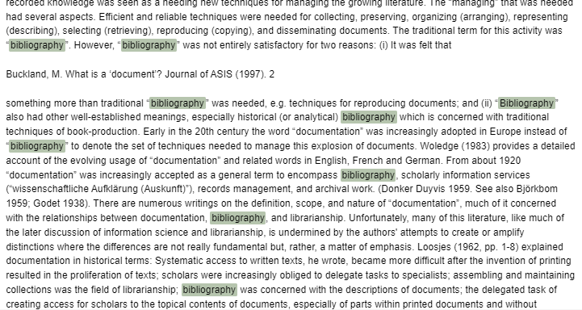
Effectively Reading a Scholarly Article: Topics
Look for Unexpected
Why does bibliography get linked with documents/librarianship/management?
Relationship between historical and meaning?
Look for (Newly) Connected Ideas
Physical/systems/storage
Written/reproducing
Look for Contrasts
“documentalist”/published vs physical/storage

Slide 27
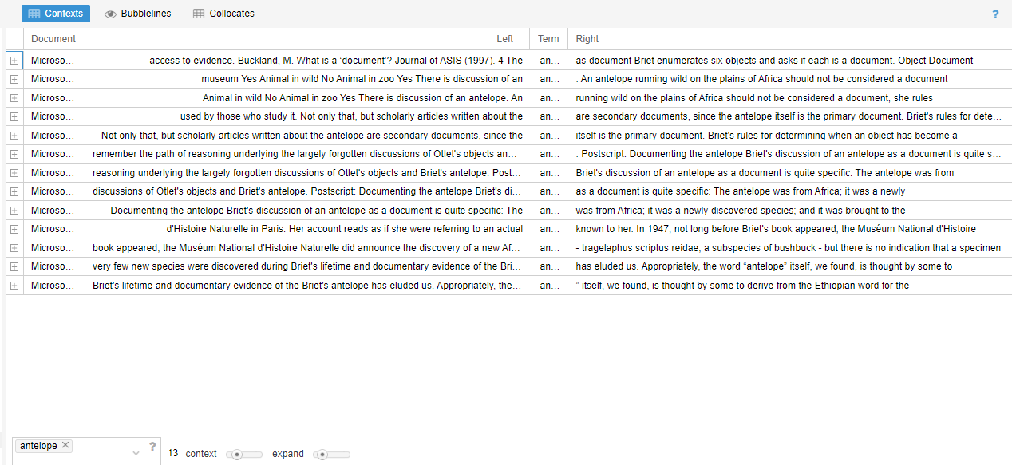
Effectively Reading a Scholarly Article: Contexts
Reading Pointers
--The antelope comes from Briet: what is their point/how is Buckland using?
--Connection to objects?
--Why that whole long thing about the history of the antelope??

Slide 28
Reading a Scholarly Article: Trends and Terms

Slide 29
Reading a Scholarly Article: Trends and Terms

Slide 30
Effectively Reading a Scholarly Article
Scholarship as Conversation
Communities of scholars, researchers, or professionals engage in sustained discourse with new insights and discoveries occurring over time as a result of varied perspectives and interpretations.
Research in scholarly and professional fields is a discursive practice in which ideas are formulated, debated, and weighed against one another over extended periods of time. Instead of seeking discrete answers to complex problems, experts understand that a given issue may be characterized by several competing perspectives as part of an ongoing conversation in which information users and creators come together and negotiate meaning. Experts understand that, while some topics have established answers through this process, a query may not have a single uncontested answer. Experts are therefore inclined to seek out many perspectives, not merely the ones with which they are familiar. These perspectives might be in their own discipline or profession or may be in other fields. While novice learners and experts at all levels can take part in the conversation, established power and authority structures may influence their ability to participate and can privilege certain voices and information. Developing familiarity with the sources of evidence, methods, and modes of discourse in the field assists novice learners to enter the conversation. New forms of scholarly and research conversations provide more avenues in which a wide variety of individuals may have a voice in the conversation. Providing attribution to relevant previous research is also an obligation of participation in the conversation. It enables the conversation to move forward and strengthens one’s voice in the conversation.
Knowledge Practices
Learners who are developing their information literate abilities
cite the contributing work of others in their own information production;
contribute to scholarly conversation at an appropriate level, such as local online community, guided discussion, undergraduate research journal, conference presentation/poster session;
identify barriers to entering scholarly conversation via various venues;
critically evaluate contributions made by others in participatory information environments;
identify the contribution that particular articles, books, and other scholarly pieces make to disciplinary knowledge;
summarize the changes in scholarly perspective over time on a particular topic within a specific discipline;
recognize that a given scholarly work may not represent the only or even the majority perspective on the issue.

Slide 31
Creating New Data Sets: Why and What
Illuminate process of creating questions and defining what’s of interest (Information Creation as a Process)
Practice creating research questions/focus (Searching as Strategic Exploration)
Recognize variety of sources that constitute knowledge (Authority is Created/Contextual; Information has Value)
Highlight underrepresented stories and experiences
Looking at department of education reports from various countries to identify attitudes and emphases
Identifying trends over time, particularly in regards to attitudes towards China, in the Dali Lama’s annual speech on anniversary of Tibetan Uprising
Using tables of content and indices of theory readers to identify how French theory moved through the American academy
Examples of student projects that create and analyze new data sets: https://dhfellows.iwudh.reclaim.hosting/

Slide 32
Creating New Data Sets: Some Practical Tips
It’s generally best to load each document separately and name by date (or other defining characteristic)
You can look at trends over time, or segment out a specific set
PDFs are a pain to rename at the metadata level. I’ve found success saving as a .docx, going to “details” in “properties” and then over-writing the title in it
It’s increasingly easy to make documents machine readable—Adbobe Acrobat has “Scan and OCR,” Google Lens allows you to copy as text
You’re definitely going to want to work with the instructor to make sure to define goals, introduce students to specific (or various) data sets, show models of how people have used this data

Slide 33
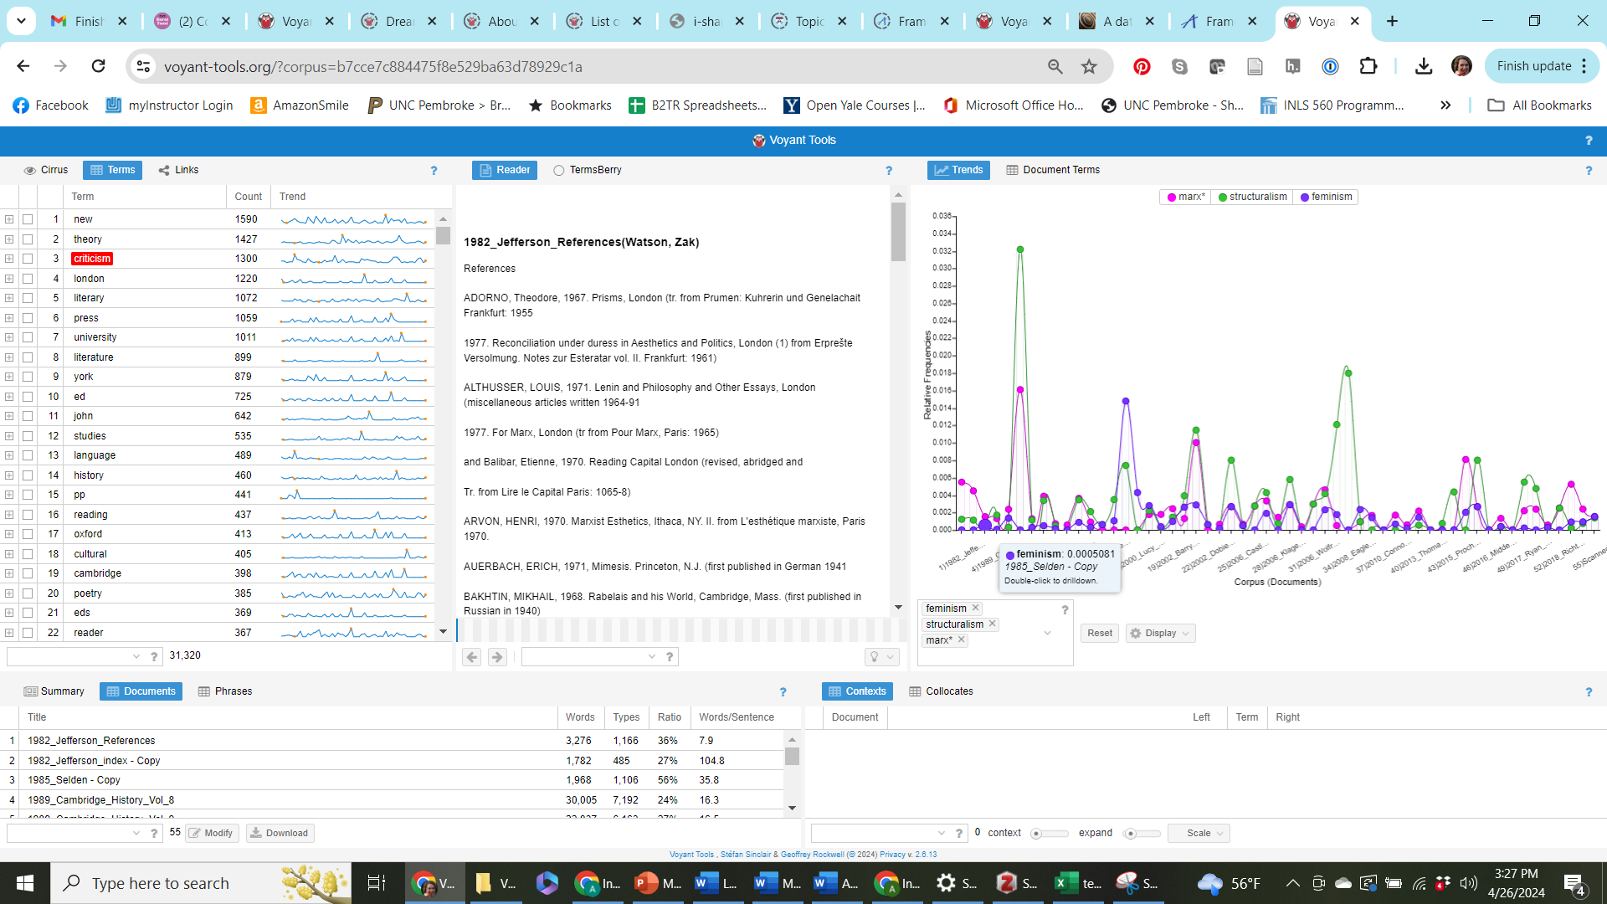
Framework: Information Creation
https://rb.gy/775l5b

Slide 35
Understanding LLM AI (like ChatGPT)
Evaluating online resources requires background knowledge of proprietary search algorithms and the existence of grey literature, paywalls, and the deep web; these thought processes would need to be explicitly taught within the context of information literacy. (2)
“Bag of Words” methodology
Visualization of Use of Statistics
Demystify “how it knows”
Blocksidge, Katie, and Hanna Primeau. "Adapting and evolving: Generation Z's information beliefs." The Journal of Academic Librarianship 49.3 (2023): 102686.

Slide 36
Understanding LLM AI (like Chat GPT)
Putting in one article= mini corpus
--Various statistics around words have been visualized
--Contexts/collocates are a starting step

Slide 37
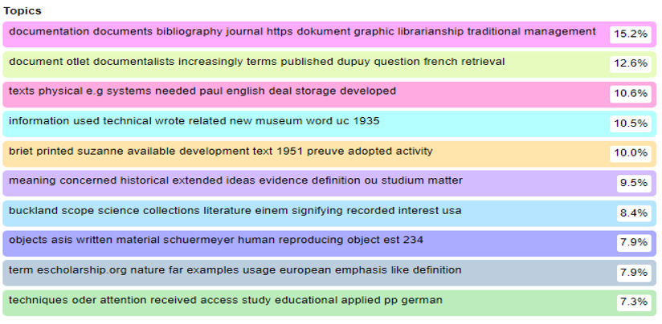
Understanding LLM AI (like ChatGPT)
“Bag of Words” methodology
Visualization of Use of Statistics
Demystify “how it knows”
But also—stress algorithms and
the “black box”
Importance of Knowledge
and Interpretation

