Slide 1
Do you have an instruction policy?
ⓘ
Click Present with Slido or install our Chrome extension to activate this poll while presenting.
Notes:
📣 This is Slido interaction slide, please don't delete it. ✅ Click on 'Present with Slido' and the poll will launch automatically when you get to this slide.

Slide 2
Control Your Own Burn
Developing Personal or Programmatic Instruction Policies
Notes:
Anna Hi, everyone, and welcome to our workshop “Control your own burn: developing personal or programmatic instruction policies.” Thank you so much for being here today! If you haven’t taken our entry poll, do so now!

Slide 3
Hello!
Anna White (she/her)
Grand Valley State University
Samantha Minnis (she/her)
Grand Rapids Community College
Notes:
My name is Anna White, and I am a health sciences library liaison and first-year writing information literacy coordinator at Grand Valley State University in Allendale, Michigan.
I’m Samantha Minnis, I’m the Information Literacy and Outreach Librarian at Grand Rapids Community College. The Information Literacy part of that job means I serve as the social sciences librarian as well as coordinate our library instruction program.

Slide 4
Agenda
Background on this project
Poll to help us get to know each other
Share perspectives
Brain writing activity
Collect policy language
Notes:
Samantha Here is our plan for today. We’ll give you some background on where this project came from and why to get us thinking about instruction policies, get a sense of who is in the room and how we’re feeling, share our perspectives on instruction policies, and engage in activities to help us begin writing concepts and language that we might use in personal or programmatic instruction policies.

Slide 5
Rules of Engagement
Share from your own experience
Give space for the experiences of others
Anonymize where possible
Notes:
5 minutes in Samantha Policy sounds like it’s going to be dry and boring, but I know from experience that it can make some people hot under the collar. Since we’re going to be talking about how we feel and things that have happened to us, we want to set some rules of engagement. Share from your own feelings and experience, and where possible, anonymize. I often do that thing that memoirists do--collapse multiple characters into one or change insignificant details

Slide 6
Background
Survey conducted 2023 of 284 American and Canadian academic instruction librarians
22% said their libraries have an instruction policy in place
64% said a policy would make them more confident determining when to say no to a session
Notes:
Anna So, in 2021 I hit a major instruction wall. I was teaching a lot, and we’d had some retirements and some unfilled positions, and the whole team was feeling stretched. We agreed, as a group, that we could say no to instructions sessions for a wide variety of reasons. And even though we all agreed, we discovered that in practice, none of us actually said no. It made me curious about when and why instruction librarians say no to sessions, so I surveyed librarians in the US and canada, and you’re seeing a small piece of results here. 22 percent of respondents said that their libraries had an instruction policy in place. 64 percent said that having a policy would make them more confident in saying no to a session. That’s what led us to this workshop--if that’s true, what would it take to begin to clarify the elements of a policy.

Slide 7
An Instruction Policy Is…
A set of expectations that describe when and why an instruction librarian will and will not teach an information literacy session
Personal…
Programmatic…
Notes:
8 minutes in Anna: add loose considerations When we talk about “instruction policy” in this session, what we mean is a set of expectations that describe when and why an instruction librarian will and will not teach an information literacy session. These policies can be personal--for one librarian--or programmatic--an agreed-upon set of expectations for a group of librarians who work together in an instruction team. Whether you have a personal policy, a programmatic policy, or both, and how strict those policies can be, depends on your instruction context. My team operates on a liaison model, where every librarian schedules their own sessions. Personal instruction policies work really well. We talk about them together and negotiate them with our supervisors, but at the end of the day, we enforce our own policies with our own departments. Samantha schedules sessions for her department, and so a programmatic policy works better because they collectively agree on what constitutes a reasonable request. Policies can be posted on your department website or sent out with your regular communication to liaison departments to help reinforce your messaging when you choose to rely on them. We will couch this now to say: policy is one potential solution to a problem, not the only solution, and there will certainly be some instruction contexts, some library leadership environments, that are not immediately open to it. If you’re in that context today, we hope you stick with us and hold on to some of the more generalizable content, since we would argue that you can still apply some of it.

Slide 8
Why Policy
Meet student needs while honoring librarian time, energy, and expertise
If you have said no, why?
Time
Labor/Resources
Ineffective lesson
Communication challenges
Lack of instructor presence
Burnout/overwhelm
If you have never said no, why?
Perception of library/librarian
Deference behavior*
Service orientation*
Relationship with instructor or program
Driving numbers up
Lack of support
No desire to say no
*McCartin & Wright-Mair, Muelemans & Carr
Notes:
9 minutes in Anna But why a policy? In the survey I mentioned earlier, and in the literature review I completed prior to that survey, a bunch of librarian instruction issues emerged. Things like, I don’t have enough time, either because the request is for tomorrow, or because I have too much else to do. Or maybe it’s a resourcing issue, where there aren’t enough of you, or the professor won’t return your emails or send you a copy of the assignment, or you feel like you have to say yes because what will the professor think about the library if you say no? Shouldn’t the library be a place of yes? What is a librarian if not a teacher? What does it say about your professional identity if you say yes to a session where I’m basically just babysitting because the professor is at a conference and wants me to just “show them to use the databases”? What about if you say no? What if the expectation in my library is just that I get as many butts in seats as possible and it doesn’t matter if all I do is teach them the macarena? McCartin and Wright-Mair say that academic librarians are likely to engage in deference behaviors, where we cede our expertise and authority to classroom instructors, and Muelemeans and Carr describe how some librarians find themselves trapped in a service model of instruction rather than a curricular partnership. All of these questions and issues intersect with elements that can appear in instruction policy.

Slide 9
How do you feel about saying no to instruction requests?
ⓘ
Click Present with Slido or install our Chrome extension to activate this poll while presenting.
Notes:
📣 This is Slido interaction slide, please don't delete it. ✅ Click on 'Present with Slido' and the poll will launch automatically when you get to this slide.13 minutes in Samantha Now we’ve had some time to hear about the background of this project and how other librarians feel about instruction policies and saying no to instruction, so we’d like to hear how you are all feeling. You can be honest in answering this question, “How do you feel about saying no to instruction requests?” As you fill out this word cloud it will appear on the screen, but anonymously. Go ahead and fill it out and let’s get a sense of how we’re all feeling.

Slide 10
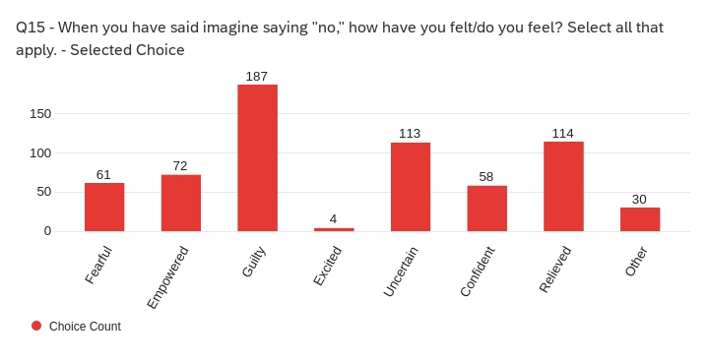
Survey Results
Notes:
16 minutes in Anna You might see yourself reflected in the response to the survey! This was a “select all that apply,” so many selected a combo--”guilty” plus “relevied,” for instance, but note that “guilty” was way up there as the big feeling. I’m curious to know if using policy might reduce some of that guilt.

Slide 11
Perspectives
What are your feelings, thoughts, and reactions to instruction policy (personal or programmatic?)
What challenges or successes have you experienced in coordinating, planning or teaching instruction sessions? Describe or tell a story about a time things went poorly or well.
We will share as a room in a few minutes.
Notes:
15 minutes in Anna Let’s turn to a few partners or to those at your table and share for the next few minutes. You can answer both of these questions or focus on just one; talk more about what feelings and reactions are coming up for you and why, or tell your table about a challenge or success you’ve experienced in instruction, preferably that might be related to something that could be written into policy.
The purpose of this activity is to start to notice themes in our experiences that might help us identify areas of policy to focus on, but for now just enjoy hearing each other’s experiences and celebrating and commiserating, and we’ll share out in about five minutes.

Slide 12
Brainwriting
Thinking about these and other stories:
Write elements or wording of personal or programmatic instruction policy that someone could implement
Don’t censor yourself
When you see one you like, give it a star
Notes:
25 minutes in Samantha Thank you all for sharing your stories and perspectives with us. Now we’re going to transition into an activity that will allow us to start thinking about how we might write or refine our instruction policies. We’re going to hand out sticky notes to each of you. When we get started, you can write an element or wording of a personal or programmatic instruction policy. This is meant to be a generative brain storming activity, so now is the time to dream big. What elements would be important to you in an instruction policy? That might look like a specific situation in which you’d say no, or a requirement you have for saying yes, or it could even be a question about how it would work, or an idea you have for wording. So you’ll write each of your ideas on separate cards and then pass them to your right. When you receive a card from your neighbor, read it. If you have a strong reaction or a question you can write on it. You can start it if you love it! You can underline parts that resonate with you! Or just pass it on. We’ll facilitate getting them from one table to the next so when you a card for the second time, make a pile. When we’re all done, you’ll get a chance to see all of them at once. If you would like to submit your answers online for any reason, feel free to do so and Anna and I will turn them into cards so they can go around. Any questions? Ok, go!

Slide 13
Don't want to write? Put your policy element/language here and we will put it on a card for you.
ⓘ
Click Present with Slido or install our Chrome extension to activate this poll while presenting.
Notes:
📣 This is Slido interaction slide, please don't delete it. ✅ Click on 'Present with Slido' and the poll will launch automatically when you get to this slide.

Slide 14
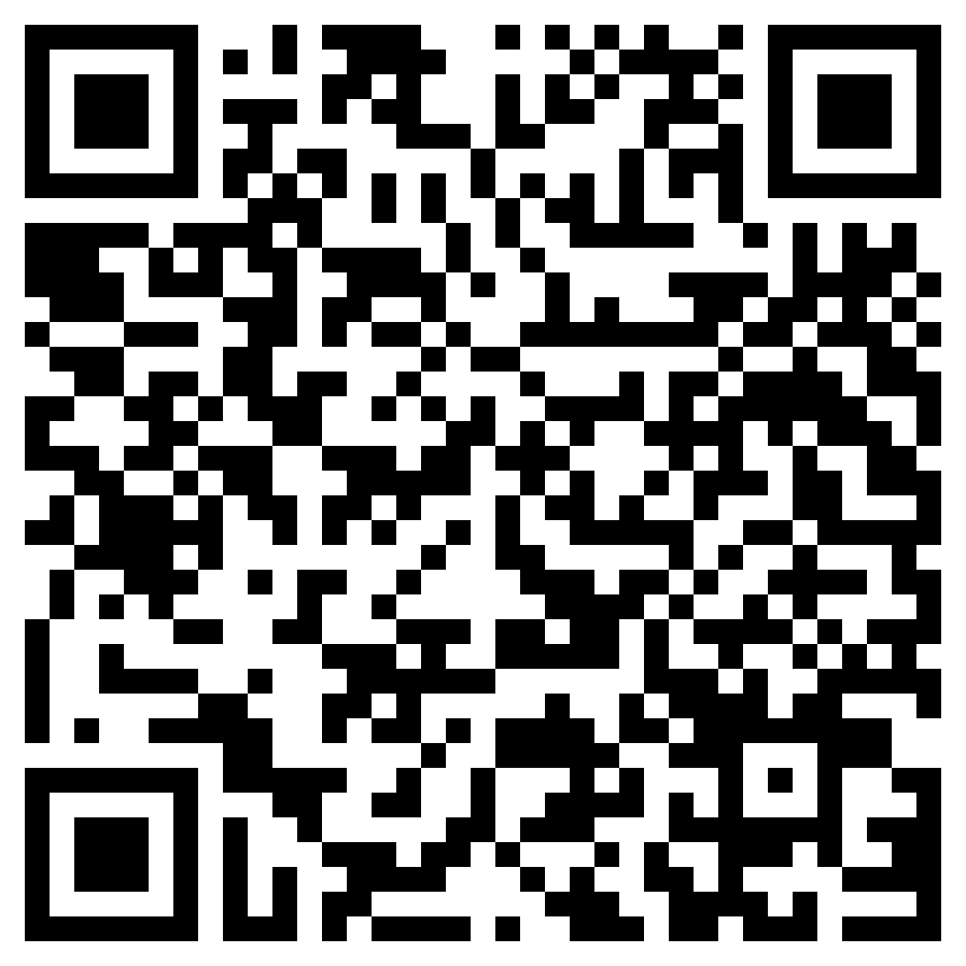
Take what you like
Notes:
40 minutes in Samantha Thank you all for your wonderful ideas, I hope you had as much fun as we did hearing them! We are going to be sharing them with this QR code, but if there are ideas that you want to make sure you capture, please feel free to take a picture or a note now.

Slide 15
Thank you! Let us know how it goes.
Anna White whitean2@gvsu.edu
Samantha Minnis samanthaminnis@grcc.edu
Notes:
Samantha
Anna: Next steps for policy might be to take some ideas back to your supervisor or coordinator or instruction team, or to practice role playing enforcing basic policy patterns with your team. This is only part of the conversation!
Time for questions?

Slide 16
Brief References
McCartin, L. F., & Wright-Mair, R. (2022). Manifestations of deference behavior in teaching-focused academic librarians. The Journal of Academic Librarianship, 48(6), 102590. https://doi.org/10.1016/j.acalib.2022.102590
Meulemans, Y.N., & Carr, A. (2013). Not at your service: Building genuine faculty‐librarian partnerships. Reference Services Review, 41(1), 80–90. https://doi.org/10.1108/00907321311300893
White, A. (2023). Let ‘no’ be ‘no’: When librarians say ‘no’ to instruction opportunities. In the Library with the Lead Pipe.
https://www.inthelibrarywiththeleadpipe.org/2023/let-no-be-no/

