Slide 1
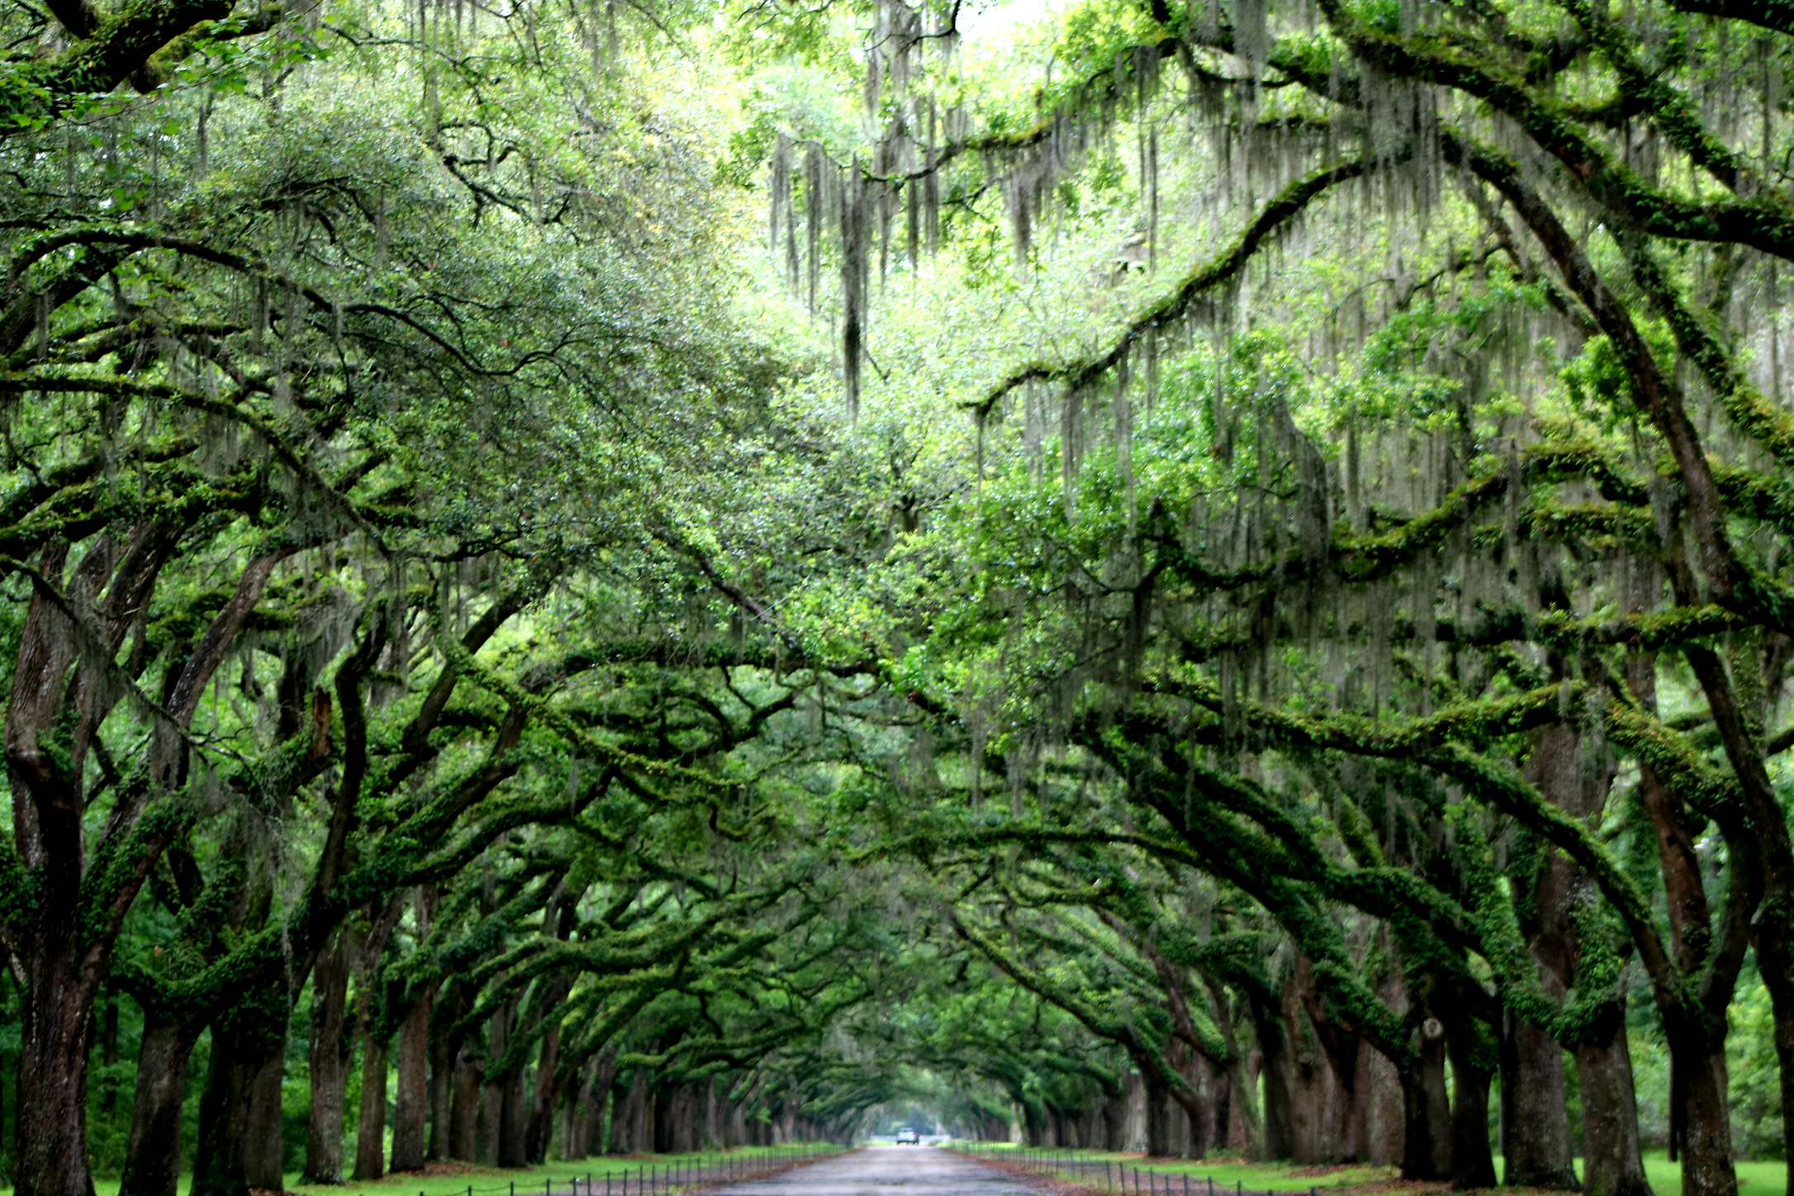
Growing the Canopy
Inosculation & Grafting
Archival Projects to Create Opportunities for Students
and the Community
LOEX 52nd National Conference​
May 2-4, 2024, Naperville IL​
​Ann E. Merryman, MLIS and Laura Karas, MLIS​
University of South Carolina Upstate
Notes:
Slide 1: ANN
Welcome to "Growing the Canopy: Inosculation and Grafting Archival Projects to Create Opportunities for Students and the Community". Whew! What a mouthful. At the end of our presentation today we hope you will leave with three things:
1. You will be able to IDENTIFY potential project partnership opportunities.
2. You will be able to CREATE opportunities for High-Impact Practices (HIPs), skill-building, and improving career-readiness for students.
3. You will be able to ASSESS and EVALUATE the outcomes of the partnerships/projects for your institution and students as well as the community partner.
(transition to slide 2)

Slide 2
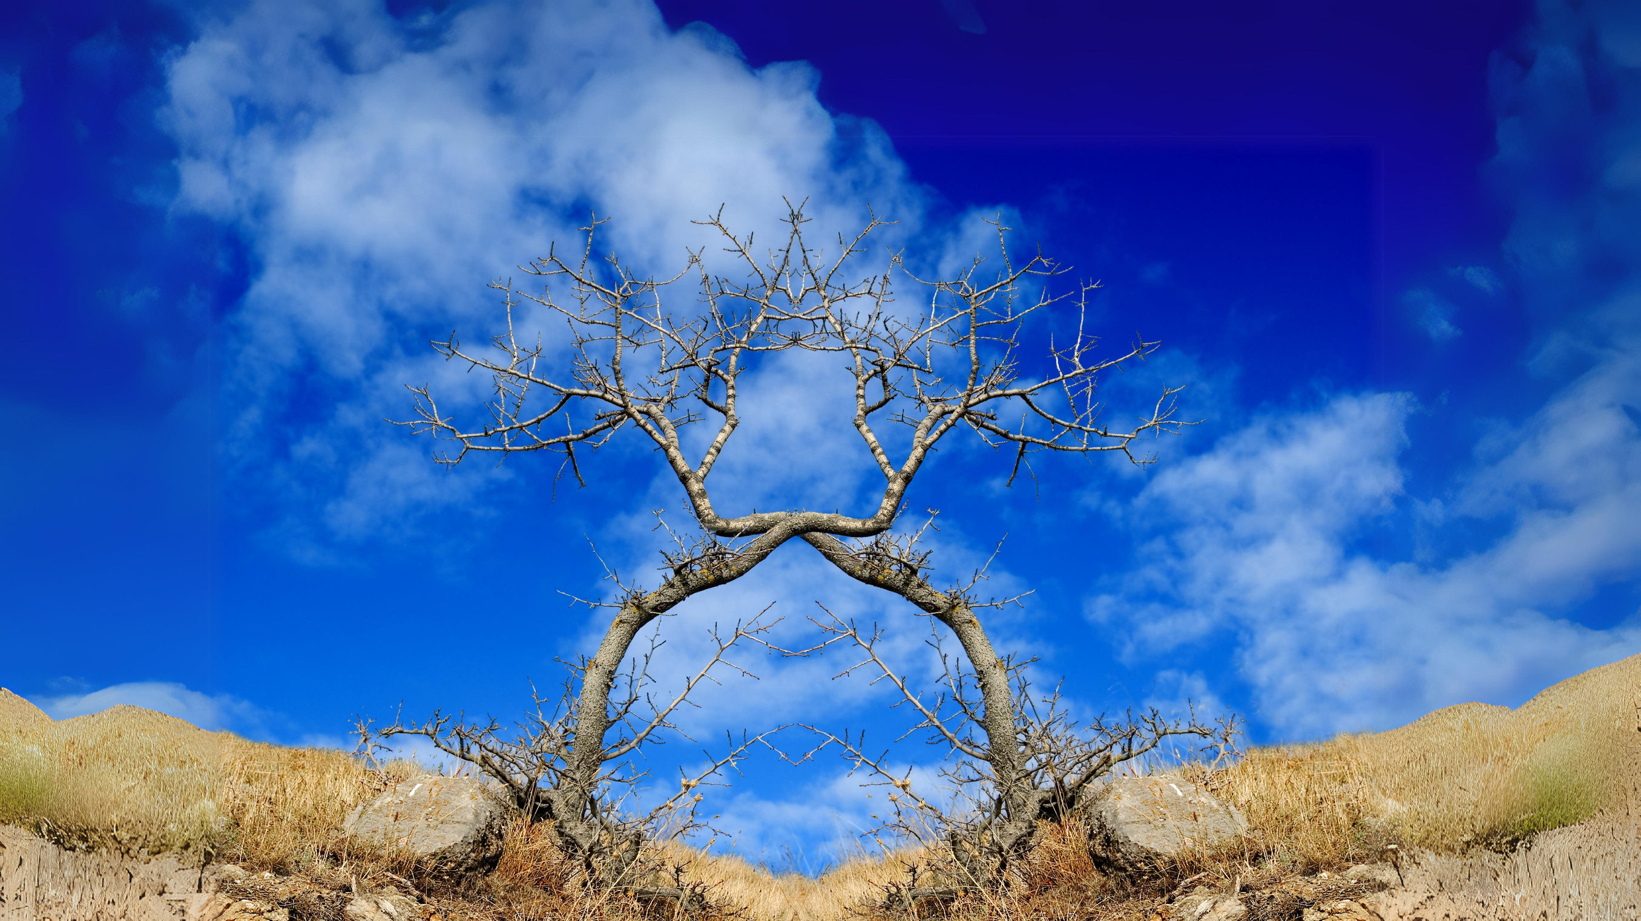
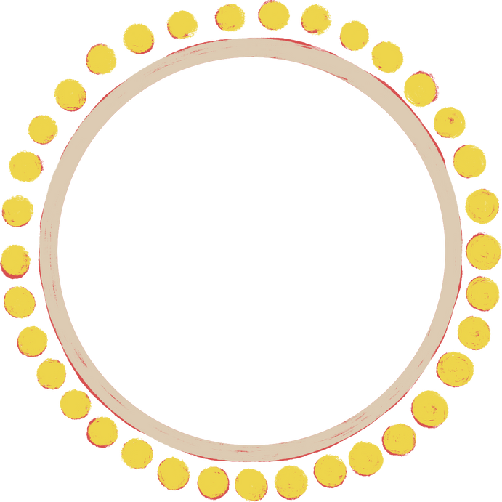
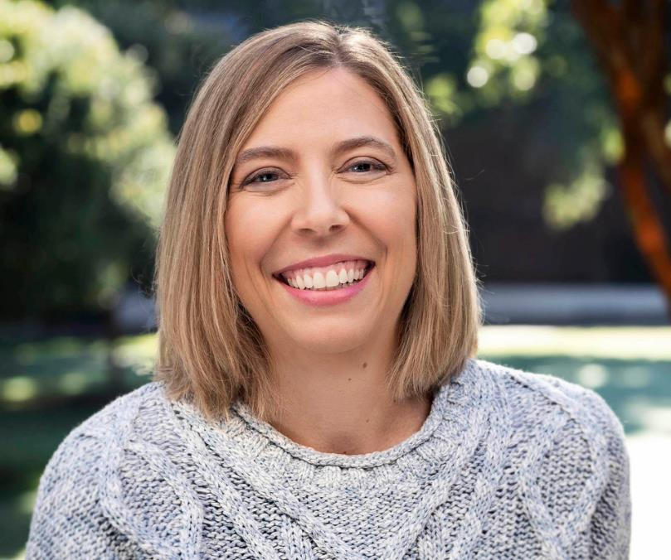
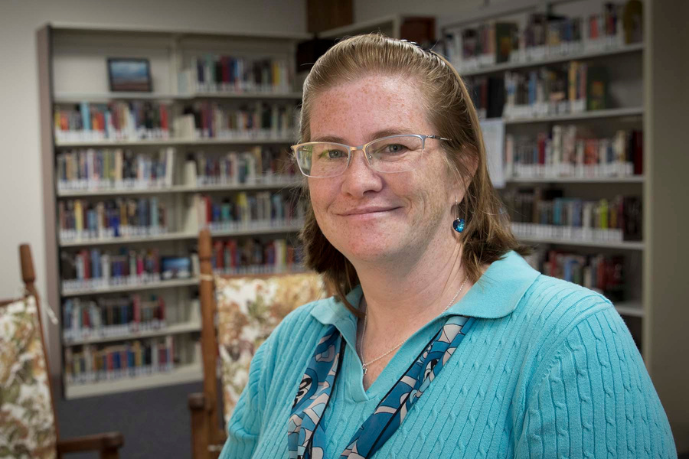
Who are we?
Ann Merryman
Laura Karas
Research Librarian
Archivist &
Research Librarian
Notes:
Slide 2: ANN and LAURA
I'm Ann Merryman. I'm a research librarian and the University Archivist at USC Upstate. I'm the first official archivist at the university, and I'm in my 11th year. This is my second career; prior to this I spent many years in retail management before returning for my MLIS degree. This is my colleague...
I'm Laura Karas and I am a 24-year veteran of the USC Upstate library where my first job way back in 1999 was to overhaul the Pathfinders and keep them up to date. For all of you youngsters out there, pathfinders were the LibGuides before the computer brought everything online. When the university first got LibGuides I had been working with HTML and CSS to bring information online and I jumped on board with this platform and the rest as they say is history. (transition to slide 3)

Slide 3
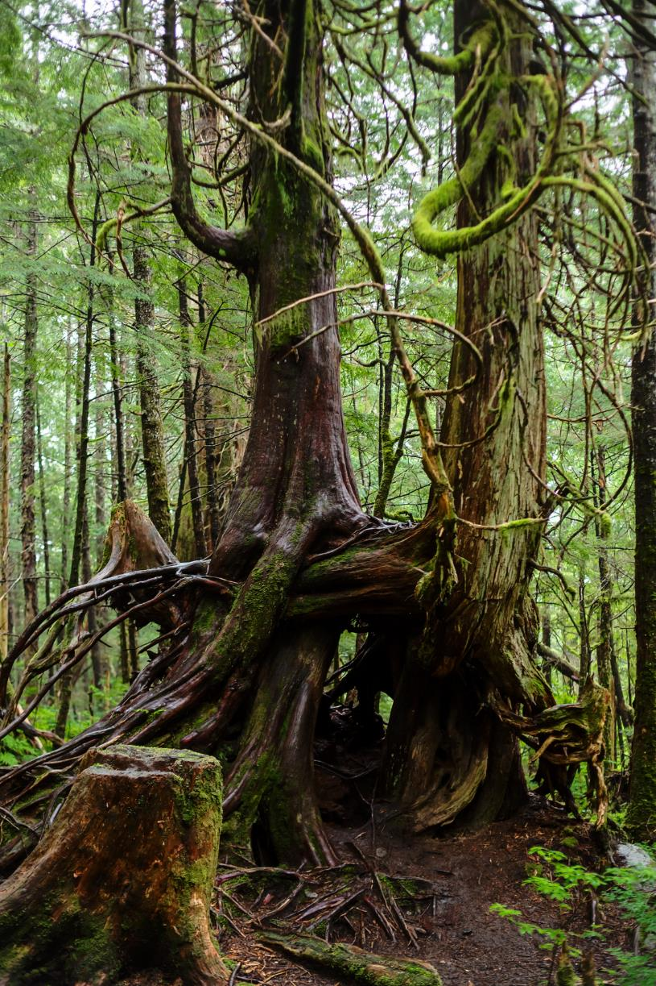
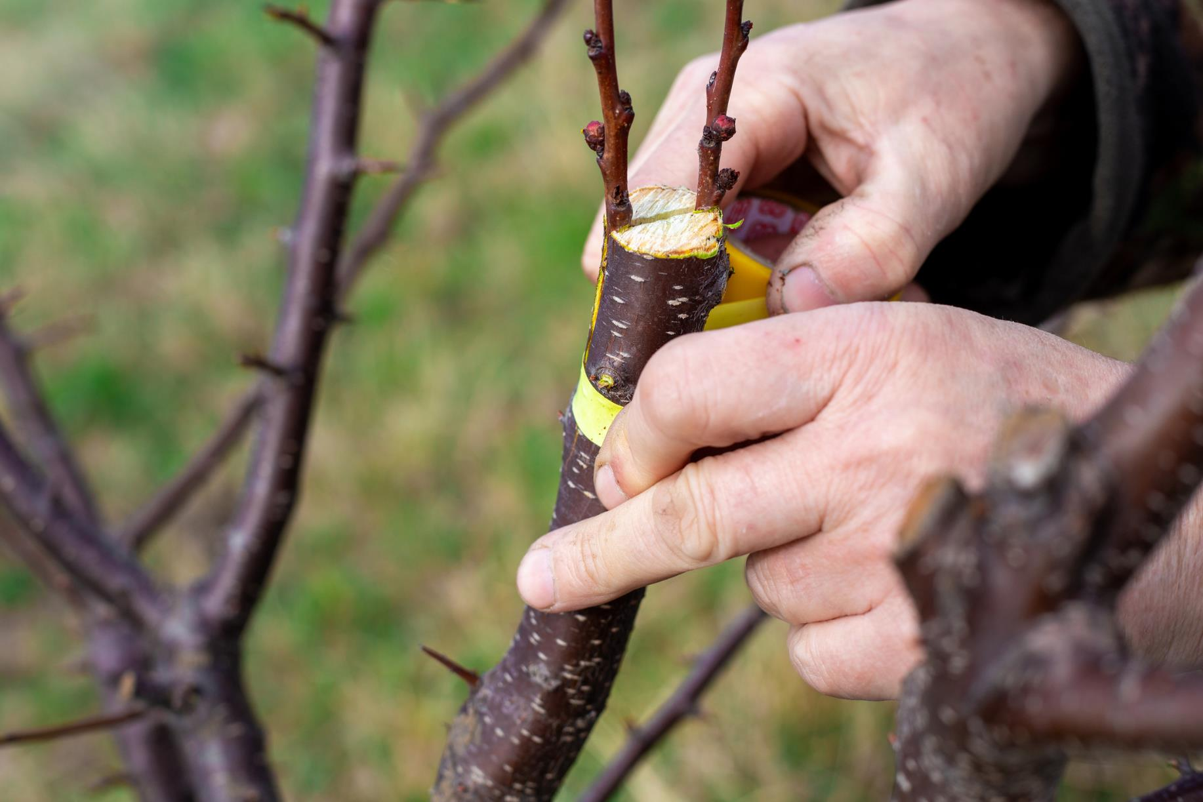
Grafting
is
Intentional
What made
our project
Grow?
A bit of being in the right place at the
right time,
and a bit of
“purposeful propagation”
Inosculation
IS
Organic
Notes:
Slide 3: LAURA and ANN
(Laura)
As we finished the first project, I told Ann that we should see about presenting at LOEX. I have been to several and I really enjoy this conference. So when we found out the theme for LOEX 2024 was arboretum/tree-themed I took my horticultural vocabulary and played up the theme. LOEX loves a good theme.
Did you know that Inosculation is the organic merging of two or more trees? When trees grow near each other they can rub and bump creating callus tissue and eventually merge on a cellular level. Point to first image
Grafting on the other hand is the deliberate joining of two or more trees to create a new tree. Often arborists will add new branches or scion to an old trunk or rootstock, hoping to get the best of each half. Point to second image
(Ann)
But what does this horticultural information have to do with archival projects and libraries? Sticking with the arborist theme, we’re going to tell you how we staked and guyed the three participants in our project to stabilize and allow it to flourish. (transition to slide 4)

Slide 4
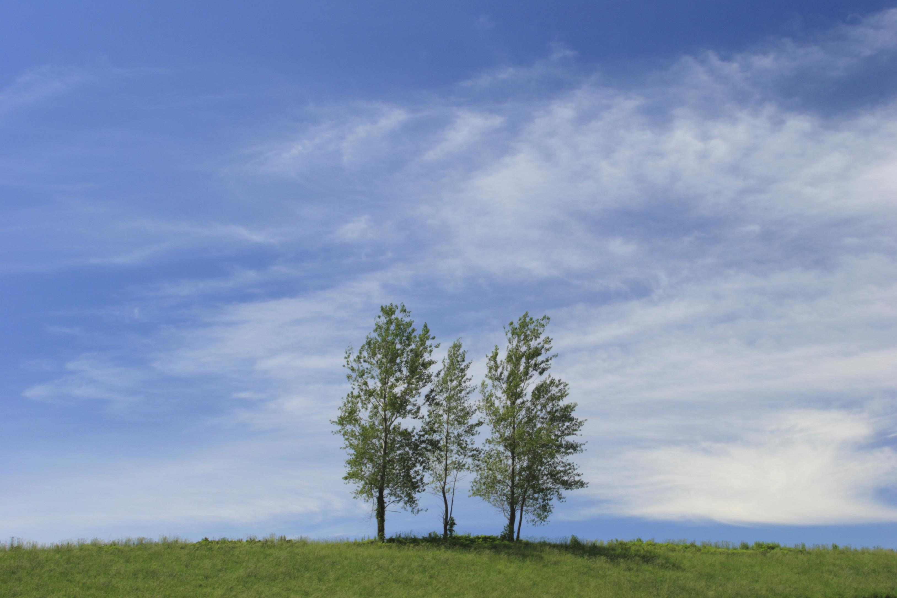
Three trees,
connected by their proximity,
yet each rooted separately...
Notes:
Slide 4: LAURA
At the start of this journey, it was like we were 3 trees planted independently in a field...
• The first tree is the Piedmont Historical Preservation Society;
• The second is Tammy Pike, USC Upstate Instructor of History;
• The third is the USC Upstate Archives and Library.
So how did these three separate organisms merge into one? We will explain the process.
(transition to slide 5)

Slide 5

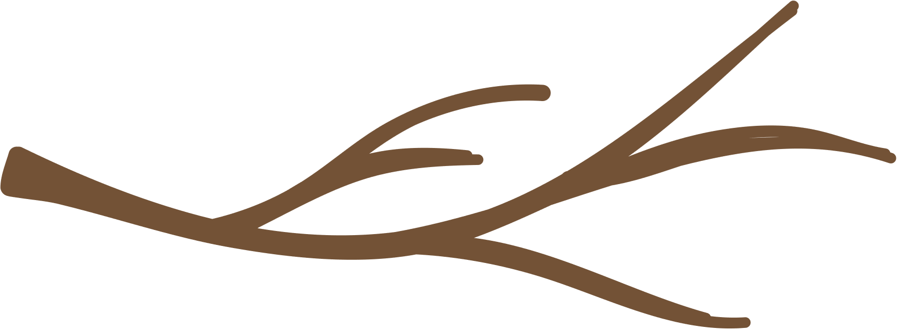
Piedmont Historical Preservation Society
Planting the seeds... starting small
Notes:
Slide 5: ANN
The Piedmont Historical Preservation Society held several significant collections in need of processing to make them accessible to researchers. These collections included the Henry P. Hammett Collection of textile mill records, along with the Margaret Payne Collection which spanned over two centuries of correspondence and family records. They received a grant to do the processing work, but as an almost wholly volunteer organization, they lacked enough personnel to do the work efficiently within the grant's timeframe. (transition to slide 6)

Slide 6
Piedmont Historical Preservation Society
Tammy Pike
Historian
Identifying the partnership opportunity...
Notes:
Slide 6: LAURA
At the same time, the Piedmont Historical Preservation Society reached out to Tammy Pike, professor of history at USC Upstate, and asked her to act as their unofficial historian.
Professor Pike’s volunteer involvement alerted her to the unprocessed archival collections being worked on as part of the grant, and seeds of ideas were planted. (transition to slide 7)

Slide 7
Piedmont Historical Preservation Society
  The Henry P. Hammett Collection
Tammy Pike
Historian
Student
Independent Study
Transcriptions
  The Margaret Payne Collection
Growing the Project... branching Out
Notes:
Slide 7: ANN
With their partnership in place, Tammy developed an independent study in the fall of 2022 for three history students to do transcriptions of ledger records in the Henry P. Hammett Collection as part of PHPS's grant project.
As the semester progressed, the students also began transcribing a group of WWII-era letters from the Margaret Payne Collection as an added assignment and ended up transcribing 44 letters. These letters were almost exclusively written by John Dolin, a 20-year-old Army soldier stationed at Greenville Army Air Base in Greenville SC, to Margaret Payne, a 17-year-old resident of Piedmont, SC, about 10 miles away. (transition to slide 8)

Slide 8
Piedmont Historical Preservation Society
  HIST 391 - Women & WWII:
War, Propaganda & the Homefront
Tammy Pike
Historian
Tammy Pike
Service Learning
Class
Student
Independent Study
Transcriptions
Opportunities for High-Impact Practices...
Notes:
Slide 8: LAURA
Although the independent study mainly centered on transcribing documents, some processing and arranging of the collection was performed by the students under the supervision of the PHPS archivist, Joe Hursey, to help meet the deadline of the processing grant they had received.
As the semester progressed, Professor Pike arranged with Joe Hersey to have students in an upcoming spring 2023 history course “Women and WWII: War, Propaganda and the Homefront” continue transcribing additional letters from the Margaret Payne Collection as a service-learning element of the class. (transition to slide 9)

Slide 9
Piedmont Historical Preservation Society
Ann Merryman
Archivist
& Digital Humanities
Tammy Pike
Historian
Tammy Pike
Service Learning
Class
Student
Independent Study
Transcriptions
  Collaboration​
  Creation
  LibGuides
Leafing out the Project...
Notes:
Slide 9: ANN
During an unrelated faculty meeting in late November of 2022, I was alerted to the fact that Tammy was planning on doing this transcription project of WWII-era letters with students in her upcoming Women & WWII course that spring. I had just completed a presentation with a colleague from Georgia Southern University who had used LibGuides as a platform for undergraduate and graduate student digital projects, and I thought this might be an opportunity to try something similar at USC Upstate. I reached out to Tammy and asked if she was interested in trying to expand the transcription project into a larger Digital Humanities project, and she immediately said yes.
Service-learning is a big focus on our campus, so creating the opportunity for us to design a project for students that fulfilled this mission was important. Creating this digital humanities project would add value to the student's course experience by giving them opportunities to engage in high-impact practices like collaborative projects and service learning. In turn, this would improve their overall career readiness. It would also provide an added benefit to the PHPS, as the project would showcase their materials while also contextualizing the collection for viewers of the digital exhibit. (transition to slide 10)

Slide 10

Piedmont Historical Preservation Society
Ann Merryman
Archivist
& Digital Humanities
Tammy Pike
Historian
Tammy Pike
Service Learning
Class
Women & WWII
Course
Student
Independent Study
Transcriptions
Laura Karas &
LibGuides Platform
Women & WWII
Digital Exhibit
The canopy expands...
Notes:
Slide 10: LAURA
Once Tammy and Ann had agreed on the project idea, Ann then reached out to me and asked if I would partner with them to be the technical lead for LibGuides on the project (I jumped on this opportunity anything that allows me to show off LibGuides in a new way!). The three of us met in December to discuss the project parameters and to lay out some basic content and design concepts of the guide that would make up the Digital Exhibit.
Tammy altered the content of the course to support the project better. Students would not just transcribe the letters; they would also conduct contextual research to situate John Dolin and Margaret Payne within the time and setting of each letter. I created a working draft of the guide and then Ann and I spent the remainder of the fall semester, about two weeks, finalizing the framework for the guide. (transition to slide 11)

Slide 11
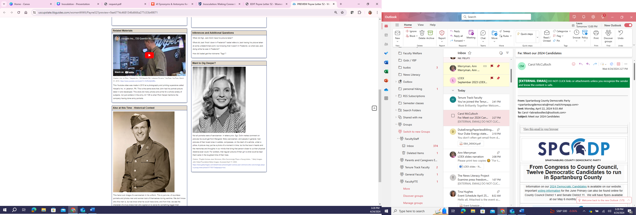
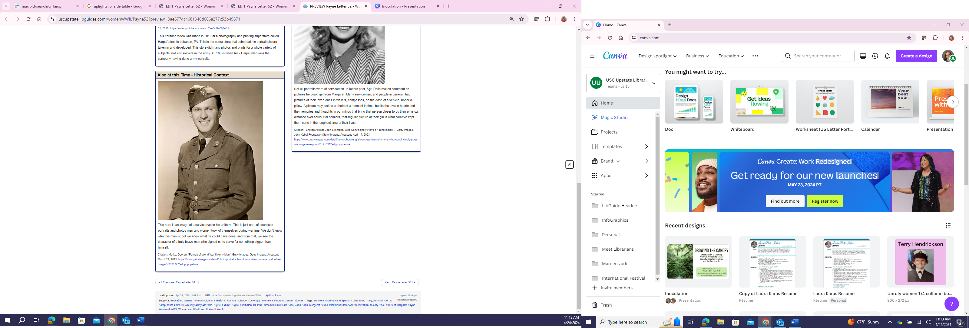
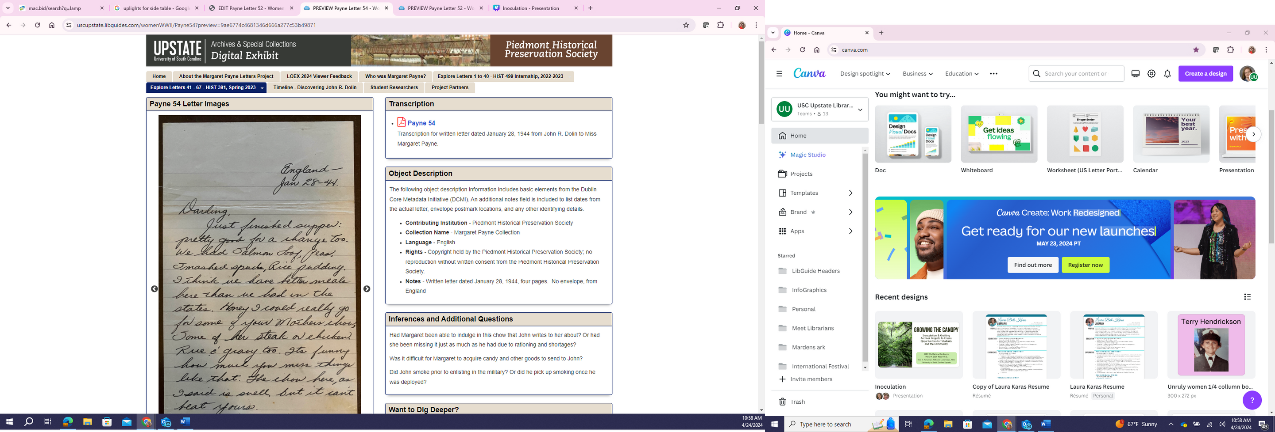
Each Page Included:
  Letter and envelope images
  Transcription PDF
  Object Description (metadata)
  Related Materials
  Also at this Time - Historical Context
  Want to Dig Deeper?
  Inferences and Additional Questions
Notes:
Slide 11: LAURA
Before we go further, we wanted to offer a glance at the finished product, so you can have a mental image of what we are talking about.
Here are two images of what a final page looks like in the digital exhibit. I attempted to create a museum-like vignette for each letter.
Digital image of the letter and when available the envelope, shown in a Gallery Box
PDF copy of the transcript done by the students
Meta data about the object
“Inferences and Additional Questions” used by students as a place to ask questions as trey transcribed their letters for possible future research we told the students they did noto have to use any of the questions they placed in the box but I think this helped them to begin to choose reseach topics
“Related Materials” this is where many students put their propaganda images that was one particular assignment
“Also at this time” this box was to choose a historical event that happened during the time of the letter
“Want to dig deeper” while some students used this box to put links out to other websites that discussed their topic some used this area to do additional research on one of their topics from another box
The students were trained in how to add their content to the boxes and edit if they wished to make changes. As we worked, I did realize that to keep images together and to maintain control of some information we would need to create some particular protocols, such as having the students send images to us so we could be the owner and they would sit in a folder we could access. More than ½ way through the class i realize the Citations with links in the rich text boxes of the student research would not work with the link checker so my solution was to create a hidden box that would contain the citation as a link
I also want to mention that at the end of our presentation, we will open up the guides and show you around the front and back sides of our exhibit during the questions and answers. (transition to slide 12)

Slide 12




Assess and Evaluate...
26 letters transcribed and researched as part of the Women & WWII class
44 letters transcribed by the internship class didn’t include the additional research
Independent Study,
First 40
Letters
Women & WWII
Class,
2 letters
per student
Women & WWII
Digital Exhibit
Creating a cohesive exhibit requires consistency among all components
Ann Merryman,
Laura Karas, &
Student Employee
Notes:
(Ann)
The organic way this project evolved left the initial portion of the letters written to Margaret Payne by John Dolin transcribed but without the supporting research for the letters that students were creating in class. As a result, Laura and I, plus my student archives worker (who was also a student in this class) decided to take on the the task of researching and adding the contextual information for the first 44 letters transcribed by the independent study students. We did this in order to ensure uniformity across the digital exhibit and provide consistency across all letters. This decision turned out to be a LOT more work than we anticipated.
Despite the very large additional workload, this decision helped us to see the student's side of the project and encouraged us to come up with additional resources to help students more efficiently complete their assignments. It also allowed us to build a foundation of information about "who" the students were reading about in the letters, Margaret and John.

Slide 13

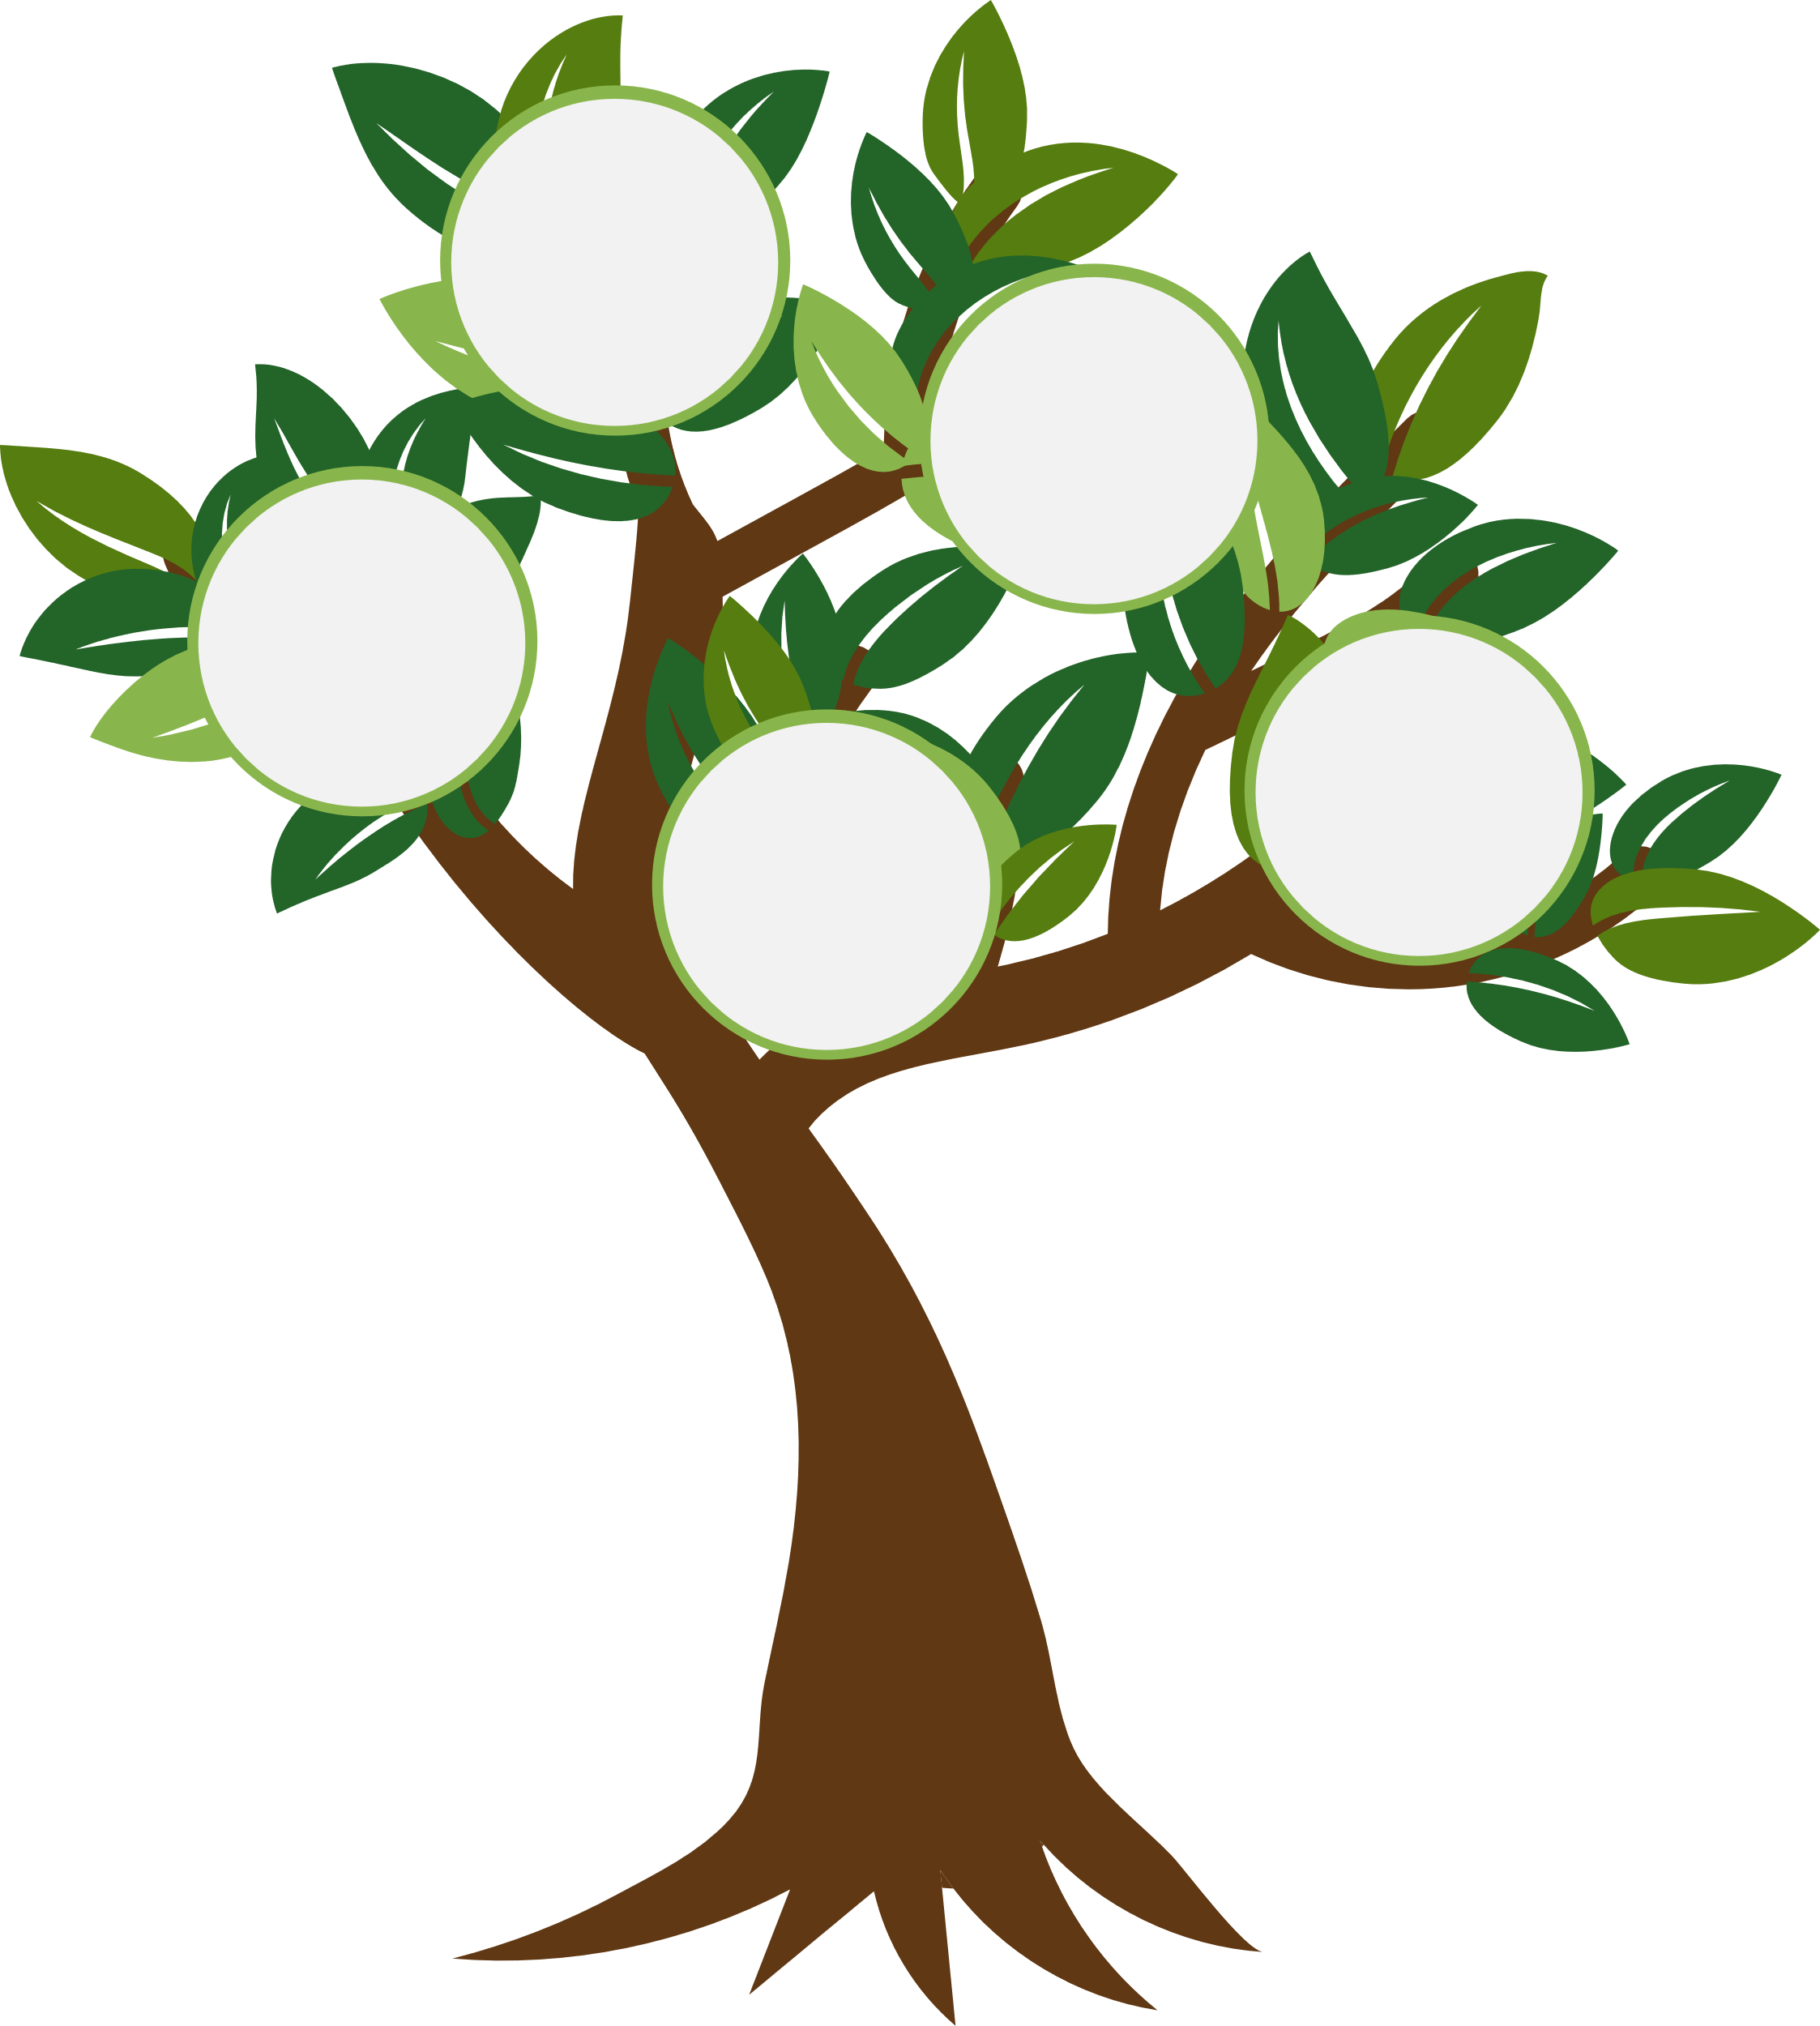
Adding Context &
Family Trees
Richard
Dolin
James
Payne
Lucy
Goss
Dolin
Blanche
Peden
Payne
Isabel
Dolin
Forney
Lillian
Payne
Bertha
Dolin
Rhea
Ruby
Payne
John
Dolin
Margaret
Payne
  Family Trees
  Genealogical Profiles
  Timeline
  Local History & Maps
John Richard
Dolin
Family Tree
Margaret Payne
Family Tree
Notes:
Slide 13: ANN and LAURA
(ANN) As we began working on the first 44 letters, we very quickly asked ourselves a few questions like: WHAT makes Margaret so special? She kept and donated the letters to PHPS and they show everyday life in Piedmont SC during this time. AND SECOND, Who was John Dolin? From reading his letters, we only got a brief view of who he was (and honestly it wasn’t very flattering). We realized that we needed to do some significant research into John Dolin and uncover details about his life that would allow us to create a holistic picture for the students. This would allow the students to understand not just who he was, but also where he was during the time the letters were written. Laura and I did extensive research using Ancestry.com, Fold Three, and contacted many public libraries and school archives to pull together this information. For those of you who now *NEED* to know these answers, we’ll be happy to pull up the live version of the exhibit at the end of our presentation and show you the timeline!
(LAURA) I also used my genealogy skills and created family trees for both John and Margaret that included other family members mentioned in the letters, such as John's sisters, and Margaret's sister Lil and her cousin Ruby. Building a profile of who these people were and how they were related helped make this assignment come to life. And the juicy drama that was John's life kept everyone captivated.
We were excited to do this part of the project because 1. I’m nosy and curious and 2. it allowed us the ability to improve and expand on the project's design as we went through the semester. We shared this information and our suppositions about John and his life to help the students connect. Creating examples for the students by working on the first 44 letters helped them to understand the goal of the exhibit and illustrate what each page they were responsible for could look like.
Ann's student worker created a spreadsheet of all the letters and a LibGuide page of potential topics for context, and the three of us connected the topics to specific letters and then did the research needed to build out the content boxes on each letter page.
However, in subsequent projects, we would NEVER be doing this work as it would be the students' responsibility. (transition to slide 14)

Slide 14
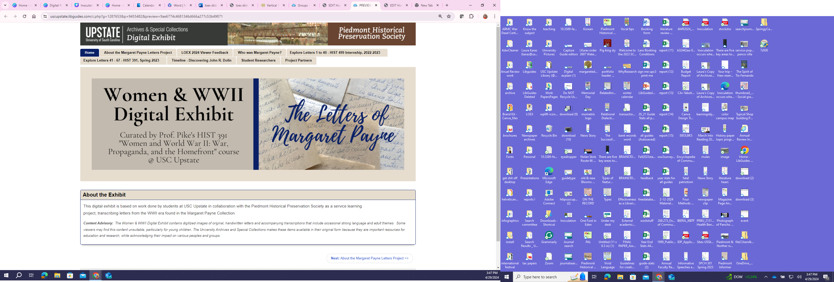



The Fruits
Student Researchers
LibGuides Platform
Women & WWII
Digital Exhibit
The Letters of Margaret Payne
Notes:
Slide 14: LAURA
From the beginning, I took my experience with LibGuides CMS to create a distinct look and feel for this project that would have more of a feel of a webpage that was also searchable to a degree.
I created a separate group for this project giving it a group header, and distinct look and feel. Also, with the Group I could give the students permission to get into the back side of JUST THIS GUIDE and be the editors of their own pages. I would later use this guide and enhance the Group to include the Blanche Peden Payne Letters and possibly other collaborations with the Piedmont Historical Preservation Society.
If you want more information on how I did the “behind the scenes LibGuide stuff” email me and I would be more than happy to share.
Both Ann and I were embedded in this class and attended work periods most Fridays to teach the students how to put things into LibGuides and also help them think outside the box for research ideas. I also encouraged the students to use images, video and other artifacts on their pages to make them visually interesting as well as educational. (transition to slide 15)

Slide 15
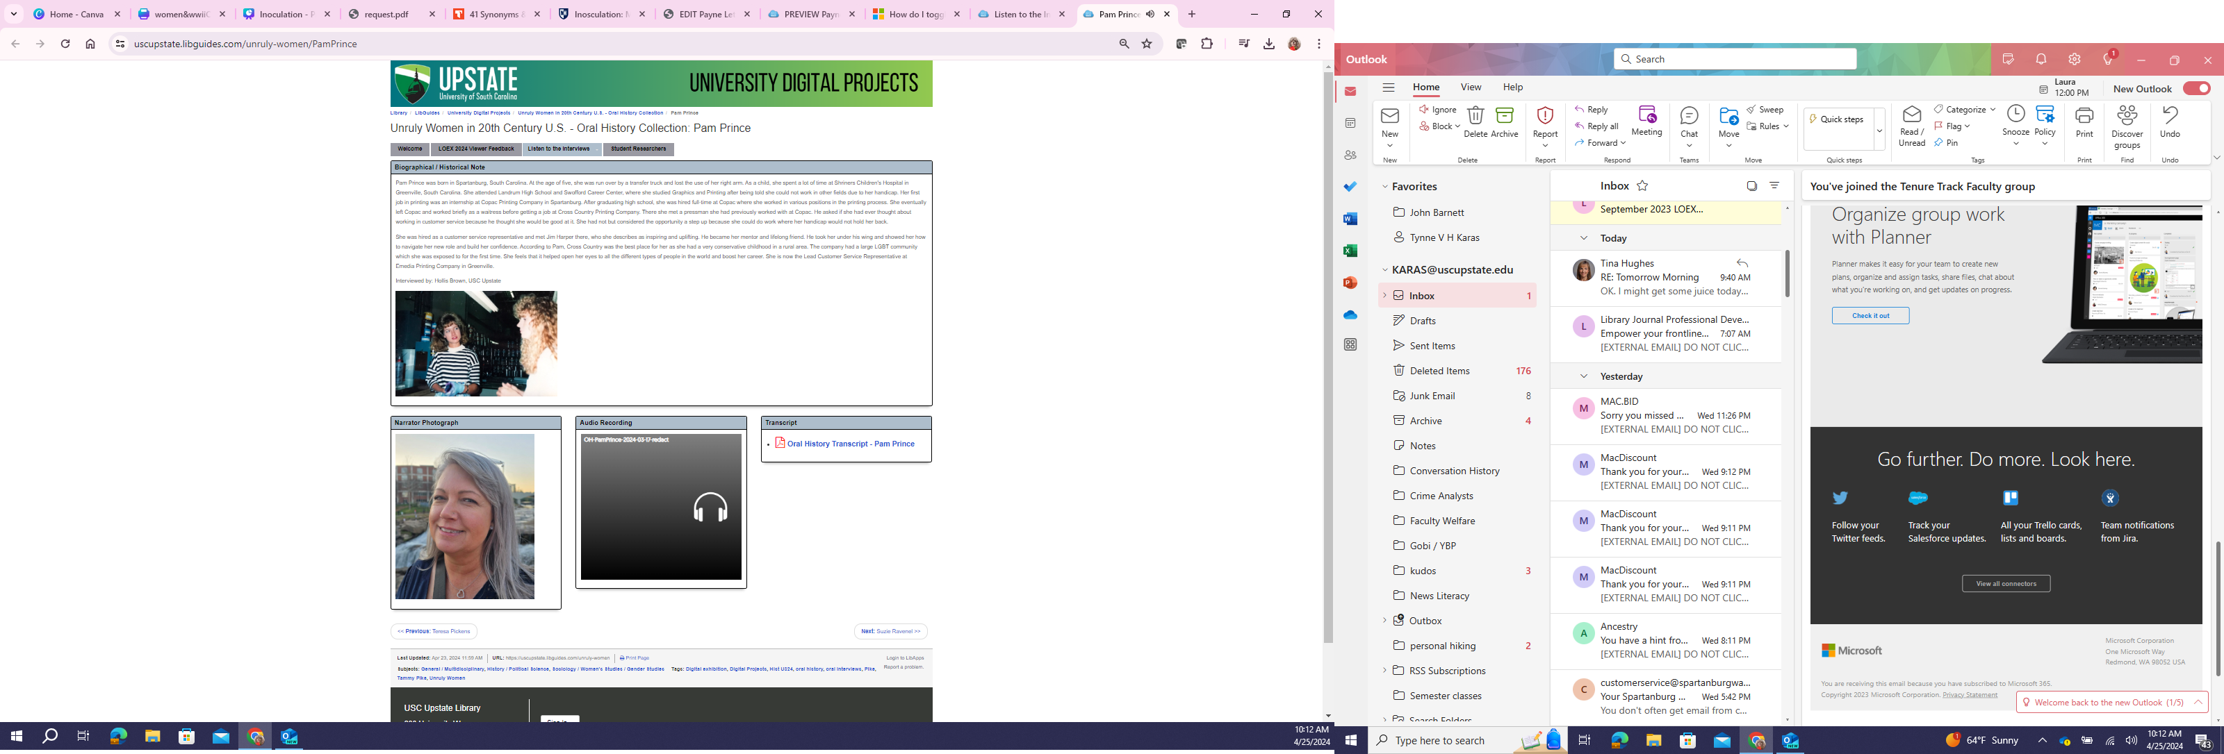
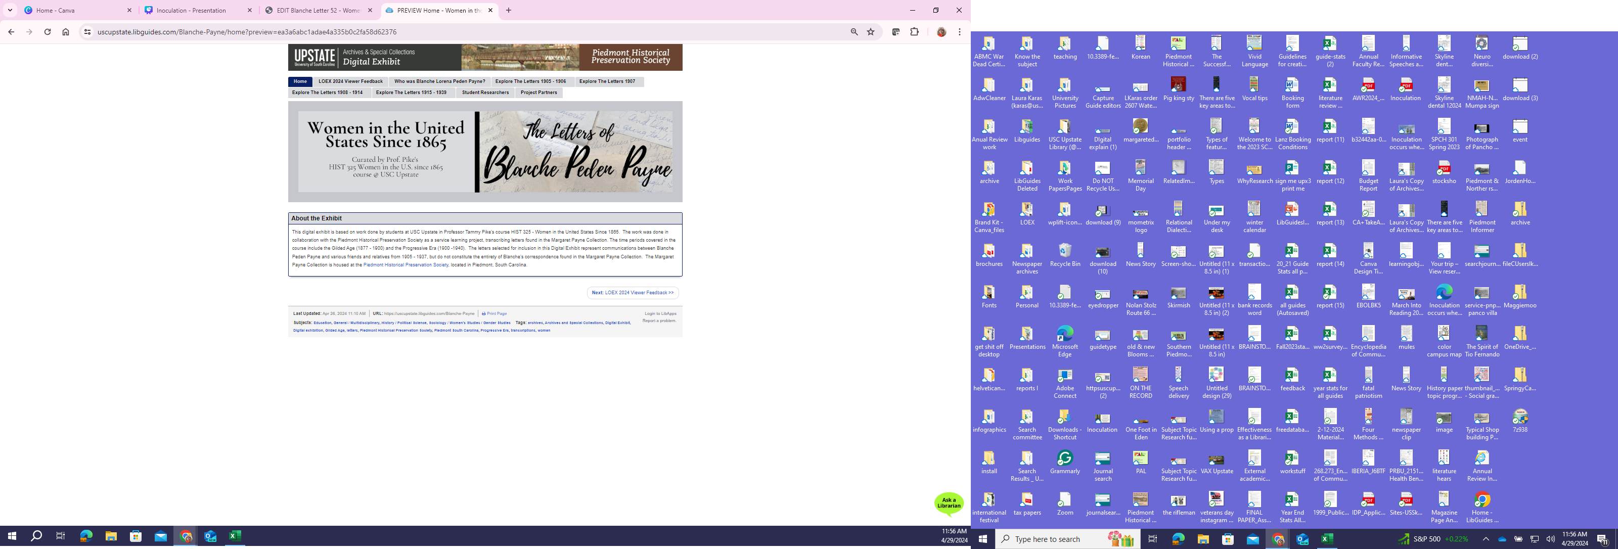
New Growth - additional projects leaf out...
HIST 325 - Women in the U.S. Since 1865 (Fall 2023)
Letters of
Blanche Peden
Payne
Digital Exhibit
Unruly Women Oral Histories
Project
Tammy Pike
Service Learning
Classes
HIST 324 - Unruly Women in 20th Century U.S. (Spring 2024)
Notes:
Slide 15: ANN
As we approached the end of the semester and the completion of the digital exhibit, Tammy requested to repeat the project again with her upcoming Fall 2023 course, "Women in the U.S. Since 1865". The project would be set up the same way and would involve students transcribing a selection of letters written by Blanche Peden Payne, Margaret's mother. The letters spanned the years 1905 - 1937, bringing them up to the time just before Margaret's letters began. This time, Laura and I would not generate content for the exhibit but would still provide training and support through regular work periods during the semester.
This project was also successful, but the students had a more difficult time engaging with the content of these letters as they were written by many different people. This made it much harder for students to see a single “through-line” connecting all the letters. To help the students, Laura again provided deep, contextual genealogical research by generating a family tree for Blanche and her husband James Huff Payne. This seemed to help some students, but we realized that this time, the greater value would be to researchers and viewers of the digital exhibit.
Near the end of the semester, Tammy once again asked for assistance with a third digital project for her upcoming “Unruly Women in 20th Century U.S”. This time she wanted to have students record oral history interviews with someone they identified as a "Remarkable Woman". However, she needed assistance understanding and developing the process the students would use, and how the LibGuides platform could be used to present these oral histories. Using a combination of LibGuides and YuJa, the audio files were presented along with the transcriptions and supplied photos of the student's chosen narrator. (transition to slide 16)

Slide 16
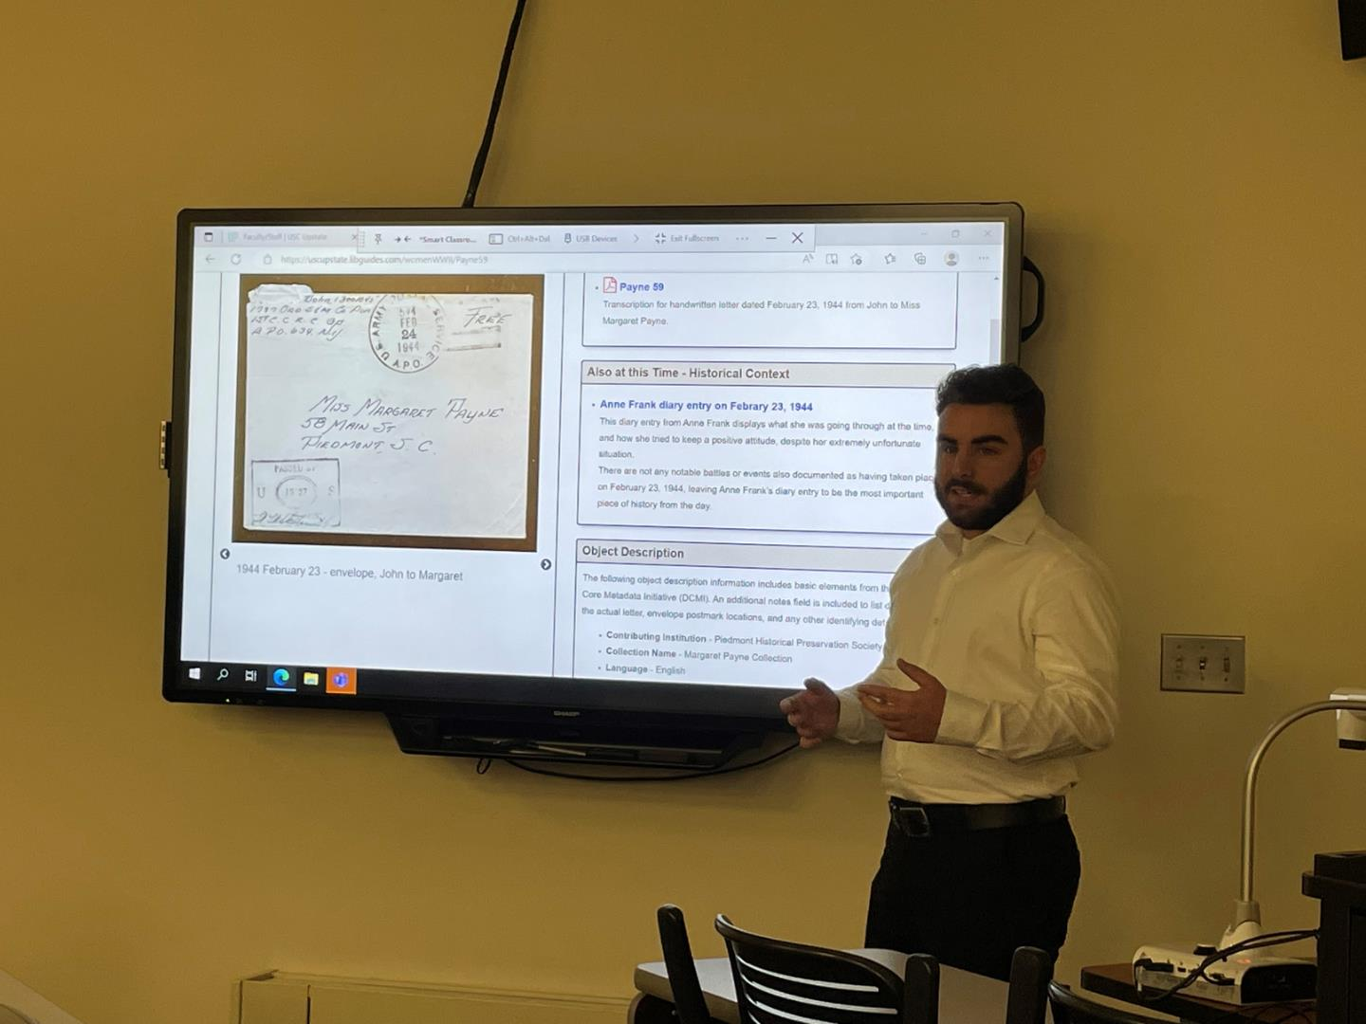
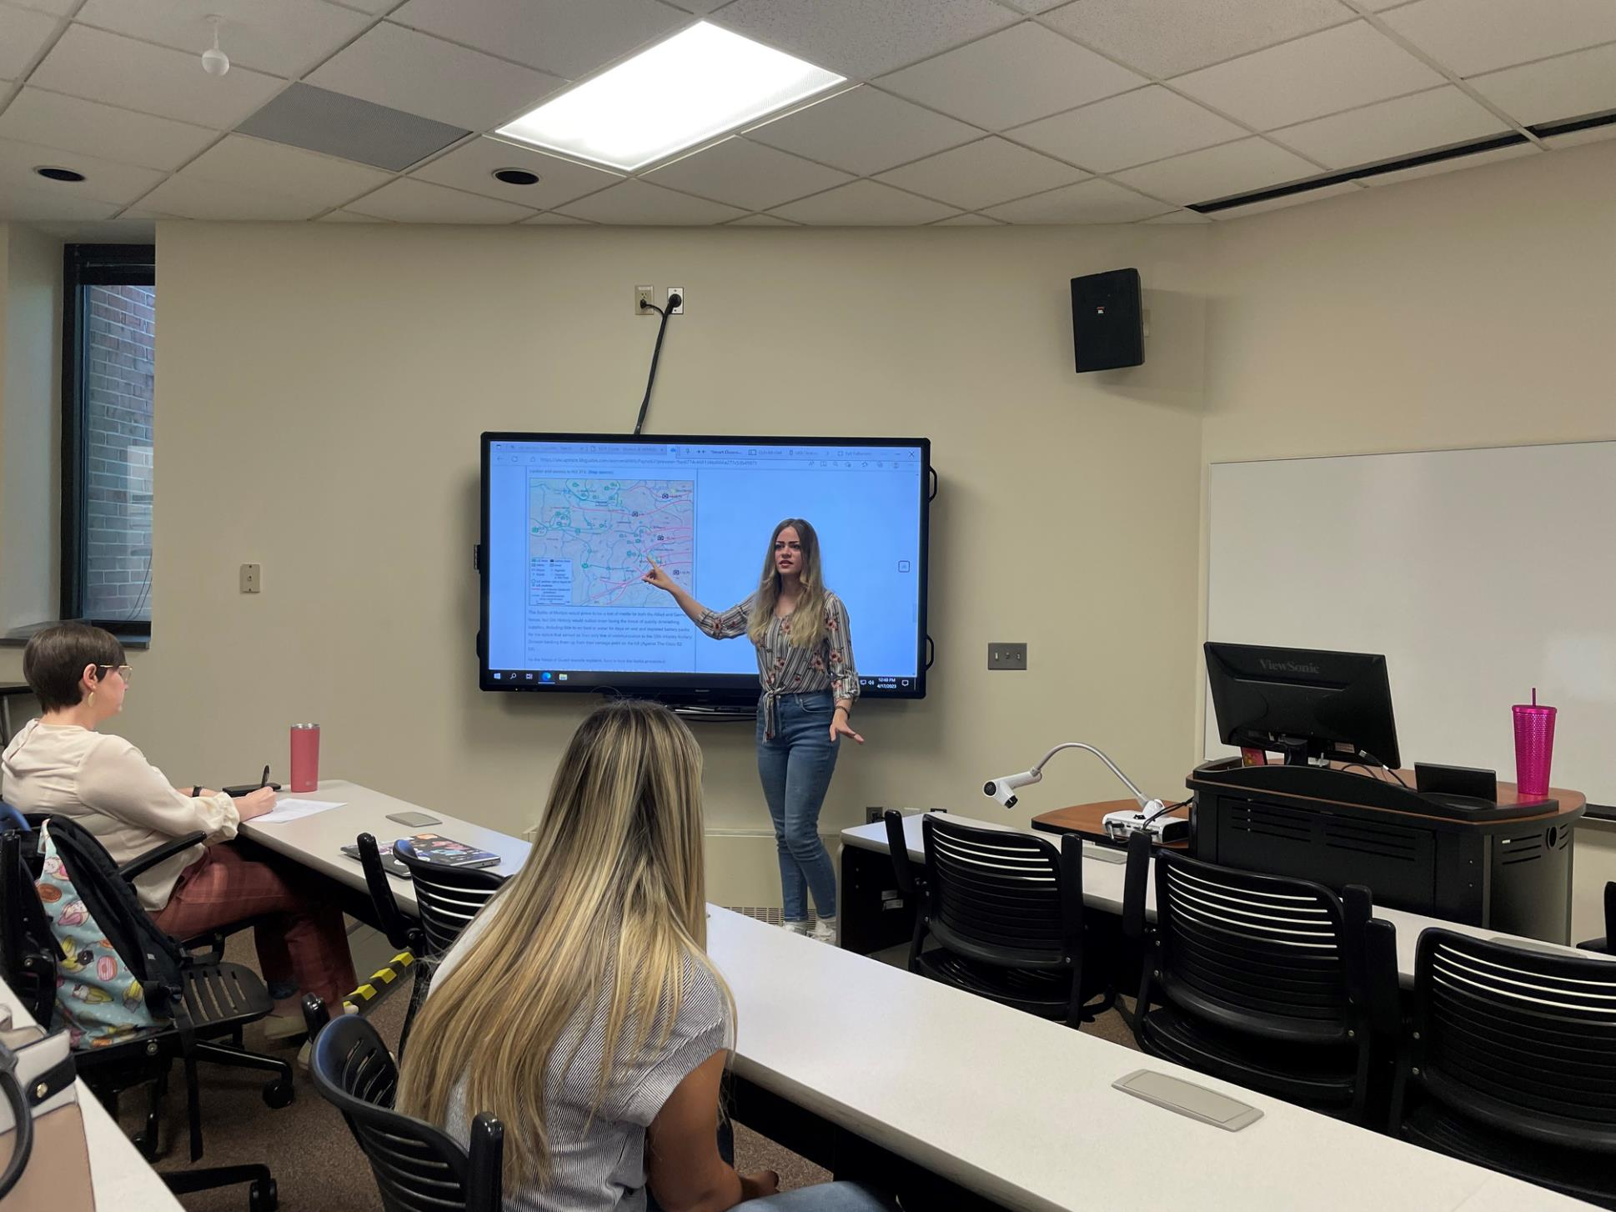
2023 Awards
Faculty Excellence in Service‐Learning Course Design -
Tammy Pike
Student Excellence in Service‐Learning in Research -
Lauren Henderson & Mallory Stoop
2023 Presentations
Women’s History Month Digitizing Hand-written Letters: Working
with Students to Preserve Women’s History – Tammy Pike
SL/CE Panel Engaging Students and Developing Community Partnerships -
Tammy Pike and Joe Hursey
SCURS: New History Discovered Through Digitization -
Lauren Henderson and Mallory Stoop
SCURS: Women & WWII Digital Exhibit - The Margaret Payne Letters -
Ann Merryman and Laura Karas
Notes:
Slide 16: LAURA
The original project finished with every student in the course presenting on their letters and the guide pages that included all their supplementary research. This proved to be a very good experience for the students. Pictured are two of the students standing in front of the classroom presenting their pages. We both attended as many of the presentations as possible to continue our embedded commitment and show support for the students.
A few students did presentations at the South Carolina Upstate Research Symposium on the project, where Piedmont Historical Preservation Society members were in attendance. Professor Pike did a panel presentation and a women's history presentation talking about the instructor's side of designing this type of project.
Professor Pike won the Faculty Award for Excellence in Service-Learning Course Design, and two students won the Student Excellence in Service‐Learning in Research award. (transition to slide 17)

Slide 17
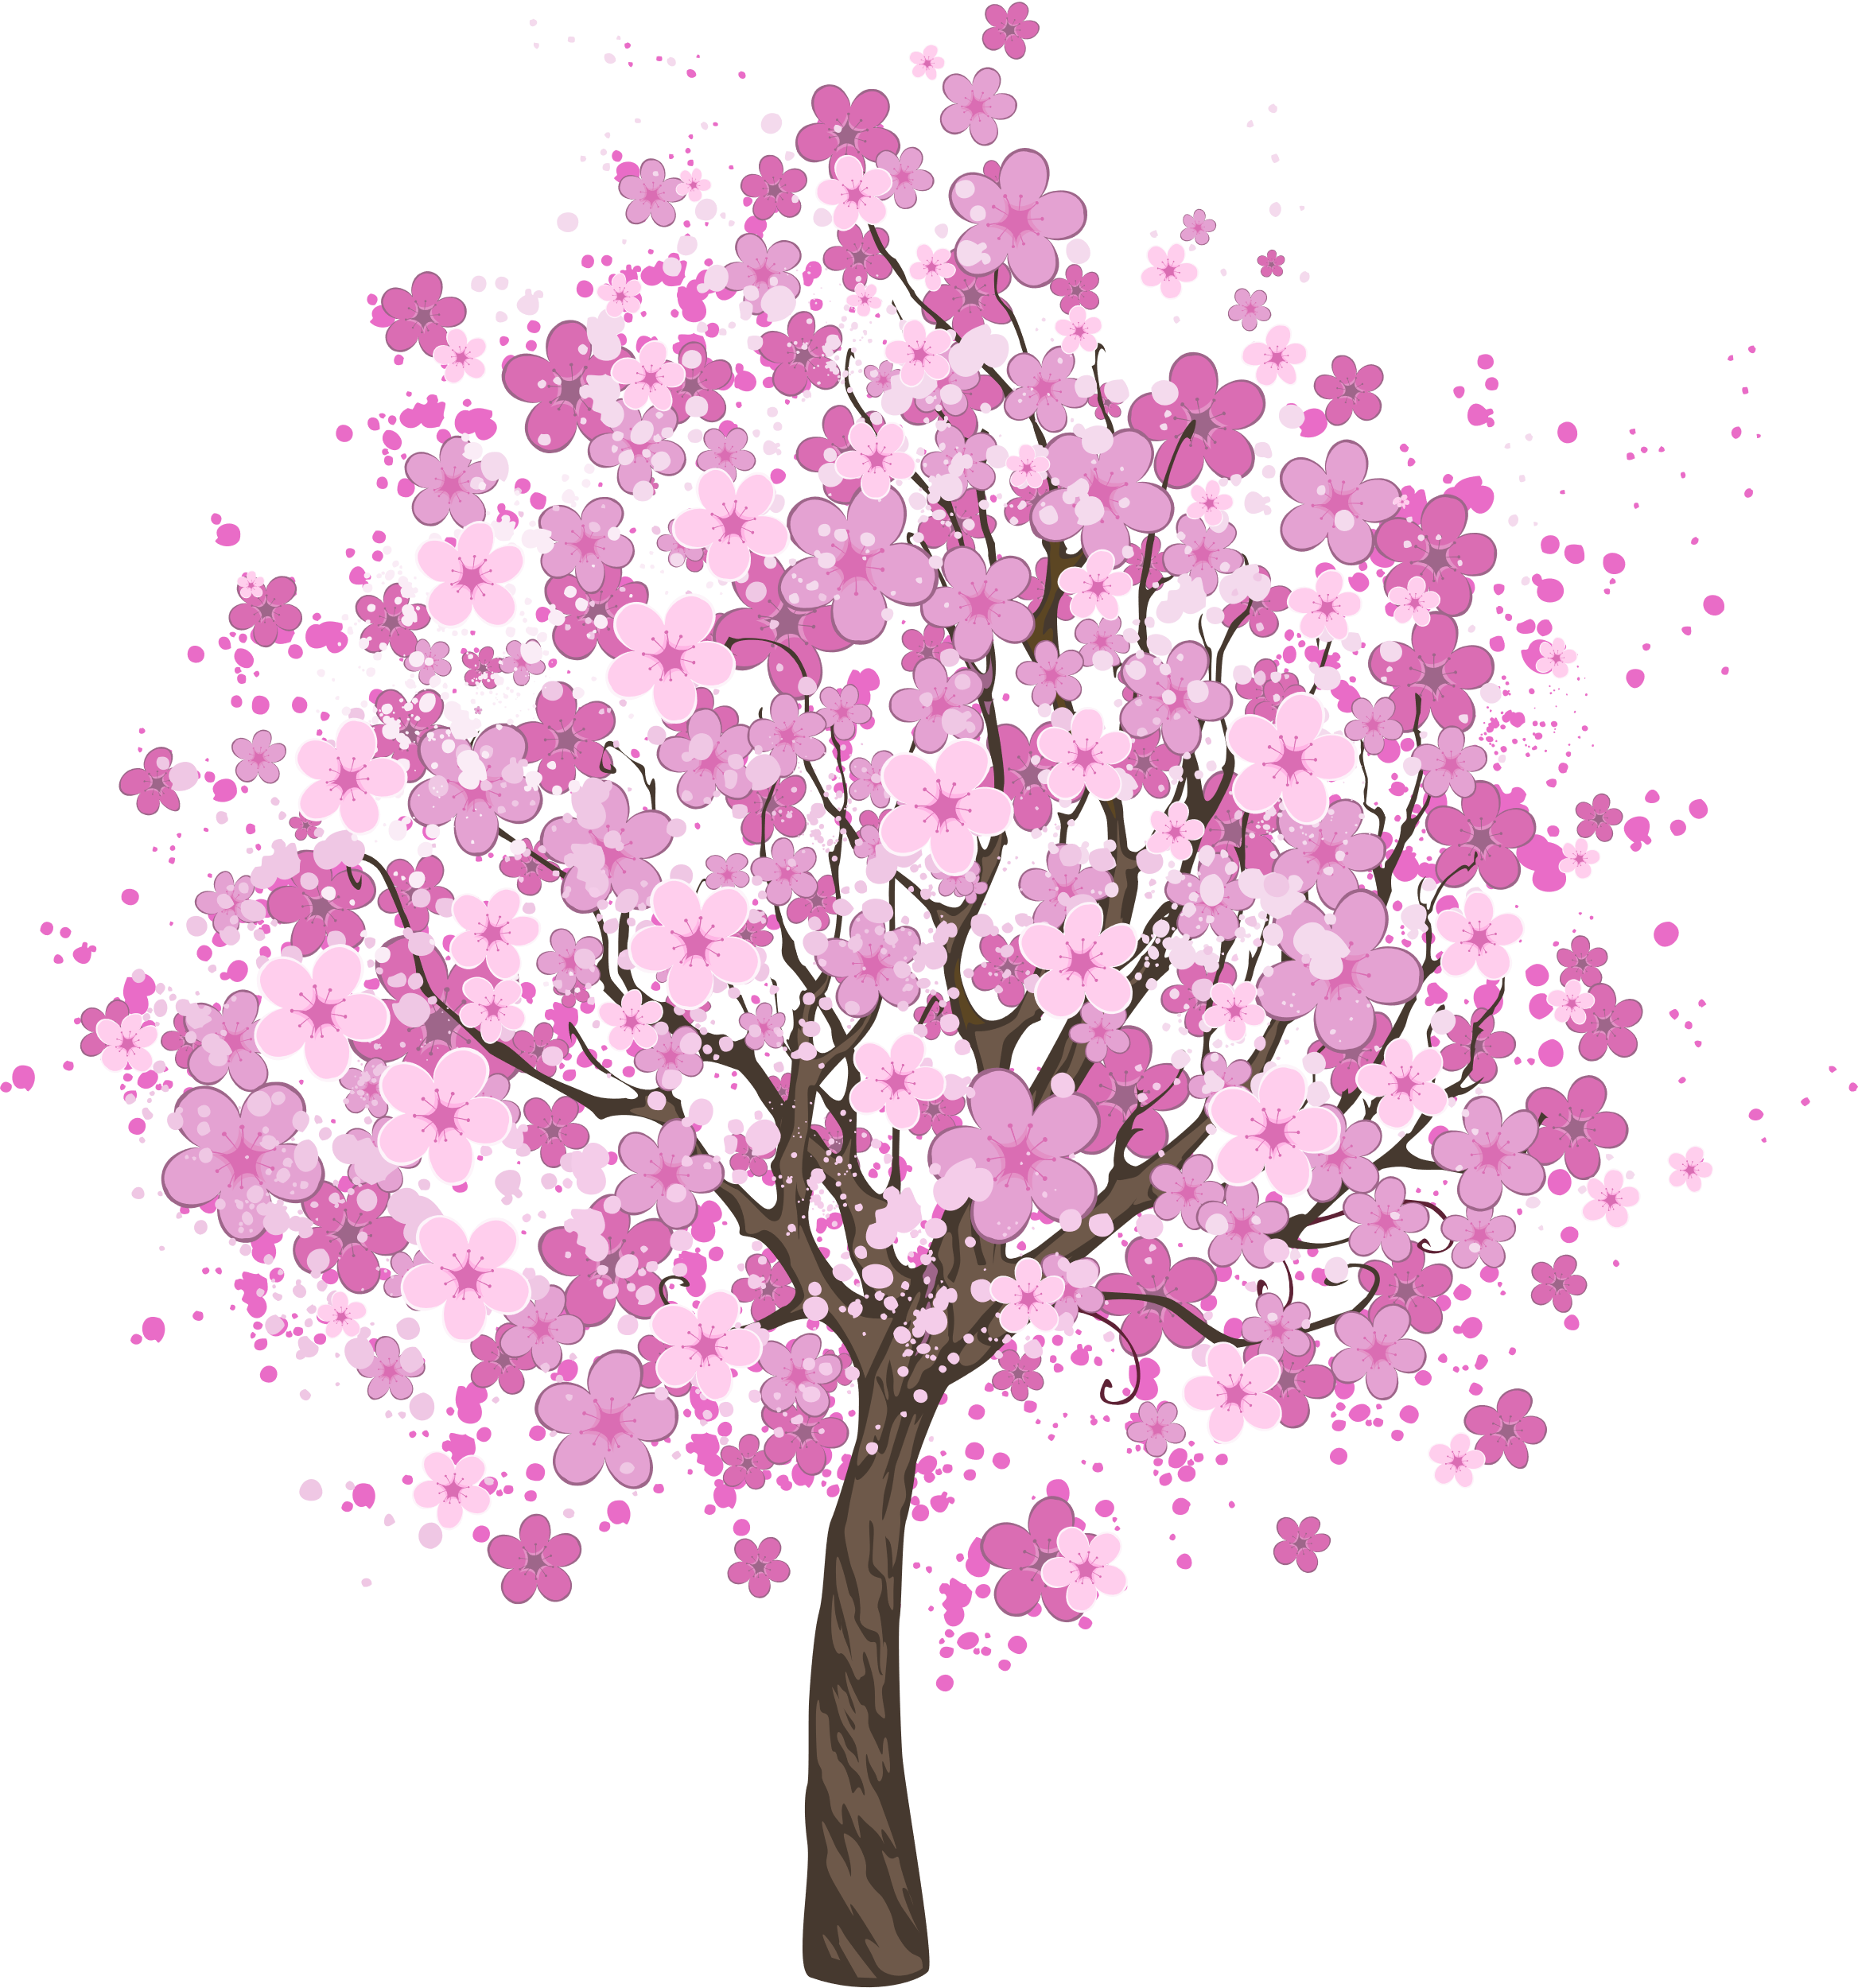
Who Benefits & How?
Community Partners
  Publicity, visibility, free labor, and fundraising opportunities
Students
  High Impact Practices (HIPs)
  Career Skills
Archives/University/Library
  Examples for
  Unofficial recruitment tool
Notes:
Slide 17: ANN
Let's look at who benefits from grafting and growing projects like ours. Our community partner, PHPS, benefitted from the partnership. First, they received the transcription and organizational help of the students. They also used the finished digital exhibit as part of a successful fundraising push to renovate a historic house in Piedmont that will become their museum. They have also used the exhibit to provide greater visibility to their organization throughout the community, and it has become a tool to generate more interactions among community members.
Students also benefit in multiple ways when these inosculated and grafted projects are created. In our projects, students benefitted from the High Impact Practices we integrated into the course: collaborative projects, service-learning, and community-based learning.
Students gained experience with document transcription and were exposed to various types of genealogy documents and ephemera. They also finished the project with concrete examples of project work that could be included on their resumes and LinkedIn profiles. Finally, they gained valuable skills such as: critical thinking, reasoning and inferences, communication (both personal and professional), public speaking, basic graphic design and layout skills, research, and some project-specific technology skills.
The university, library, and archives all benefitted by gaining a strong community partner who could provide additional service-learning opportunities for students in the future. The ongoing partnership also acts as an unofficial advertisement and positive recruitment tool for the university. The library has been able to use the project to advertise the versatility of the LibGuides platform for other projects around campus, and highlights the willingness of library faculty to create partnerships. The archives benefits from greater visibility through my involvement with all these different projects. (transition to slide 18)

Slide 18
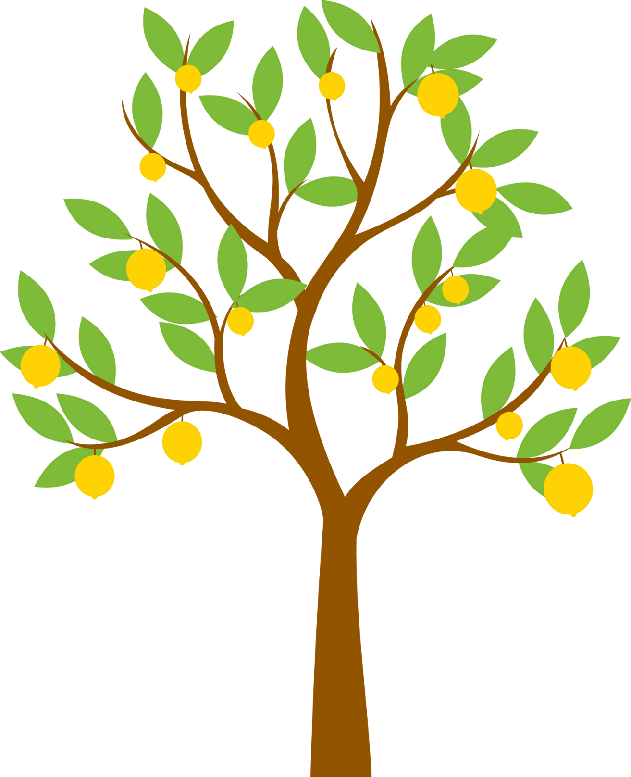
Finding Partnership Opportunities
  Faculty (including liaison areas)
  Partner institutions
  Campus groups
  Community organizations
Notes:
Slide 18: ANN
Identifying opportunities for partnerships can take many forms. For university librarians, it could be as simple as talking to your liaison faculty and identifying those who seem willing to try something different, or who are already doing their own outreach to various community organizations. Watching for announcements from campus groups and administration about various initiatives can spark inspiration, as can local news stories. Building collaborative partnerships with fellow librarians, other universities, and public libraries is often a source of inspiration. Finally, canvassing community groups and historical societies to find those willing to host student projects will provide mutual benefits. (transition to slide 19)

Slide 19

It would be beneficial to show students how to attempt each of the technical, design, and layout features of using a digital exhibit.
I enjoyed being able to use small pieces of information that led me to uncover larger pieces of history. Making connections between individuals or places with bigger events was an incredible aspect of this course. The most fulfilling part of the digital exhibit project was being able to preserve personal letters, give them context in order to tell a story, and share the letters and our research with a greater audience of historians, researchers, and community members.
The thing that kept me the most motivated throughout the project was my sense of community responsibility for the success of the LibGuide. I really felt like everyone's contribution mattered equally and everyone was responsible for the project to succeed. I also had a sense of personal pride and excitement for my projects and wanted to make sure I contributed a good effort to help the LibGuide succeed.
More demonstrations on how to do everything, and possibly trying to make students more comfortable reaching out about their letters/research, or offering that help to them. More frequent checks on Libguide progress.
Working with both the instructor and librarians in weekly workshops was the most beneficial aspect of this course by making sure students were caught up with the digital exhibit project.
I loved reading the letters themselves! It was so interesting to see how similar people from a different time period are to modern people.
The workshops were a great motivation because they were a specific time for us to work on our Libguides and ask questions and seek assistance if we needed it. It was great having that dedicated time to work on things and get the advice of others.
Doing the research was fun and exciting. I never knew what I would or where the research would take me. It was like reading a book and being on the edge of my seat until the end.
Student
Feedback
Sometimes the letters were sparse, making settling on research topics difficult. Maybe providing links to resources such as timelines to help guide students to their historical contexts would be helpful? Then again, they are very easy to find, especially if you already have a date from the letter to work with.
Notes:
Slide 19: LAURA
Each time we did a digital project, we included a student feedback survey that they completed near the semester's end. We wanted to know what we did well, and what didn't work for the students so that we could adjust the next project.
We had about 95% survey completion after the first semester, with students overwhelmingly positive about the project design and what they learned during the semester. They were also honest about what they didn't like, and what they would change if another project came around. All feedback was used to adjust the next project: The Letters of Blanche Peden Payne.
like this quote:
The workshops were a great motivation because they were a specific time for us to work on our Libguides and ask questions and seek assistance if we needed it. It was great having that dedicated time to work on things and get the advice of others. The work periods were often very collaborative.
(ANN)
My favorite quote is this: The thing that kept me the most motivated throughout the project was my sense of community responsibility for the success of the LibGuide. I really felt like everyone's contribution mattered equally and everyone was responsible for the project to succeed. I also had a sense of personal pride and excitement for my projects and wanted to make sure I contributed a good effort to help the LibGuide succeed.
(LAURA)
I often struggle with how much to "suggest" with students since I don't want to DO their research for them, and that was one complaint we got for both projects, that the students had problems tying their letters to topics. I think this is a skill students are losing or don’t have so I try to encourage them to think outside of the box and do some interpreting and conjecture.
For example one letter implies Margaret was baking in her underwear, it was summer, and she was wearing a slip. What direction could you go from this? How hot was it in July in SC hotter than usual? What did slips look like back then? When did the air-conditioner become a household item? How did people in mill houses keep them cool? And the possibilities go on.
Having pre-finished examples will help future students get a grasp on the concept and hopefully allow them to make smoother connections. I think in the future I may create a more in-depth timeline before the class starts so the students can look at some of the things that were happening at the time of the letters. Maybe even include links to "Today in History"-type websites to encourage the students to look around and research... In some ways the Letters of Blanch Peden Payne ran smoother because of all that we learned during the Margaret Payne project.
Also, I feel like the classroom “buy-in” from the students will affect the overall success of a project. It seemed very high with the first project with lively banter on Friday work periods and less so in the Oral histories project. (transition to slide 20)

Slide 20

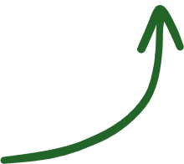



Project Execution
If we had known then what we know now...
  Steep learning curve
  Organic growth
  Student investment
Project Challenges...
  HOW-TO instructions
  Introducing small topic research
  Inconsistency and incomplete work
  Reading cursive
Notes:
Slide 20: ANN
I think the Letters of Margaret Payne digital exhibit project had some steep learning curves for EVERYONE, including us. If you’ll forgive my non-arborist analogy, we were making it up as we went along and building the airplane while flying it, and we lacked the in-floor lighting leading to the emergency exits. We didn’t know what we didn’t know. However, after the family tree information and the timeline of John Dolin’s life were added to the site, the students got a lot more invested in the project. We still had many challenges, however.
We learned early on that success would hinge on how well we set up the students to find and present their content. We added a comprehensive page of HOW-TO content, but not until the project got underway, and found ourselves adding to it throughout the semester as the students came up against roadblocks. It was also challenging to teach the students the concept of small topic research: making the intellectual leap from letter contents to identifying potential research topics to build out the guide content. While we were not instructors of record, Tammy recognized us as valuable teaching partners and encouraged us to work directly with students who seemed to struggle with various parts of the project. We had to develop ways to work with Tammy when we identified inconsistencies with student work and decide how to deal with incomplete student work. Finally, some students struggled with reading cursive handwriting, making transcribing the letters difficult.
The second and third iterations of our digital exhibits have benefitted from these challenges, but the students in our first cohort really had to blaze the trail through the woods. (transition to slide 21)

Slide 21




Questions
Look @ us
QR Code to LibGuides
merrymaa@uscupstate.edu
karas@uscupstate.edu
Notes:
Slide 21: LAURA
We want to take a few minutes now and open up the Letters of Margaret Payne Digital Exhibit guide and show you around.
(OPEN GUIDE FRONT PAGE) -
Remember earlier, I mentioned how the guides have a specific “look and Feel”
READ each tab name, and briefly describe
LAURA – survey
ANN – About the project
LAURA – About Margaret
ANN – Intern letters and Content Advisory Notice
LAURA – class letters AND open Letter 42
ANN – Timeline JS from John’s birth to death, also brief explanation about Hershey School
LAURA – Student researchers
ANN – Project partners
ANN - So, we have some time left for questions. We also want to encourage you to use the QR code on the slide to look at our project the QR code takes you to a landing page with our information and links to each of the 3 projects we discussed today.
(IF TIME, open these?)
Slips and Air Conditioning – Letter 37a PUBLIC VIEW
Sid’s Café – Letter 37c PUBLIC VIEW
Letter 65 – FRONT side, and then BACK SIDE

