Slide 1



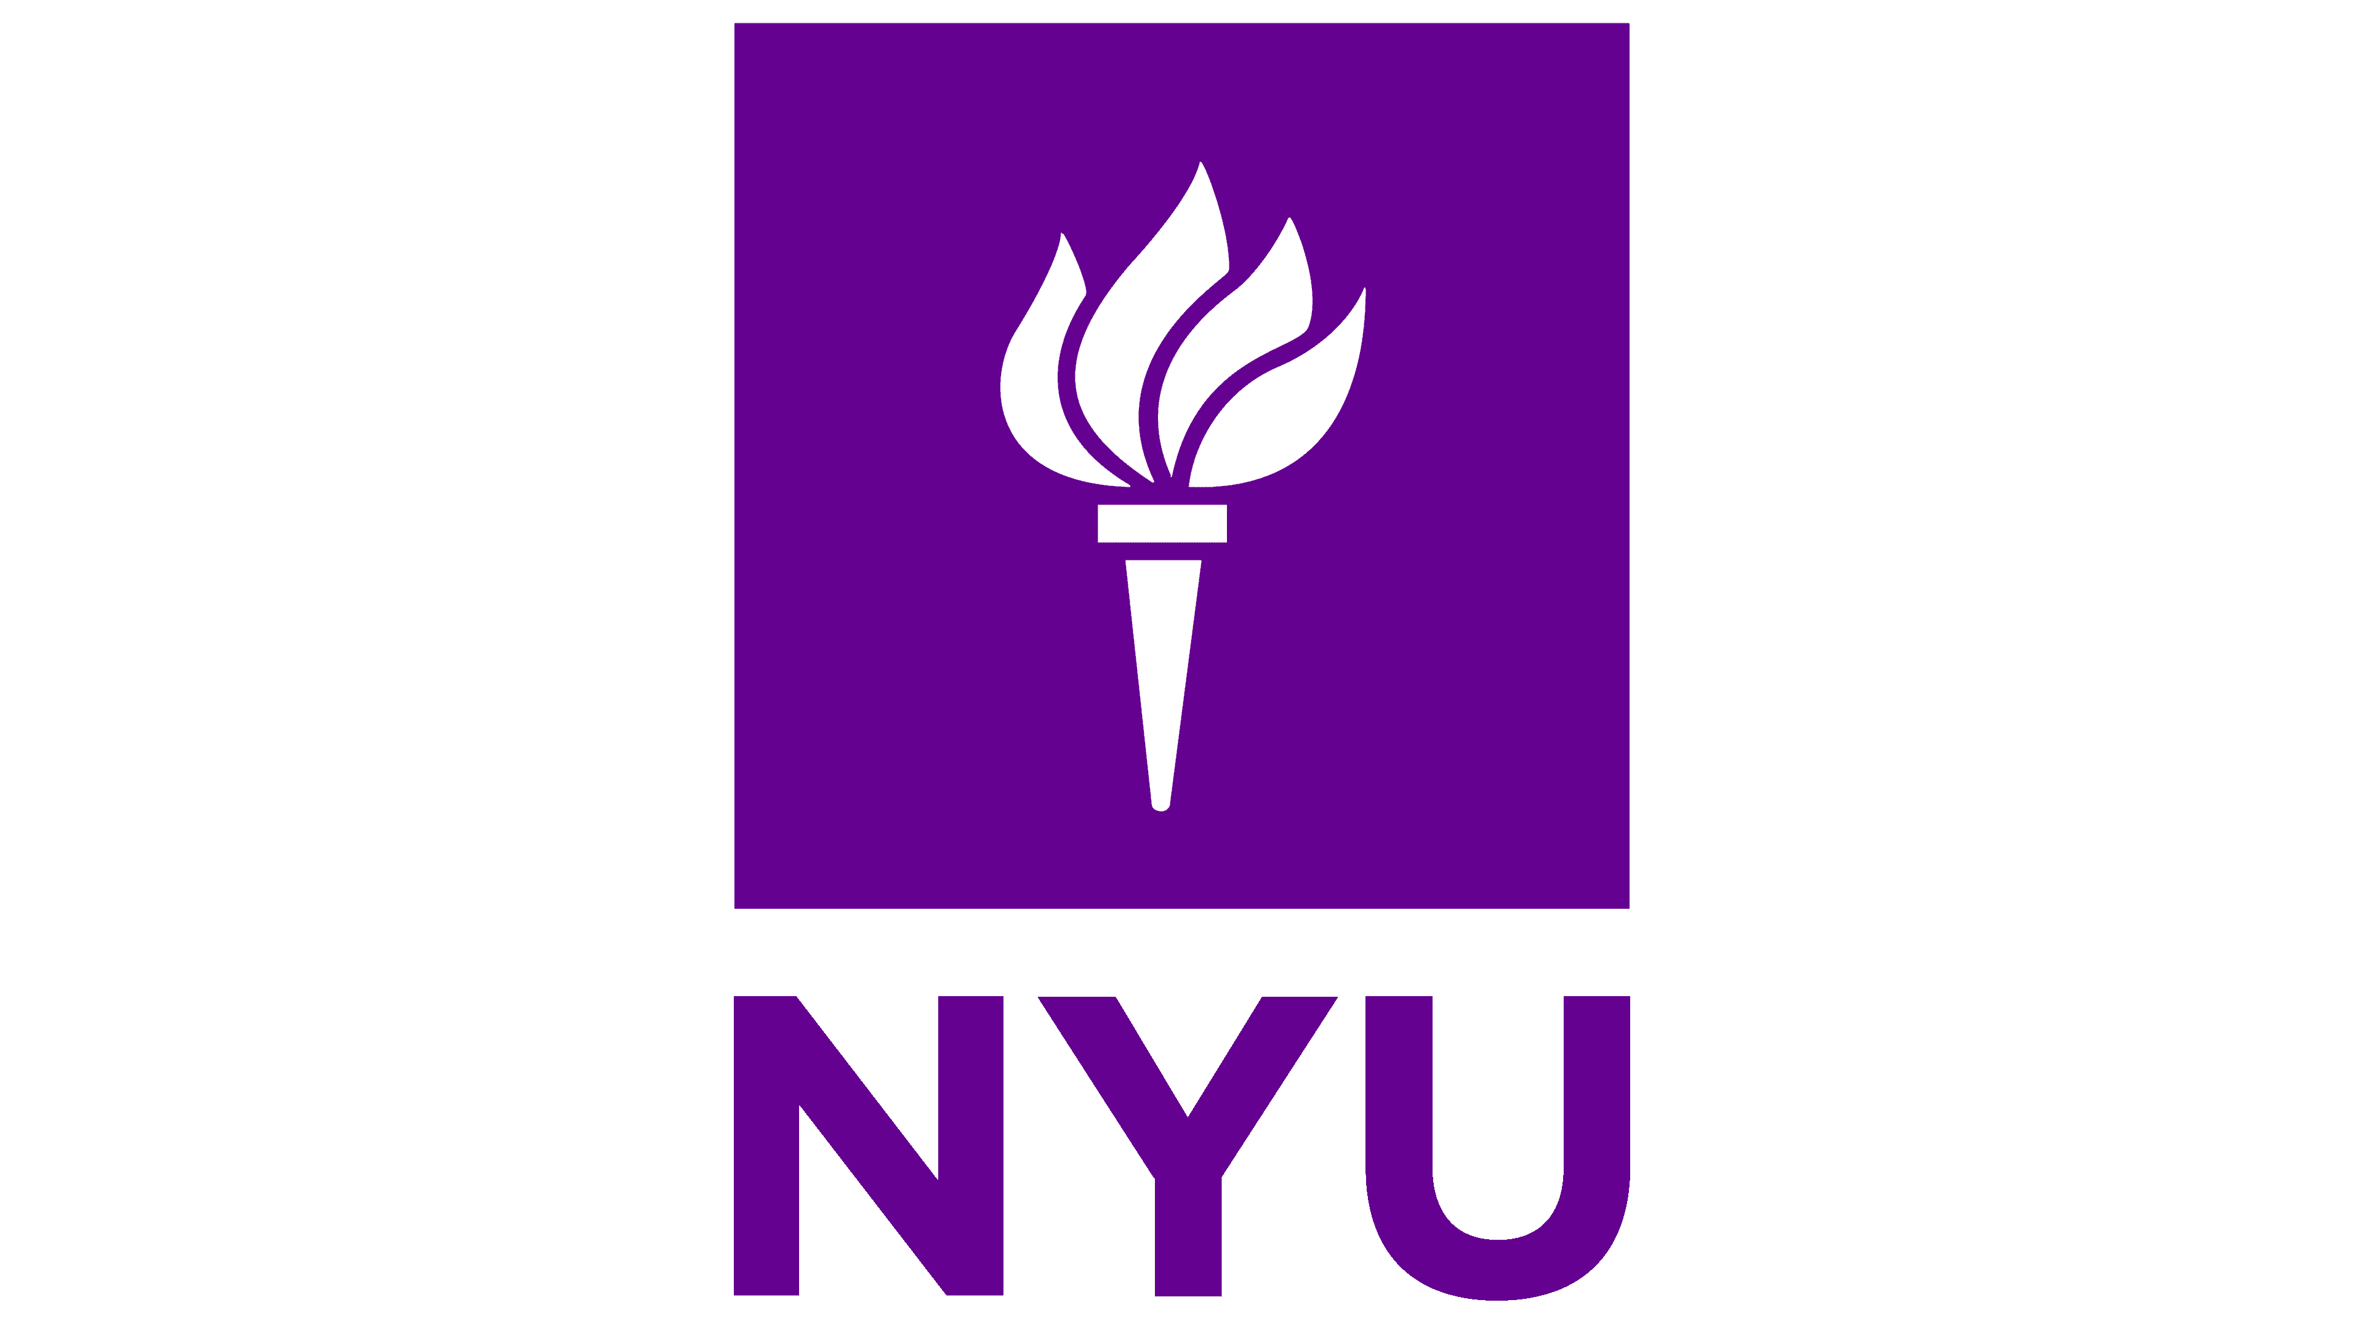
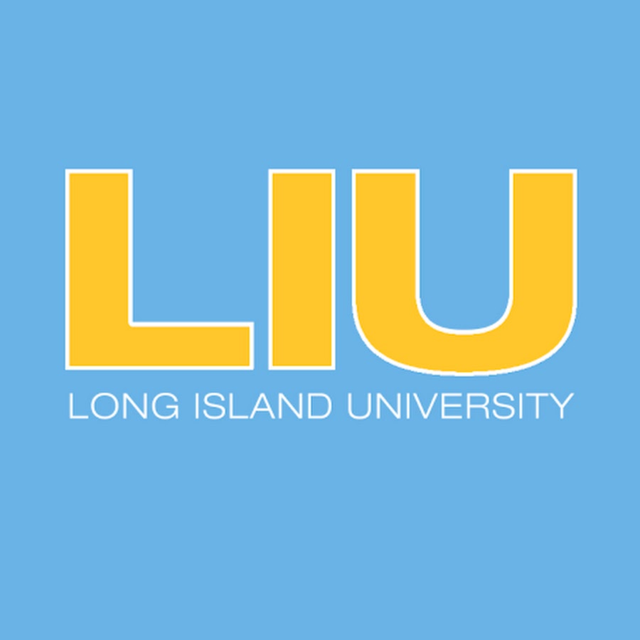
While librarians want to understand the ethical considerations of open access publishing deals, faculty are primarily invested in how open access publishing addresses their career goals and reputation in the field.
Have Your Cake and Eat it Too:
Publicizing Open Access Resources Across the University
Non-Cognitive Predictors of Student Success:
A Predictive Validity Comparison Between Domestic and International Students
STAKEHOLDER PRIORITIES
Librarians:
How do OA deals promote equity in publishing outside of NYU?
How does NYU funding contribute to an OA market with fewer APCs or toll access publications?
How do I explain the deal to faculty in a concise and effective way?
Which OA publishing method is most accessible to faculty in my subject area?
Faculty:
Do OA journals count equally for tenure evaluation?
Do I have to pay to publish OA?
Do I lose my copyright if I publish OA?
Can I embargo my OA article?
Will my research get scooped while I’m waiting for NYU to approve that my article is covered under the deal?
How does OA publishing affect the impact of my research on the field?
NEXT STEPS
In the future, I would like to continue this research by:
doing more direct outreach with faculty.
creating a LibGuide about NYU’s OA deals.
This phase of research created resources for subject liaisons to use with faculty, but I would like to harness what I learned to create resources specifically for NYU researchers.
PRESENTER:
Emma Quinn
In the Spring of 2023, I served as the Collections and Content Strategy intern at NYU. My projects for the semester included the following:
Interviewing librarians across NYU Libraries to learn what open access (OA) work is currently in progress.
Organizing data and information on NYU’s current OA publishing deals.
Creating resources for librarians and faculty to use as references and publicity for the OA publishing deals.
METHODS
Asked NYU librarians what faculty worry about when considering OA publishing.
Created one sheets answering FAQs for both librarians and faculty.
RESULTS
Different stakeholders have different priorities: creating resources to address these priorities will create broader OA buy-in and information literacy across the university.
Librarians tend to have a much broader knowledge of OA publishing and so are interested in the structure of agreements and how NYU’s deal promotes equitable publishing globally.
Faculty are not motivated to publish for altruistic reasons and so are most open to OA when librarians conducting outreach explain how OA will best benefit them and protect their rights.
How do our open access publishing deals promote equity in the academic publishing field?
How does publishing open access impact my tenure evaluation?
Our deals help fund open access publishing for researchers with less resources, work to shift open access publishing away from an APC-dependent business model, and encourage toll-access journal publishers to invest in open access.
Open access journals are peer reviewed to the same standard as toll-access journals, and so should count equally for your tenure package. Even better, open access articles often have much higher usage and reading metrics, which you can include to show the impact of your research.
Subject Liaison Librarians
Faculty
Emma Quinn ebq207@nyu.edu
See my one-sheet at: https://tinyurl.com/OAonesheet
Collections Librarian

